Slide 1
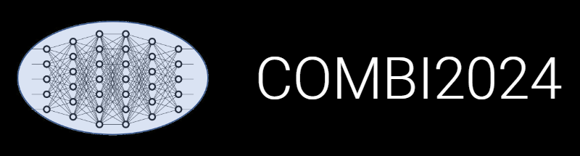

INF and Research Data Management with hands-on session
Victor Dudarev, Markus Stricker, Alfred Ludwig

Slide 2
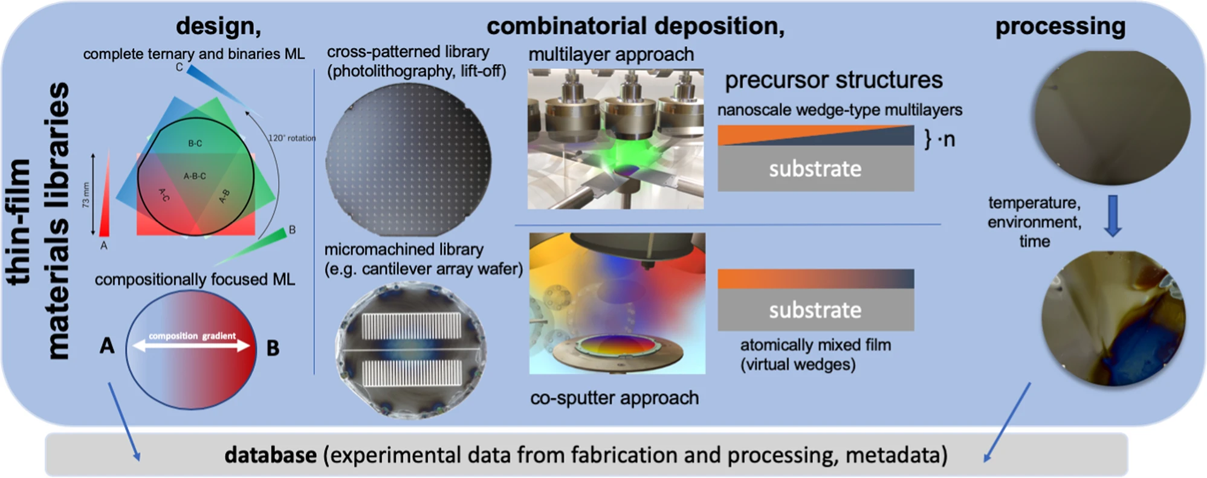
Materials Discovery and Interfaces (MDI) Research
Goal: provide Research Data Management Support for Combinatorial Materials Science and High-Throughput Methods
RDMS – Research Data Management System

Slide 3
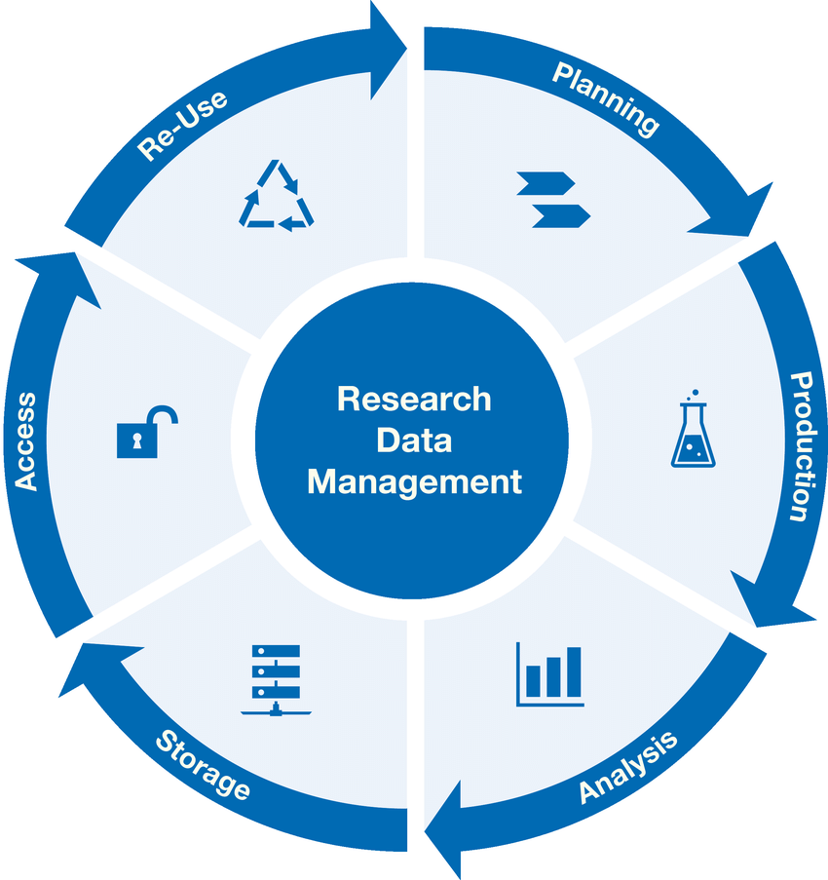
Research Workflow
and RDMS Object Types Interconnection
Research workflow support in RDMS
Defines characterizations
Provides report on samples & measurements
Idea or Plan
Calculation / Compu-tational Composition
Sample
Treatment:
annealing,
oxidation,
polishing, …
Sample_2
Report
Request for Synthesis
Characterisation:
EDX, XRD, Resistance, Bandgap, …
Characterisation:
EDX, XRD, Resistance, Bandgap, …
EDX – Energy-Dispersive X-ray spectroscopy (to determine composition) XRD – X-Ray Diffraction (to determine crystallographic structure)
RDM Image source: Yazdi, M., Politze, M. and Müller, M. (2024) ‘A Novel Approach to Outlining Research Data Management Life Cycle: A Case Study’, Research gate, accessed 15.05.2024

Slide 4
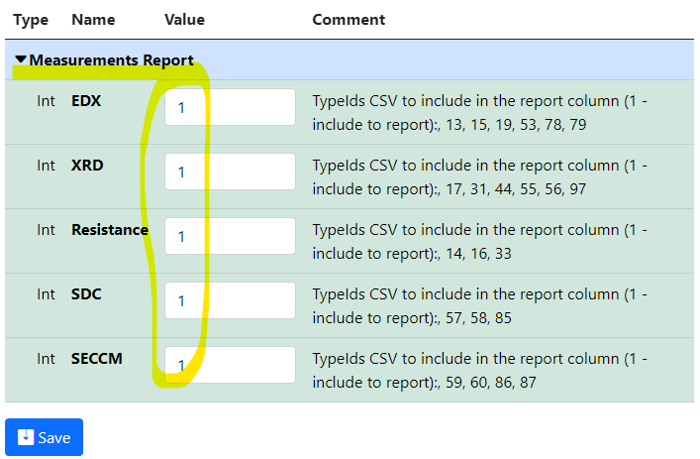
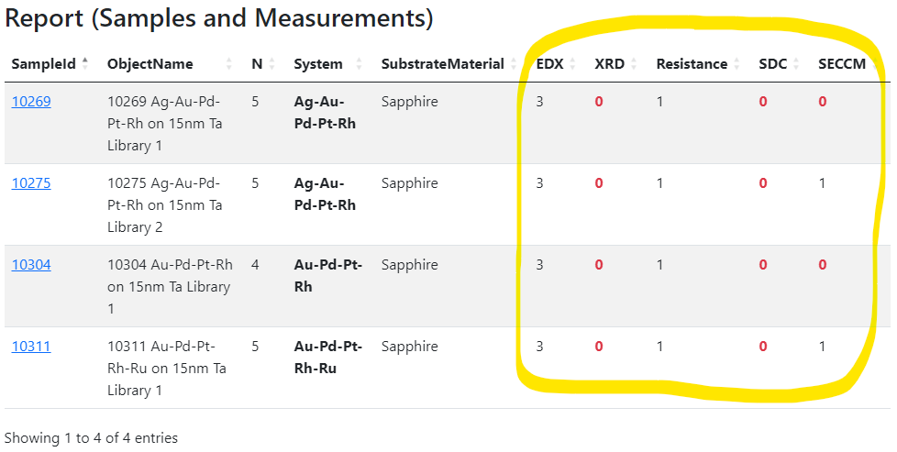
Experiment plan: setting up the measurement workflow
Motivation: set up the workflow by defining characterisation for the experiment (idea or plan).
Idea or Plan
1) Create “plan” object
2) Define characterisations
3) Add samples and
measurements…
4) Monitor workflows via reports in the “plan” object
https://mdi.matinf.pro/properties/edititem/103066
https://mdi.matinf.pro/object/standard-screening-crc-aka-tobias-report-103066

Slide 5
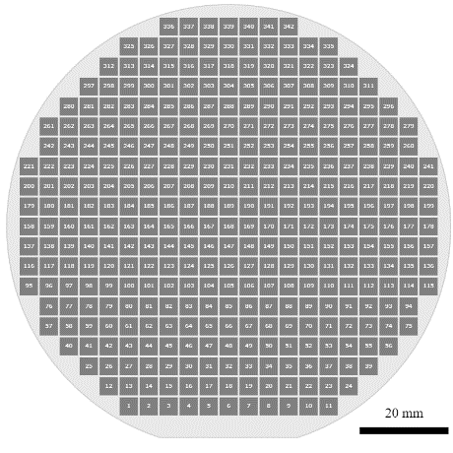
Materials Library: integrating heterogeneous measurement data
Typical Materials Library Data Lifecycle:
Measurement Area
(composition)
Sputtering:
Add Sample object (chemical system + substrate)
Phases: [ Phase₁,
…, Phase_{N} ]
Resistance: __ Ohm
Thickness: __ nm
Bandgap: __ eV
…
Add Synthesis object (sputtering parameters)
Characterisation:
Add processed EDX (342 Composition objects)
  Composition == Measurement Area
Add Other Characterisation Documents (XRD, Resistance, Thickness, Bandgap, etc…)
Storage, Curation, Search (on properties retrieved from devices / file formats), Reporting:
Find compositions with given properties in a certain range (across all known materials libraries)
Find by synthesis parameters
Find by chemical system / properties / creation date / author / text, etc…
Reports
ML – Materials Library MA – Measurement Area (a certain part of Materials Library (ML) surface)
EDX – Energy-dispersive X-ray spectroscopy XRD – X-ray diffraction analysis

Slide 6
RDMS in Chemistry-related Domains: Requirements
Priorities: Scalability + Security + Flexibility + Extensibility
Requirements (functional capabilities):
Scalability
Tenants;
User Registration / Authorization;
Users and Groups Control;
Roles;
Claims;
Data Access Policy;
Security
Upload and Store Objects;
Tree Classification;
Chemical Entities Support;
Objects Graph;
Extended Properties / Templates for Objects / Tables;
Excel Import and Export;
Search;
Flexibility
User-Defined Object Types;
Reports / Charts / Diagrams;
Reporting API;
CRUD API.
Extensibility
RDMS - Research Data Management System

Slide 7
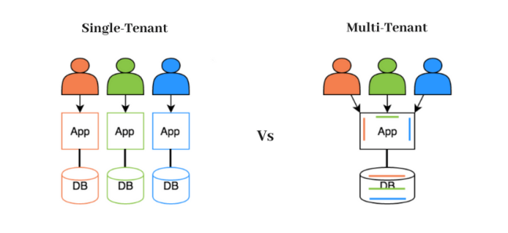
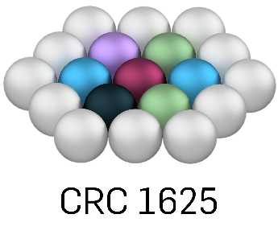




RDMS: Multiple Tenant Support
What is a Tenant?
Tenant – separate (distinct) instance of an application
(including data & configuration)
that is used by an organization / group of users / consortia.
Every tenant must have a unique URL!
Tenants in use:
          CRC 247: https://crc247.mdi.ruhr-uni-bochum.de
          CRC 1625: https://crc1625.mdi.ruhr-uni-bochum.de
          ERC DEMI: https://demi.matinf.pro
          DIMENSION: https://dim.mdi.ruhr-uni-bochum.de
          MDI: https://mdi.matinf.pro
          MDI Publications: https://pub.matinf.pro
          Bandgap Demo: https://demo.mdi.ruhr-uni-bochum.de
          Test Playground: https://inf.mdi.ruhr-uni-bochum.de
https://en.wikipedia.org/wiki/Multitenancy

Slide 8

RDMS: Object Access Level and Security
Four Access Levels (default access level depends on tenant settings):
Public (for anonymous users, search engines):
    objects are available to everybody regardless of authorization (visible to internet search engines);
Protected (visible to the community only):
- objects are visible to the community (available to authorized users with at least User role assigned);
ProtectedNDA (restricted visiblility):
- objects are visible to the authorized users with NDA claim set OR to Administrators;
Private (person’s secret, but visible for Administrators):
- objects are visible to the user-creator (at least PowerUser role assigned);
- objects are visible to all users of Administrator role.
User Roles:
User: read-only access to public and protected data
PowerUser: read access + add/modify data (+ write access to data, created by the current user)
Administrator: full access to all data (CRUD) + user management
Claims management
Claim is a piece of information (key-value pair) that describes a user. Claims are stored in a user's identity and are used to determine what actions a user is authorized to perform, such as accessing certain pages/resources/functionality.
Protected is set by default in MDI / CRC 247/ CRC 1625 / ERC DEMI / DIMENSION tenants
NDA - Non-Disclosure Agreement

Slide 9
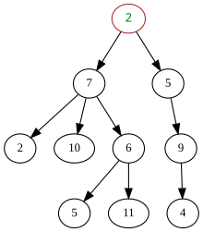
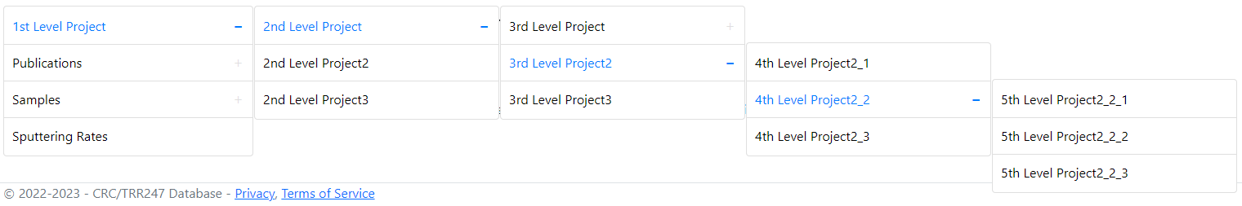
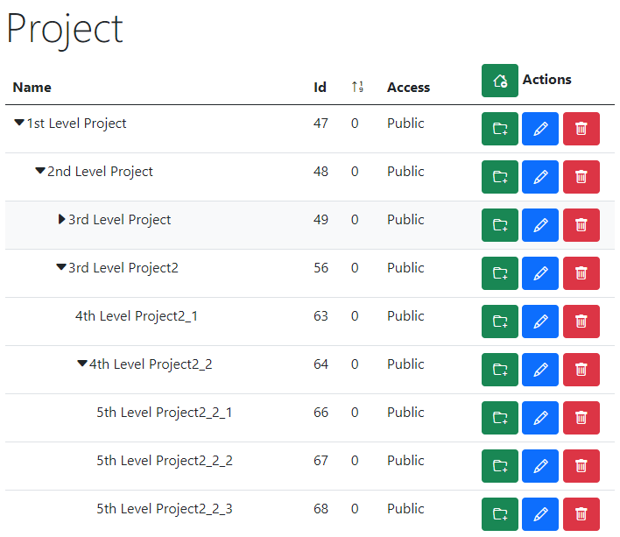
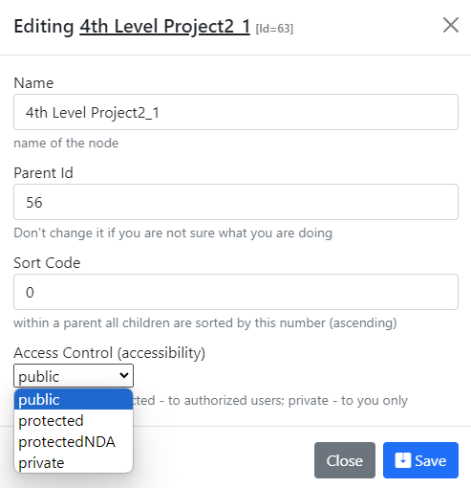
RDMS Project Tree: control and display
tree
Project Control:
Name
Parent Id
Sort Code
Access Control
Text description
https://demo.mdi.ruhr-uni-bochum.de/

Slide 10
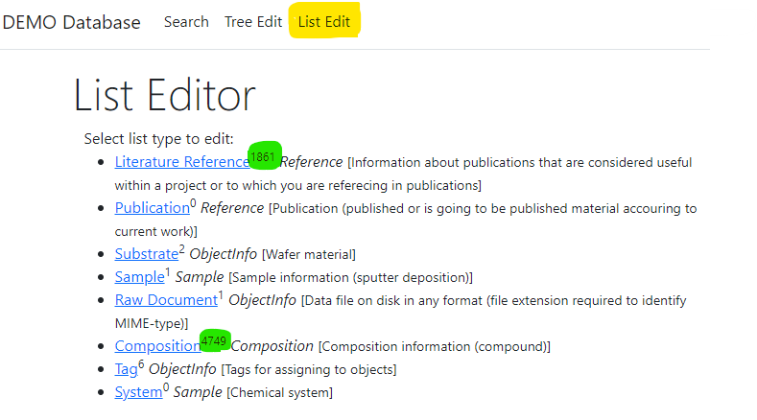
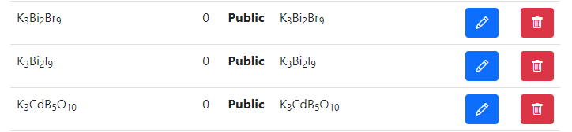
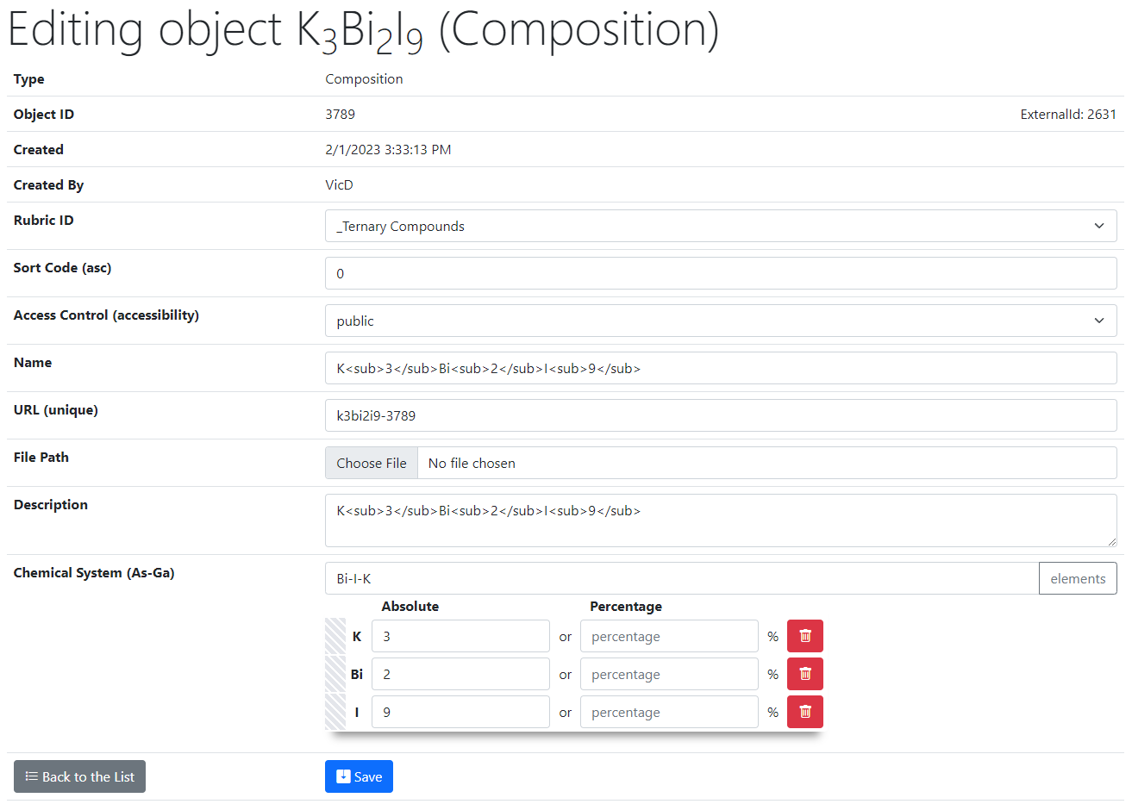
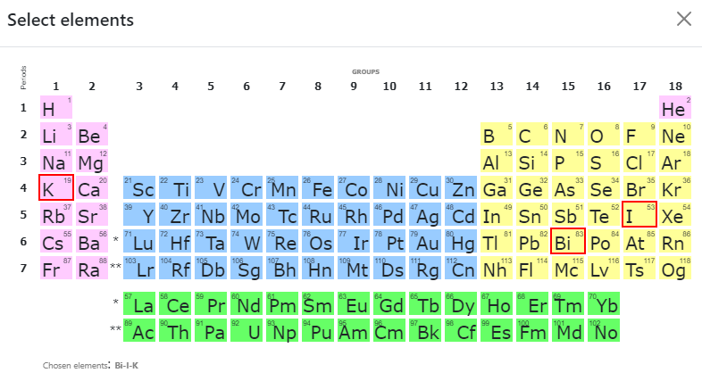
RDMS List Types: control
List of all objects (of type Composition):
Control (common to all objects):
Rubric Id;
Sort Code;
Access;
Name;
URL (adjustable*);
Attach File (document);
Description.
2
Type specific control (e.g. Composition):
Chemical System;
Composition (elements containment).
1
https://demo.mdi.ruhr-uni-bochum.de/
https://demo.mdi.ruhr-uni-bochum.de/adminobject/edititem/3789

Slide 11



User-Defined Type Support
Motivation: to support new user-defined object type (UDT) without modifying core RDMS source code
Given: New object type with/without a new arbitrary file format (could new measurement type result).
Solution (five keys to success):
Templates – define object model (data structure) in terms of key-value pairs / table (properties)
Search – enable search for UDT objects based on defined data model
Validation – provide check for data correctness (valid/invalid)
Data Extraction – if valid, extract data in terms of properties / related objects creation
Visualisation – display data, including drawing charts / diagrams, etc…
UDT Support API Documentation: available at page’s footer in every tenant
UDT – user-defined type

Slide 12
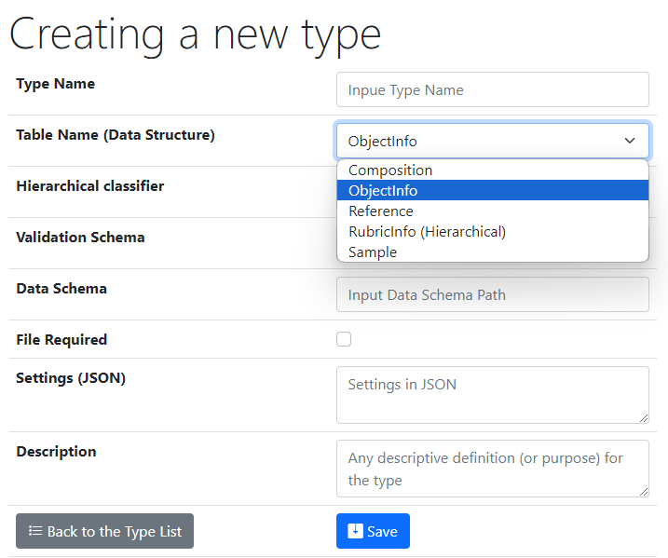
Type Definition: UI to create a new user-defined type
One of predefined base types
Type Name – user-defined type name
Core Object Types:
ObjectInfo – the simplest (bare) object
Sample – chemical system (set of chemical elements), for example Co-O
Composition – chemical composition (set of elements and quantities), for example Co₃O₄
Reference – literature reference (Authors, Title, Year, DOI, etc.)
Validation & Data Schema – only if you have external Web Services ready to validate & extract data from files
File Required – sets the file mandatory (boolean)
Settings (JSON) – type customization in RDMS
{ "CustomEditPath": "/custom/editsample",
"UrlPostVisualizer": "https://abc.de/VisualizeRT" }
Description – comments for type designation
Defining data & behavior
We can further enrich defined object specification by customized (templates!) properties of primitive types: Integer, Float, String.

Slide 13
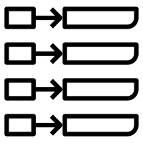
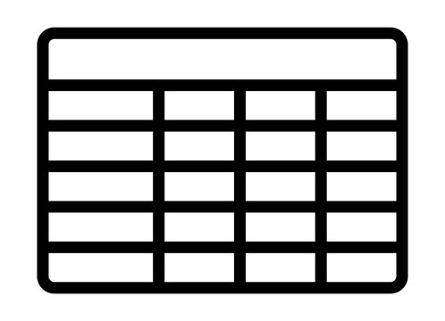
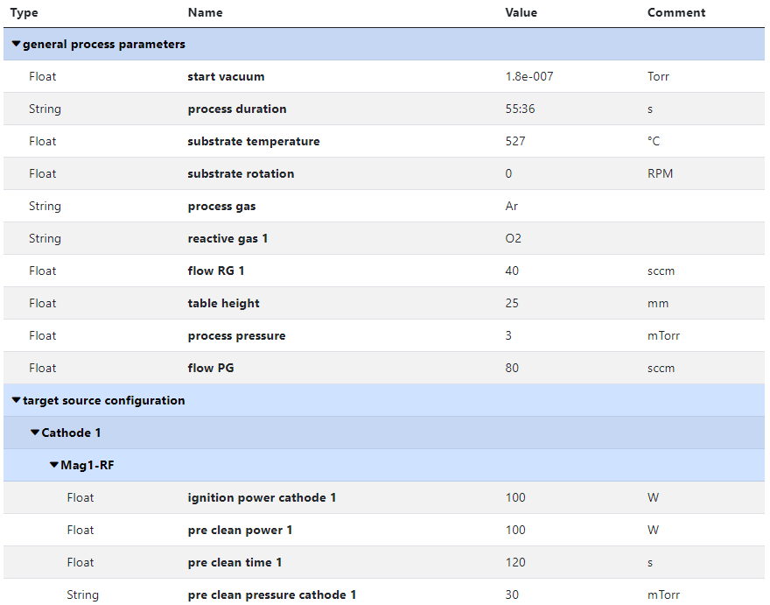
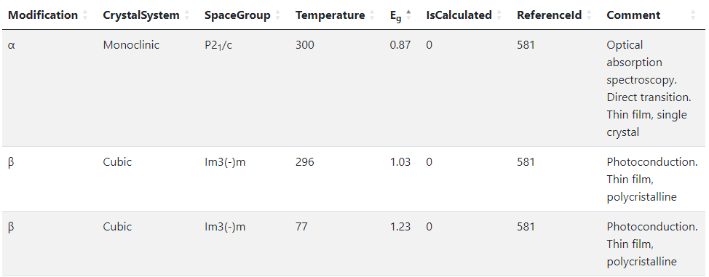
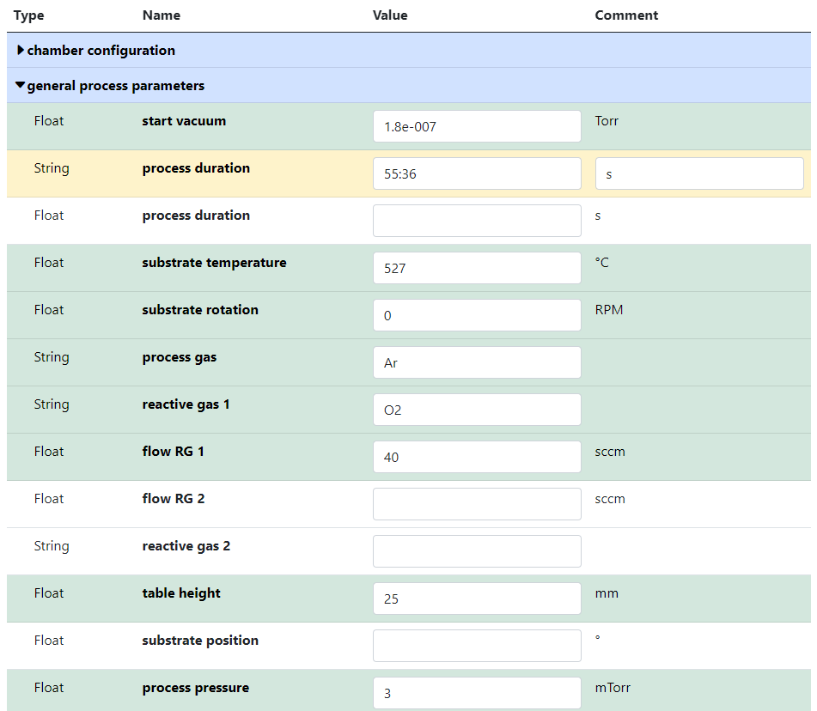

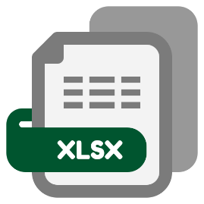
RDMS no-code customisation: Templates for object type
Template
key-value pairs
table
List
(specify sorted properties list with separators)
Table
(specify table structure: columns & types)
Data in a table with predefined structure
Key-value pairs
https://crc247.mdi.ruhr-uni-bochum.de/object/synthesis-for-sample-8220-co-deposition-221111-k3-3-1922
https://demo.mdi.ruhr-uni-bochum.de/object/ag2s-4870

Slide 14
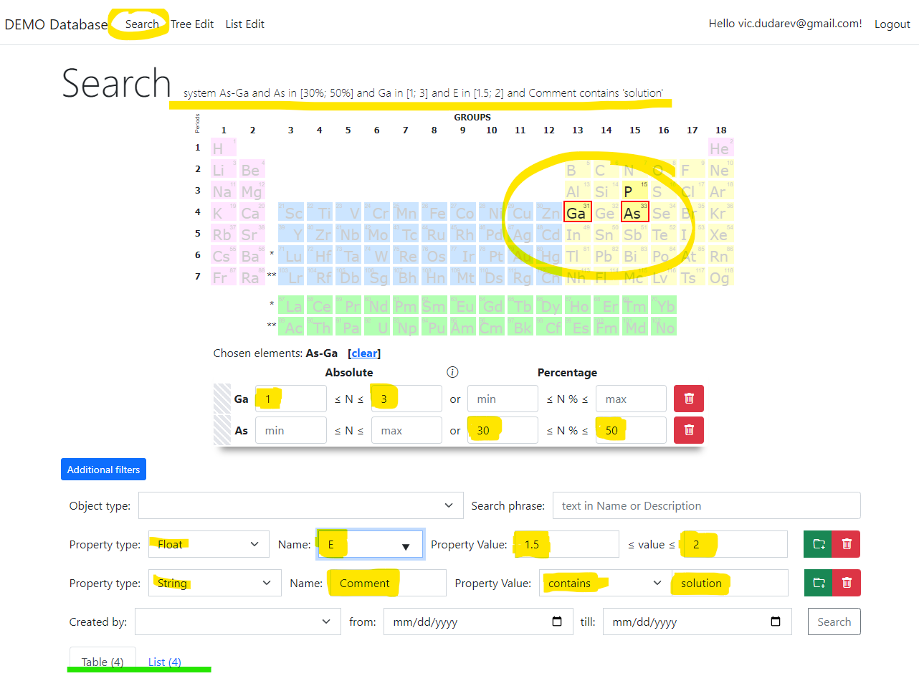
RDMS: Search
Search on:
Chemical system
Composition
Object type
Phrase in object’s Name or Description
Properties values
Person (author)
Creation date
Important feature:
persistent URL on search (share search results easily by URL*).
* - respecting current security context
https://demo.mdi.ruhr-uni-bochum.de/search/?system=As-Ga&typeid=8&Aspctmin=30&Aspctmax=50&Gaabsmin=1&Gaabsmax=3&
pr0name=E%3Csub%3Eg%3C%2Fsub%3E&pr0type=Float&pr0min=1.5&pr0max=2&prcnt=1

Slide 15
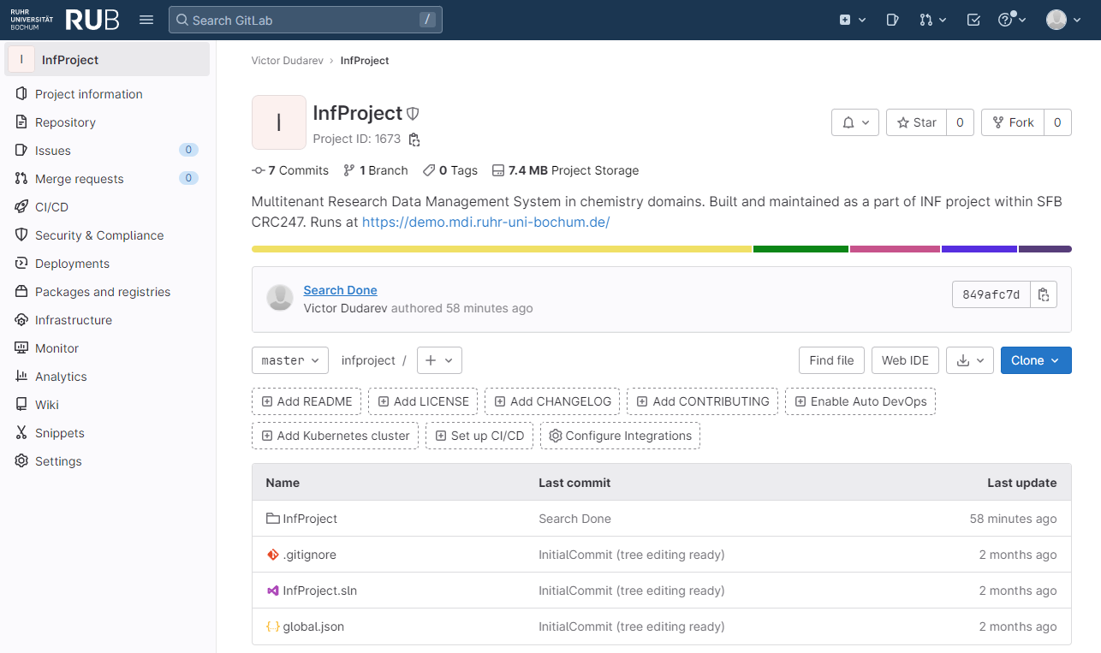

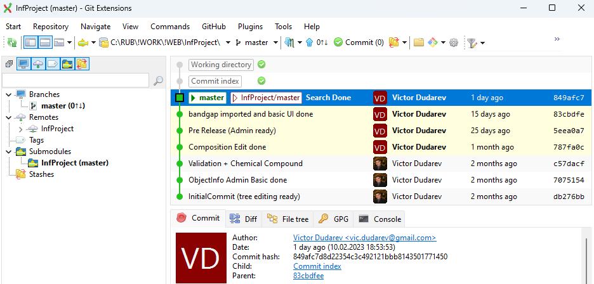



Source Control (GitLab)
Everybody’s welcome!
Feel free to contribute to open source!
Core INF project:
https://gitlab.ruhr-uni-bochum.de/vic/infproject
Shared projects:
1) Administration User Interface (Identity Manager UI):
https://gitlab.ruhr-uni-bochum.de/vic/identitymanagerui
2) Web Application General Library (WebUtilsLib):
https://gitlab.ruhr-uni-bochum.de/vic/webutilslib
https://gitlab.ruhr-uni-bochum.de

Slide 16

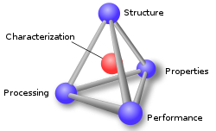

Summary
Support for multiple Tenants;
Custom Project Tree & Objects Management
Directed Object Graph;
User-defined Object Type support:
  Properties Templates
  Table Templates
  Document Validation
  Data Extraction
  Data Visualization
Search
Reporting
Rich Customizations (with HTML/JS/CSS injection & external Web Services)
Batch Import of Documents
API
System
(qualitative composition)
In-S
Substance
(quantitative composition)
In₂S₃
Modification
(crystal structure type)
β-In₂S₃
…
Priorities: Security, Scalability, Flexibility, Extensibility

Slide 17
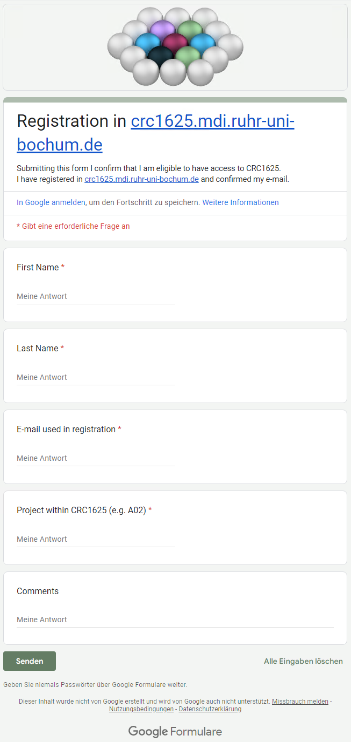
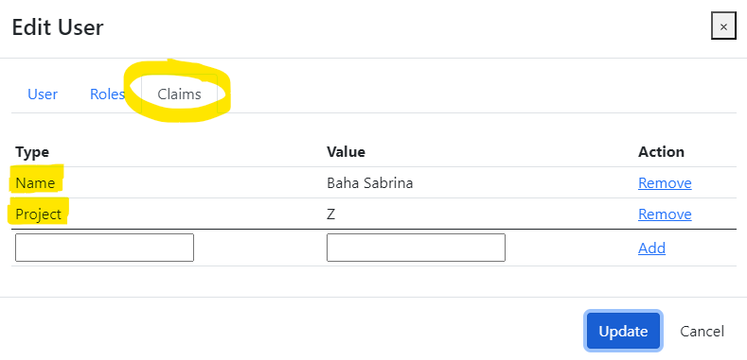
RDMS: how to register
No users from projects (as of 08.10.2024):
A04,
B02,
B05,
RTG.
Production (https://crc1625.mdi.ruhr-uni-bochum.de):
You need to register with Google account or create your own account (email/password) and confirm e-mail (warning: user created with no role assigned).
Fill the access request form https://forms.gle/F1kcKUoaFccBWHoBA, specifying your e-mail, used in registration, your name, project (e.g. A02) and optional comments.
Wait… After manual processing you will be assigned by default a PowerUser role and you are in power of adding data ))
Important for Administrators!
Please, assign the following claims:
Name
Project
Notes:
https://qr.io/

Slide 18
Announcement: Second Hands-on Session
When:
Today at 15:00
What:
  Practical use of RDMS (How do I…)
  Questions and Answers Session
  Discussions on Data Management (features, workflows, reports, API, etc…)

Slide 19
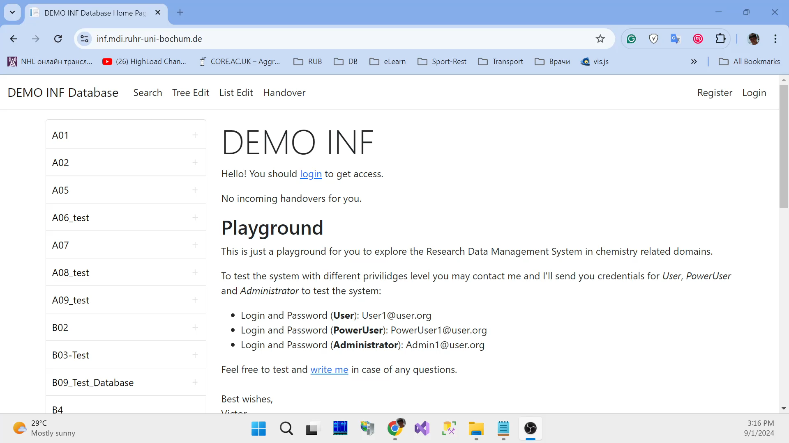
Live Demo / Video

Slide 20
Thanks for your kind attention
Questions & Answers
Victor Dudarev
Victor.Dudarev@rub.de
https://vdudarev.ru

Slide 21
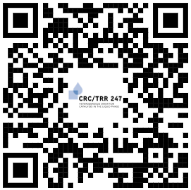
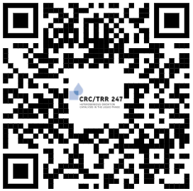
RDMS Free Playground
  https://demo.mdi.ruhr-uni-bochum.de/ https://inf.mdi.ruhr-uni-bochum.de/
Playground to test RDMS (multiple tenants with shared users list):
https://demo.mdi.ruhr-uni-bochum.de/
https://inf.mdi.ruhr-uni-bochum.de/
Login and Password (User role): User1@user.org
Login and Password (PowerUser role): PowerUser1@user.org
Login and Password (Administrator role): Admin1@user.org
https://demo.mdi.ruhr-uni-bochum.de/
https://inf.mdi.ruhr-uni-bochum.de/
Notes:
https://qr.io/

Slide 22

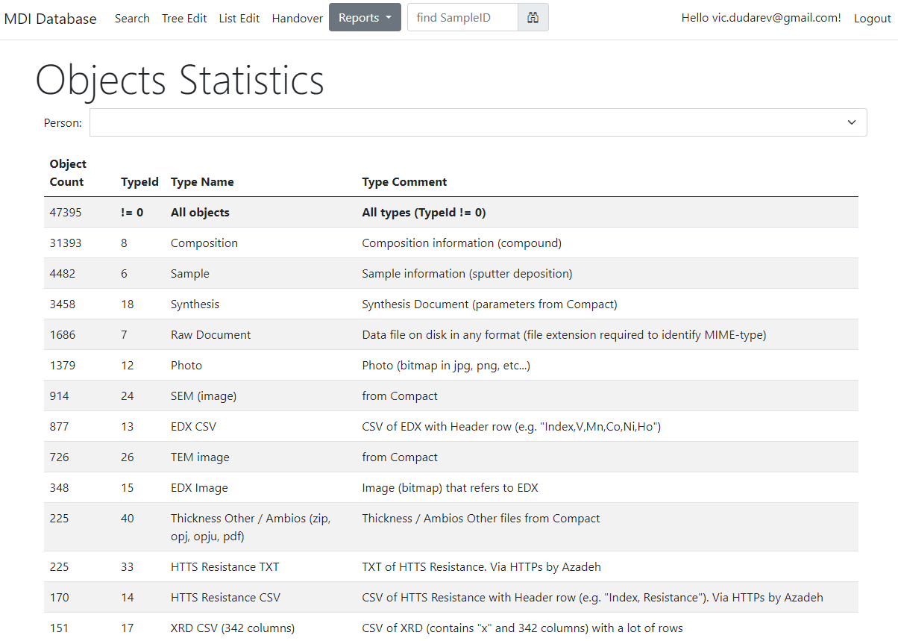
Reports & Statistics: Objects
Objects Statistics:
Objects (w.r.t. types)
Projects
Object Links
Feature:
Filter by person
https://mdi.matinf.pro/report/objectsstatistics

Slide 23
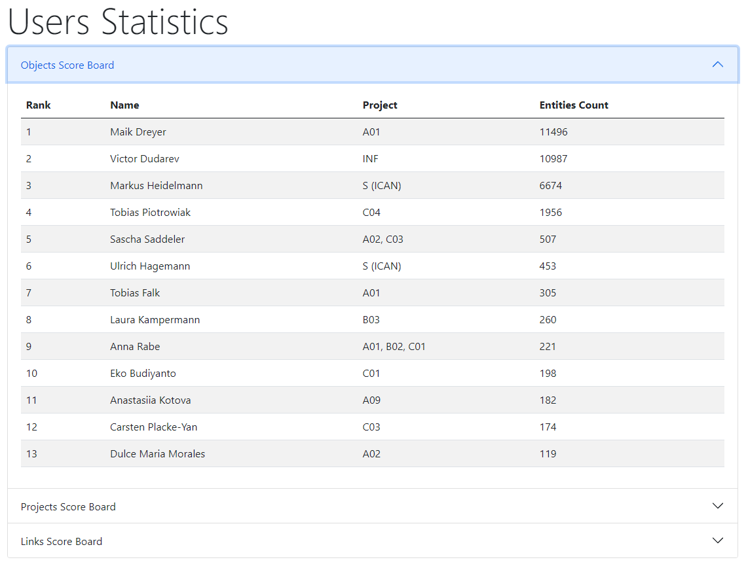

Reports & Statistics: Users
Users Statistics:
Objects
Projects
Links
“Data Creator” awards:
The most productive data creator award project/person
The people’s choice award: project subtree clarity
The citation / popularity award
https://mdi.matinf.pro/report/usersstatistics
https://crc247.mdi.ruhr-uni-bochum.de/report/usersstatistics

Slide 24
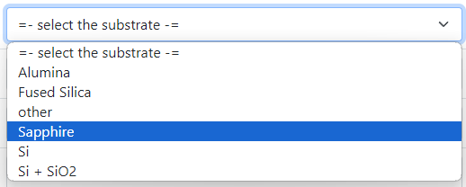

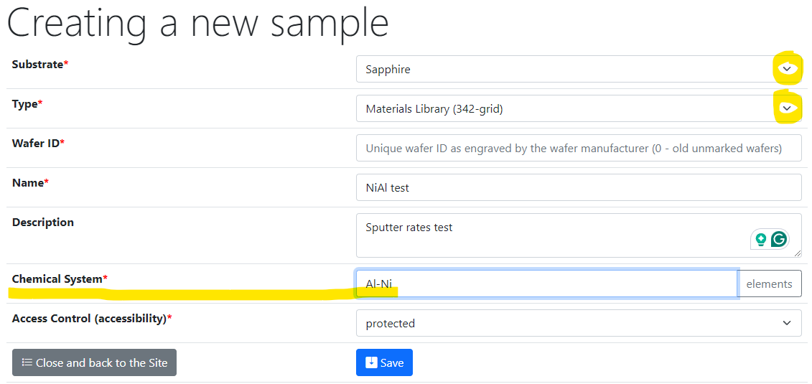
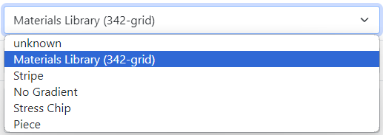
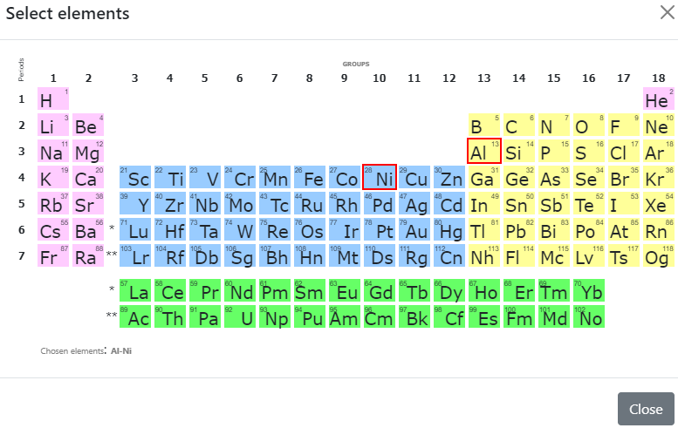
Sample Customised Form
List from Service / Substrates subproject
- Customised sample input
List from JS-template
Standard chemical system
Customisation with UI form / JS
Create a new sample form: https://mdi.matinf.pro/custom/editsample/0/?idr=1872&returl=%2Frubric%2Fservice
Substrates list: https://mdi.matinf.pro/rubric/service_substrates

Slide 25
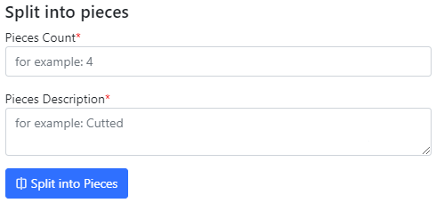
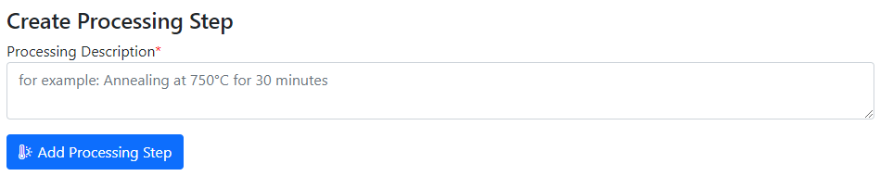
Use Case: Sample Transformation Workflow
Create Processing State & Split Sample
Sample_2a_2
(subsample 2a state 2)
polishing
Documents2a_2
Sample_2a
(subsample 2a)
Sample
(initial state)
annealing
Sample_2
(changed state 2)
splitting
Sample_2b_2
(subsample 2b state 2)
oxidation
Sample_2b
(subsample 2b)
documents
documents2
Documents2b_2

Slide 26
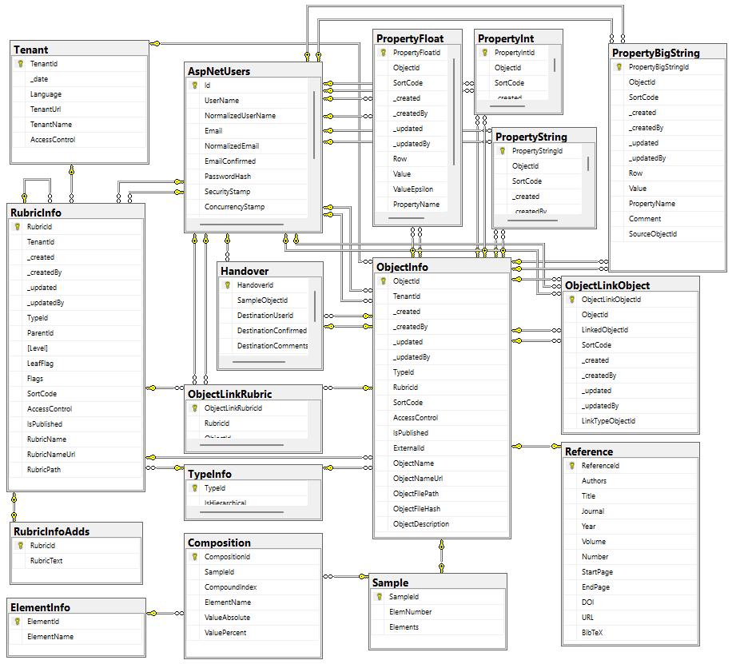
Data acquisition API
Two architectural implementation opportunities:
Provide a set of methods to deal with each table
Develop read-only views and let user introduce queries over them
POST /vroapi/v1/execute
Executes SQL statement and returns dataset (in JSON)
GET /vroapi/v1/download
Downloads document by specified identifier (ObjectId)
Database schema documentation:
https://mdi.matinf.pro/home/doc
https://mdi.matinf.pro/home/doc

Slide 27
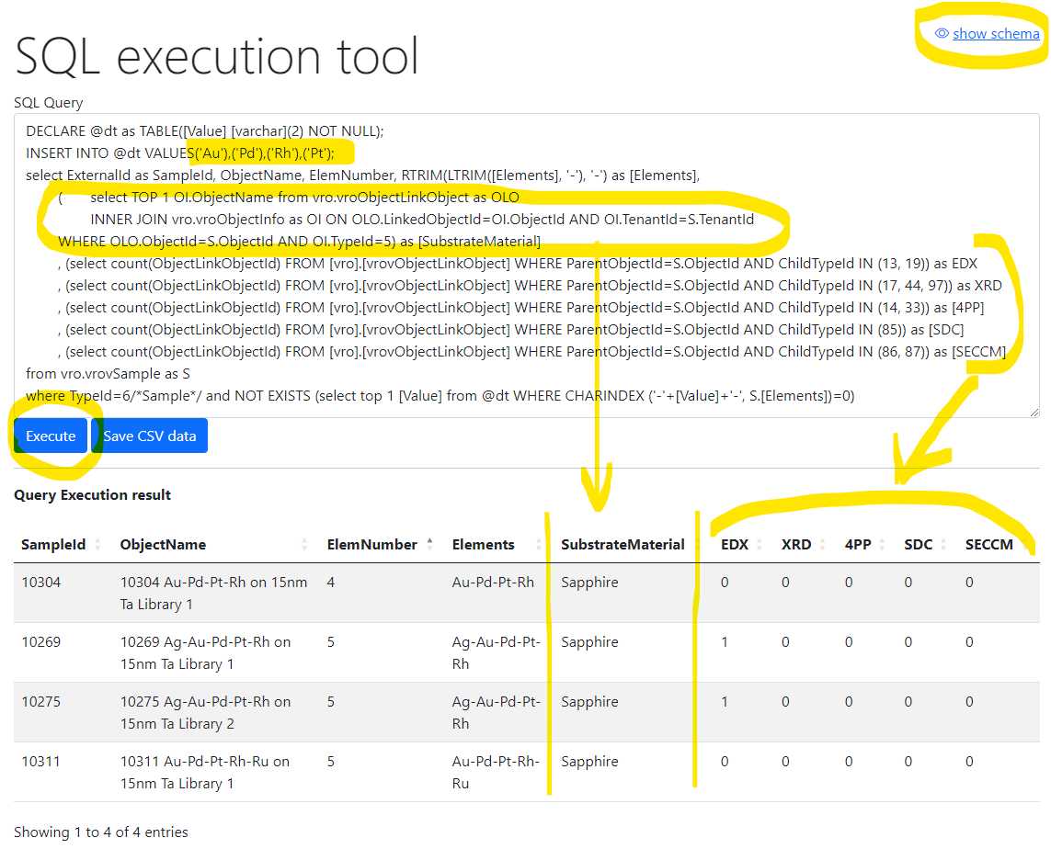
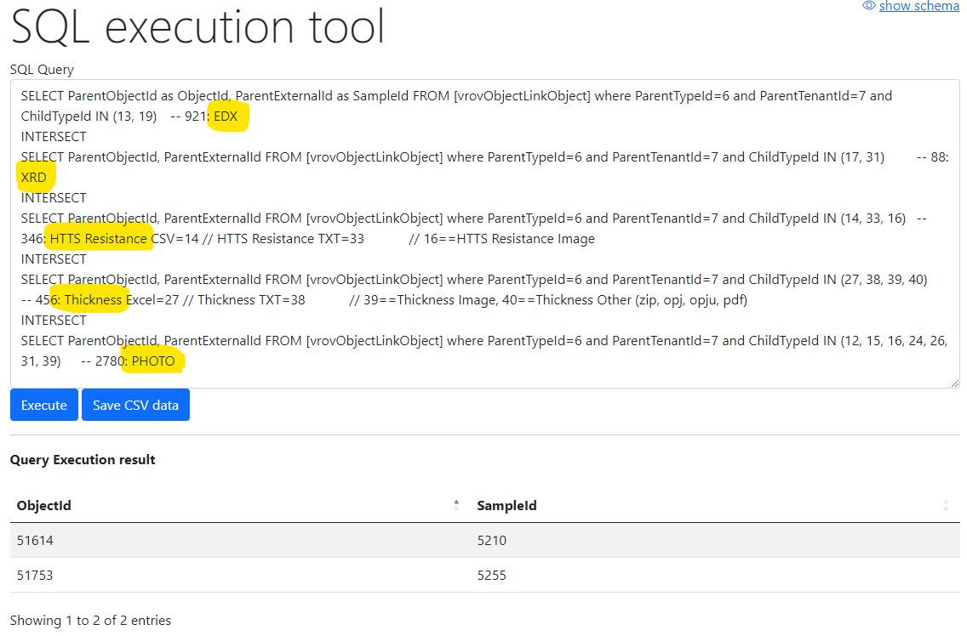
Flexible data queries for advances users
Database schema documentation:
https://mdi.matinf.pro/home/doc
Show samples having Au-Pd-Rh-Pt and how many characterization documents for them we have (EDX, XRD, 4PP, SDC, SECCM)
Show samples (identifiers) that have all enlisted characterisations: EDX, XRD, Resistance, Thickness, Photo
https://mdi.matinf.pro/vroui
EDX - Energy-Dispersive X-ray spectroscopy; XRD - X-ray diffraction; 4PP – 4 Points Measurement (Resistance);
SDC - Scanning Droplet Cell; SECCM - Scanning ElectroChemical Cell Microscopy

Slide 28
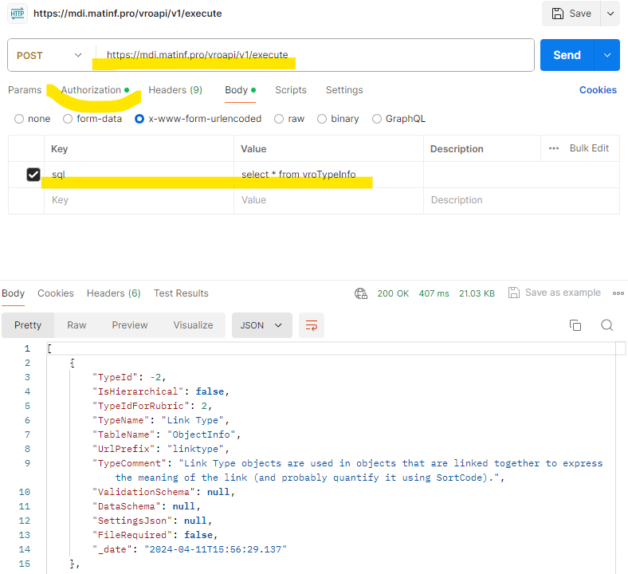
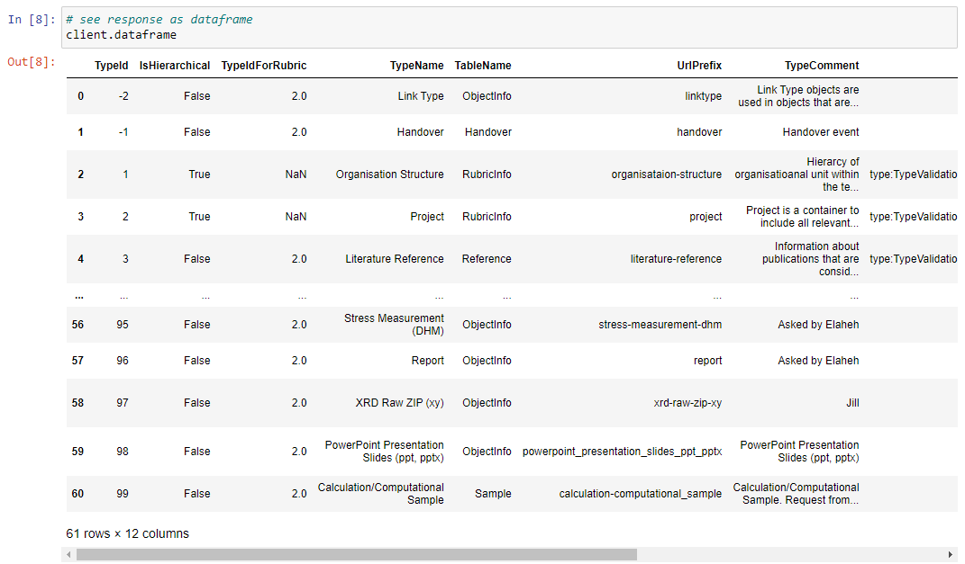
API for running arbitrary read-only queries
POST /vroapi/v1/execute
Executes SQL statement and returns dataset (in JSON)
Python wrapper to use API:
# 1. Specify tenant URL (since numerous tenants exist)
service_url = "https://mdi.matinf.pro" # tenant URL
# 2. Specify API Key ("VroApi" user claim)
api_key = "<api-key>" # your api_key here
# 3. Create a client object
client = MatInfWebApiClient(service_url, api_key)
# 4. Execute SQL and get result
result = client.execute("select * from vroTypeInfo")
# result – contains JSON
# client.dataframe – contains pandas dataframe
https://www.postman.com/downloads/

Slide 29
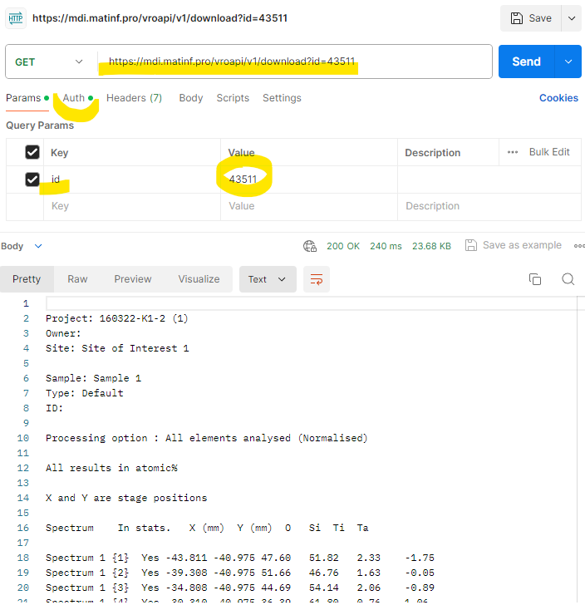

API for downloading documents
GET /vroapi/v1/download
Downloads document by specified identifier (ObjectId)
Python wrapper to use API:
# 1. Specify tenant URL (since numerous tenants exist)
service_url = "https://mdi.matinf.pro" # tenant URL
# 2. Specify API Key ("VroApi" user claim)
api_key = "<api-key>" # your api_key here
# 3. Create a client object
client = MatInfWebApiClient(service_url, api_key)
# 4. Download object file by ObjectId
result = client.download(43511)# ObjectId
# result – contains HTTP response
# result.content – contains file data
# client.file_name – contains file name
https://www.postman.com/downloads/

Slide 30
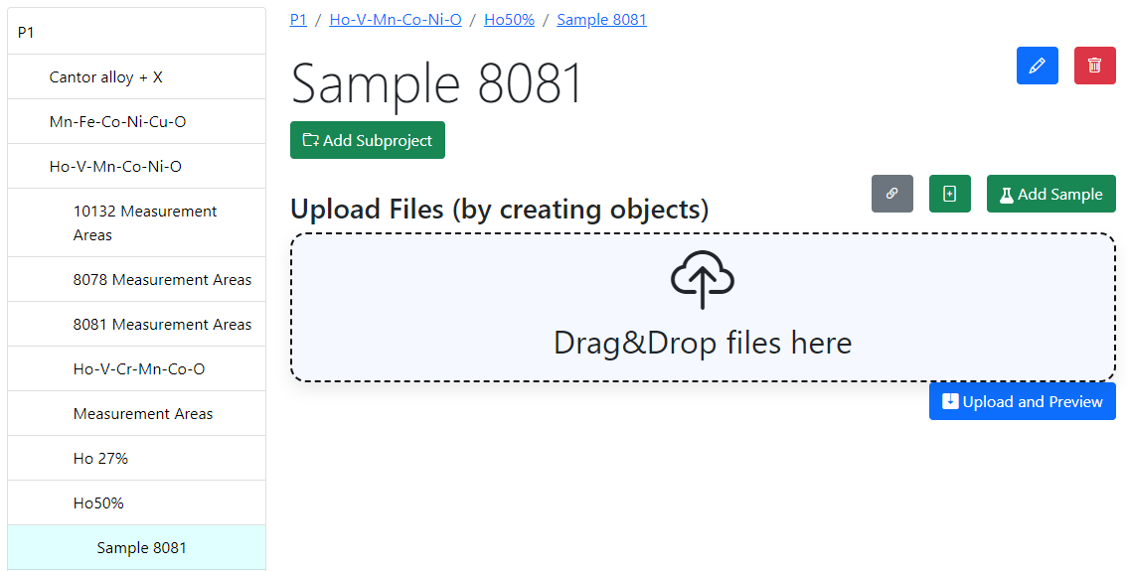
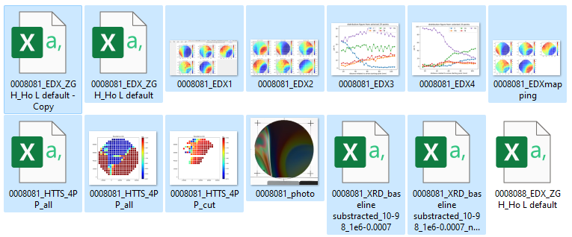
RDMS DropZone Tasks: Batch Data Validation & Import
Task: validate documents & import data
Implemented Features:
Automatic type detection;
Uniqueness check;
Data validation (build-in + external);
Data import.
https://dim.mdi.ruhr-uni-bochum.de/rubric/p1project_ho-v-mn-co-ni-o_ho50_sample-id-0008081

Slide 31
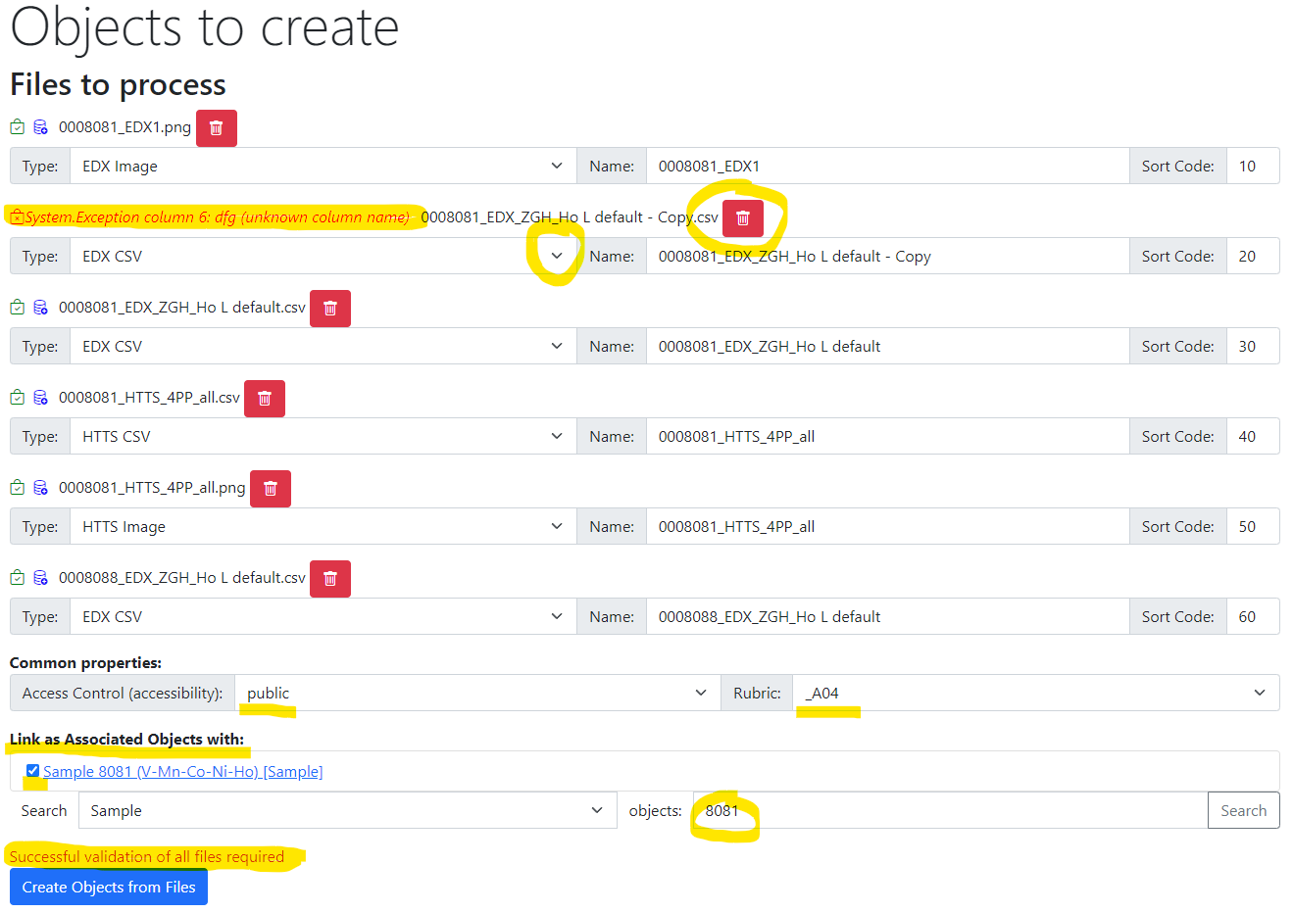
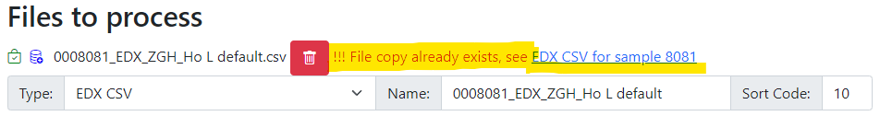


RDMS DropZone: Staged Files (before import)
Check for unique documents (based on SHA256 hash):
Check data to import:
Properties
(after import):
Workflow:
- validate every file;
- check/adjust all properties;
- Import files.

Slide 32


RDMS: Created Objects
After import:
- check all created objects (names, access level, etc…);
- share a link.

Slide 33



Tracking Samples or Handover event: initialisation
1) In “physically transferrable” objects (samples), find a green handover button
2) Fill in the form and press a blue button.
Select recipient
Specify Amount (optional)
Specify Comments
Click to initialise
Handover is available in any sample view form.

Slide 34



Tracking Samples or Handover event: delivering / delivered
1) Handover event is created & recipient is notified by e-mail
3) Recipient should add comments and confirm the handover.
2) Recipient can view pending handovers
4) The handover is confirmed
+ e-mail notification for sender
Creation by sender -> Recipient notification -> Recipient confirmation -> Sender notification.

Slide 35

Tracking Samples or Handover event: user overview
Current samples
Incoming
Outcoming
User-dependent handover overview (example in CRC247 tenant):
https://crc247.mdi.ruhr-uni-bochum.de/handover

Slide 36

Tracking Samples or Handover event: project overview
Handover overview is displayed in project that matches by name with one of Project claims for users.
Contains overview for a group of users having the same Project claim.
Successful handover
Pending handover (unconfirmed)
Project (a group of users working on the same project according to Project claim) overview for handovers (in CRC247):
https://crc247.mdi.ruhr-uni-bochum.de/rubric/area-c_c03

Slide 37



Object Links for Projects: object modification form
Motivation: Object is displayed in a project to which it belongs. Sometimes it’s required to associate object with multiple projects.
Object modification interface update
Select projects that should additionally display the object:
Press “Save” button
Any edit object form

Slide 38




Use-Case: add object links to a project
Motivation: allow everybody (PowerUser+) to add object links to a project.
1) In a project click gray “Add Link” button 2) Popup window: add links for object(s)
4) Popup: adjust link order or delete it
3) Linked object layout in the project (with link button):
Links functionality in any project view (available to all PowerUser+)

Slide 39



RDMS: Advanced Interlink Objects
a
a
c
Example: establishing graph above objects
b
directed graph
To add associated objects:
0) Go to “List edit” or select object to edit
1) Select associated object type (optional filter)
2) Input search phrase, contained in the Name of the desired object to be associated
3) Select (if required) link/association type object.
4) Drag & Drop desired object(s) from search result list to the area / adjust list
5) Save changes
Important: Reverse associations allow to browse reverse- directional associations.
User view: https://demo.mdi.ruhr-uni-bochum.de/object/ag2s-4870
Admin view: https://demo.mdi.ruhr-uni-bochum.de/adminobject/edititem/4870

