Slide 1
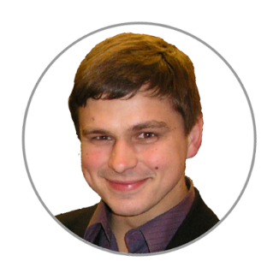
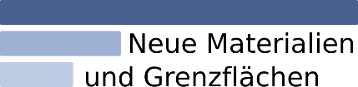

Research Data Management System:
API, Workflows, Graphs & More
Victor Dudarev

Slide 2
Agenda
    Data acquisition API
    Typical workflow:
      Idea or experiment plan (+characterisation types)
      Request for synthesis
      Samples / characterisation w.r.t. air exposure time
      Report in “Idea or Experiment Plan”
    Graph: on importance of edges orientation
    FAIR-DI Conference (FAIRmat overview)

Slide 3
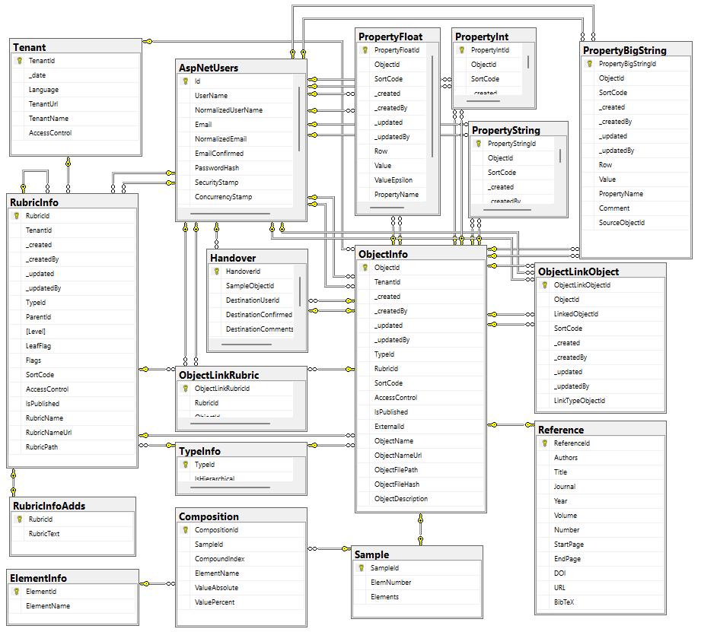

Data acquisition API
Two architectural implementation opportunities:
Provide a set of methods to deal with each table
Develop read-only views and let user introduce queries over them
POST /vroapi/v1/execute
Executes SQL statement and returns dataset (in JSON)
GET /vroapi/v1/download
Downloads document by specified identifier (ObjectId)
Database schema documentation:
https://mdi.matinf.pro/home/doc
https://mdi.matinf.pro/home/doc
https://docs.google.com/document/d/1TDtHwtjP4RSXJw6m7jBvtmlSZ4qUBqWD/edit?usp=sharing&ouid=117346421118620353373&rtpof=true&sd=true

Slide 4
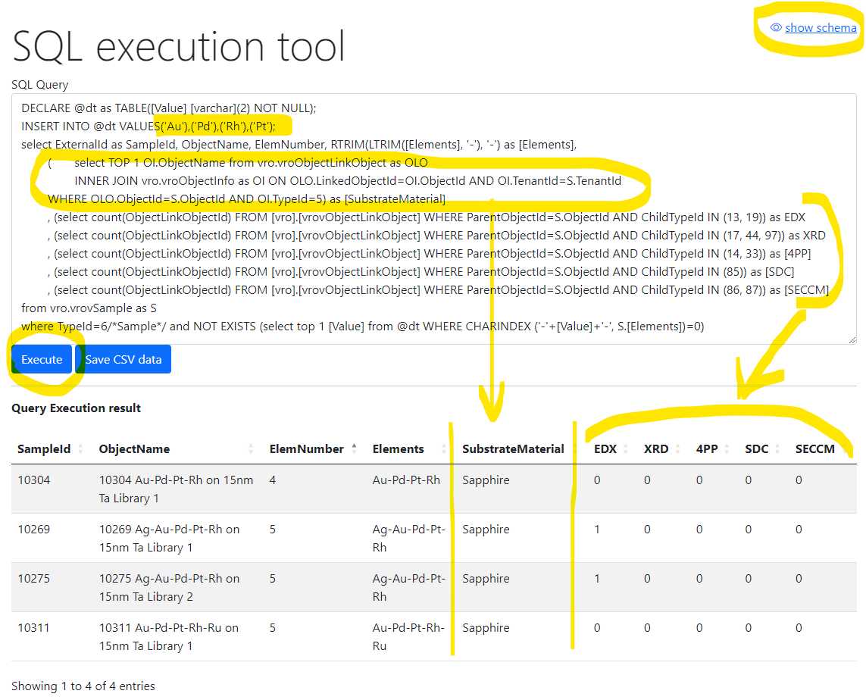
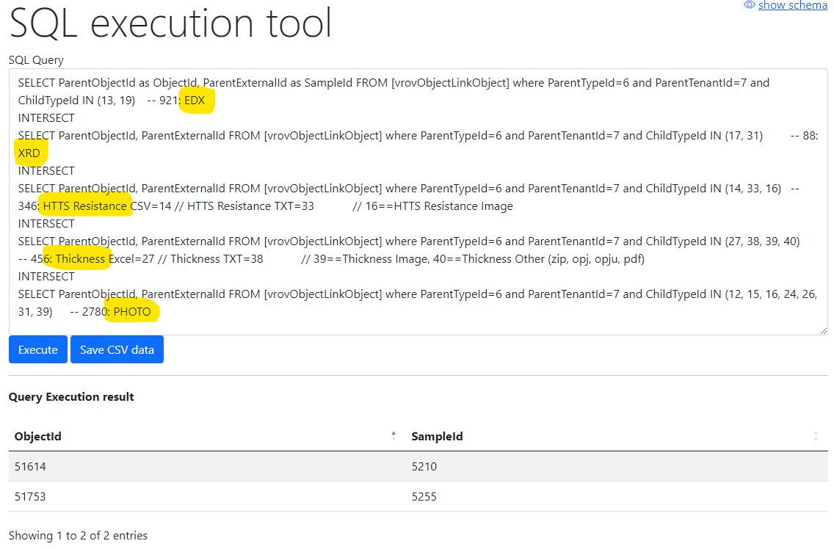
Flexible data queries for advances users
Database schema documentation:
https://mdi.matinf.pro/home/doc
Ex.1) Show samples having Au-Pd-Rh-Pt and how many characterisation documents for them we have (EDX, XRD, 4PP, SDC, SECCM)
Ex.2) Show samples (identifiers) that have all enlisted characterisations: EDX, XRD, Resistance, Thickness, Photo
https://mdi.matinf.pro/vroui
https://docs.google.com/document/d/1TDtHwtjP4RSXJw6m7jBvtmlSZ4qUBqWD/edit?usp=sharing&ouid=117346421118620353373&rtpof=true&sd=true
EDX - Energy-Dispersive X-ray spectroscopy; XRD - X-ray diffraction; 4PP – 4 Points Measurement (Resistance);
SDC - Scanning Droplet Cell; SECCM - Scanning ElectroChemical Cell Microscopy

Slide 5
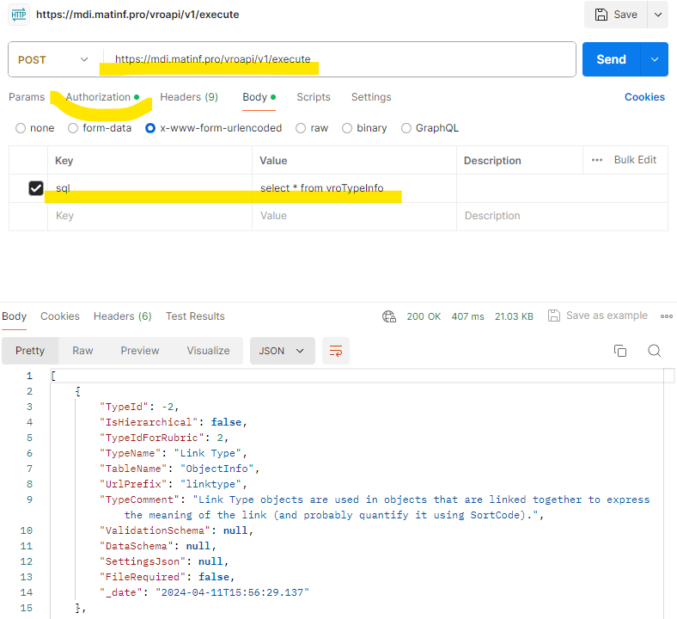
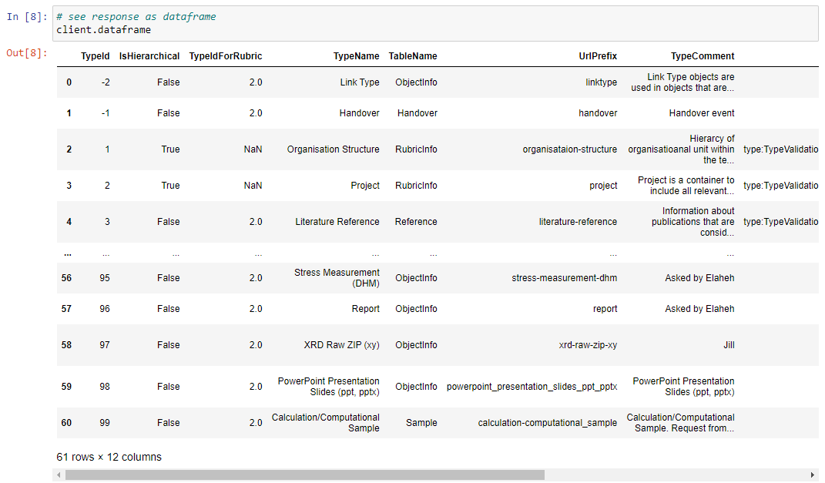
API for running arbitrary read-only queries
POST /vroapi/v1/execute
Executes SQL statement and returns dataset (in JSON)
Python wrapper to use API:
# 1. Specify tenant URL (since numerous tenants exist)
service_url = "https://mdi.matinf.pro" # tenant URL
# 2. Specify API Key ("VroApi" user claim)
api_key = "<api-key>" # your api_key here
# 3. Create a client object
client = MatInfWebApiClient(service_url, api_key)
# 4. Execute SQL and get result
result = client.execute("select * from vroTypeInfo")
# result – contains JSON
# client.dataframe – contains pandas.DataFrame
https://www.postman.com/downloads/

Slide 6
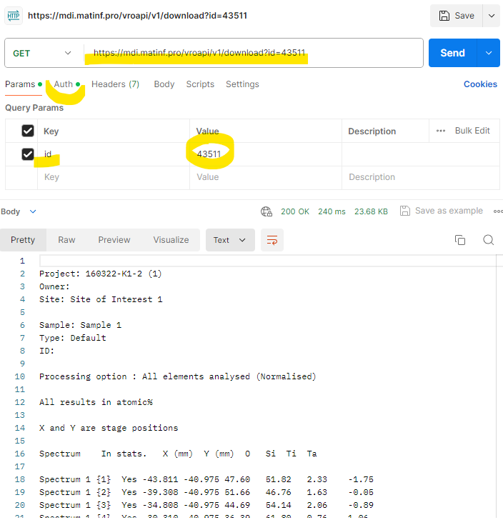

API for downloading documents
GET /vroapi/v1/download
Downloads document by specified identifier (ObjectId)
Python wrapper to use API:
# 1. Specify tenant URL (since numerous tenants exist)
service_url = "https://mdi.matinf.pro" # tenant URL
# 2. Specify API Key ("VroApi" user claim)
api_key = "<api-key>" # your api_key here
# 3. Create a client object
client = MatInfWebApiClient(service_url, api_key)
# 4. Download object file by ObjectId
result = client.download(43511)# ObjectId
# result – contains HTTP response
# result.content – contains file data
# client.file_name – contains the file name
https://www.postman.com/downloads/

Slide 7
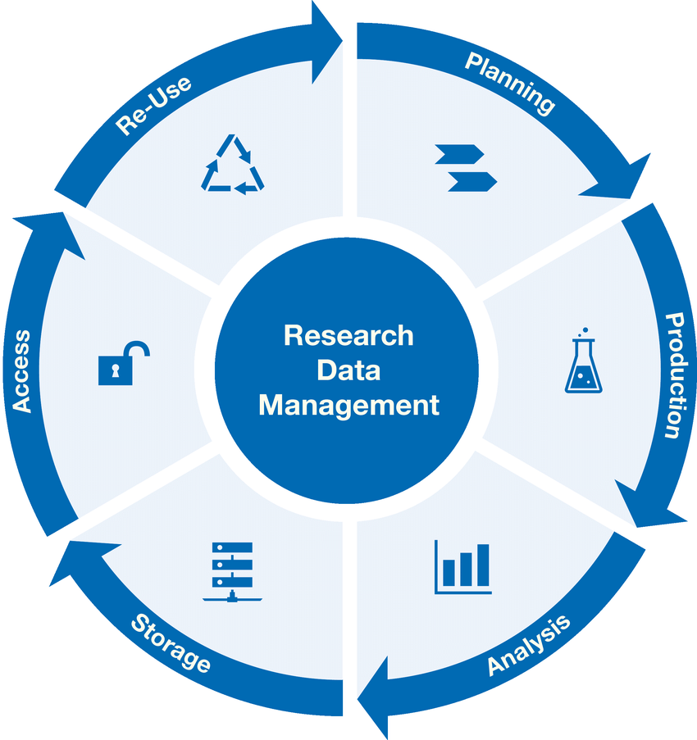
Research Workflow
and RDMS Object Types Interconnection
Research workflow support in RDMS
Defines characterizations
Provides report on samples & measurements
Idea or Plan
Calculation / Compu-tational Composition
Sample
Treatment:
annealing,
oxidation,
polishing, …
Sample_2
Report
Request for Synthesis
Characterisation:
EDX, XRD, Resistance, Bandgap, …
Characterisation:
EDX, XRD, Resistance, Bandgap, …
EDX – Energy-Dispersive X-ray spectroscopy (to determine composition) XRD – X-Ray Diffraction (to determine crystallographic structure)
RDM Image source: Yazdi, M., Politze, M. and Müller, M. (2024) ‘A Novel Approach to Outlining Research Data Management Life Cycle: A Case Study’, Research gate, accessed 15.05.2024

Slide 8
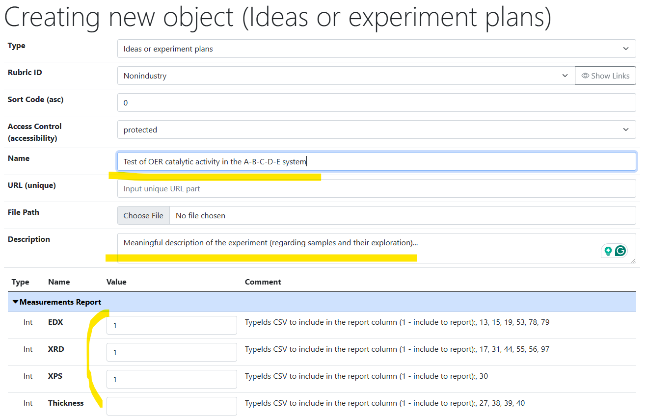
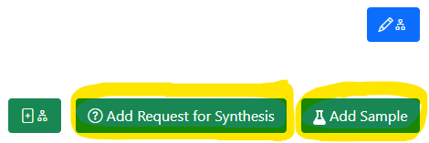
Idea or Experiment Plan
Motivation:
set up the workflow
by defining characterisation
for the experiment
(batch of samples)
Linked objects
https://mdi.matinf.pro/properties/edititem/103066
https://mdi.matinf.pro/object/standard-screening-crc-aka-tobias-report-103066

Slide 9
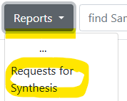
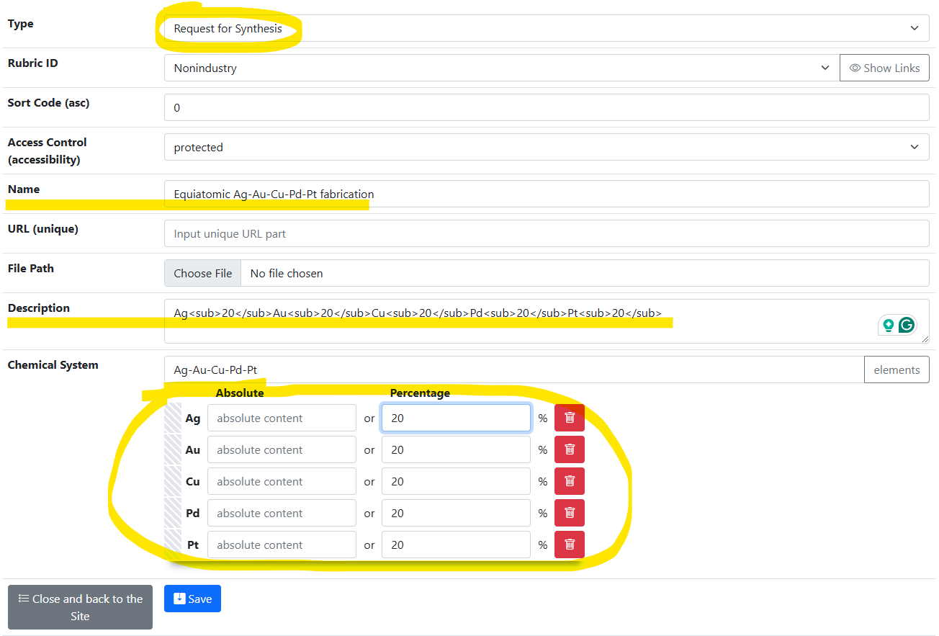
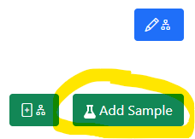
Request for Synthesis
Motivation:
provide technical task
by defining composition for sample synthesis
(batch of samples)
Linked objects

Slide 10
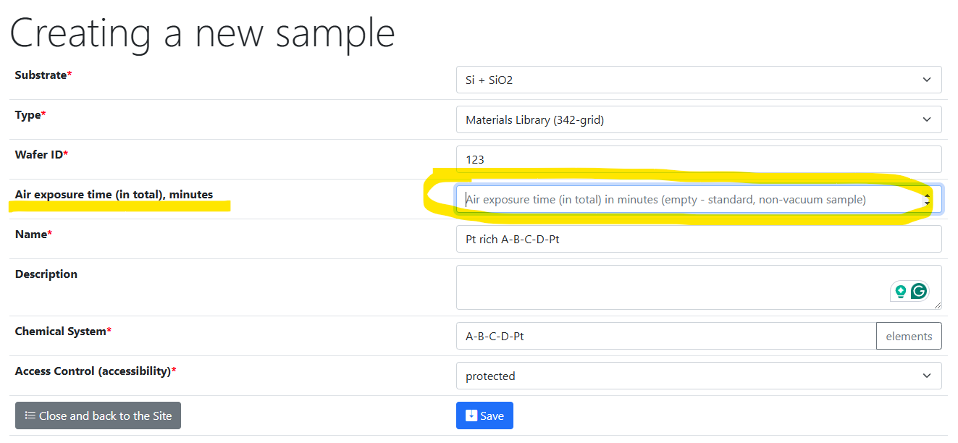
Sample: Air Exposure Time
https://mdi.matinf.pro/custom/editsample/0/

Slide 11
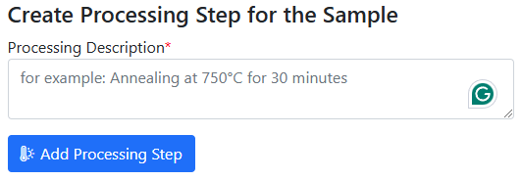
Air exposure time workflow
“Air-free” samples: Air exposure time must be specified for every sample state!
Air exposure time (in total): 0
Air exposure time (in total): 15
Treatment:
Air exposure
Next treatment:
Sample
Sample_2
…
characterisation of a sample that has not seen air
Characterisation:
XPS, EDX, XRD, Resistance, Bandgap, …
Characterisation:
XPS, EDX, XRD, Resistance, Bandgap, …
characterisation of a sample that has seen air
https://mdi.matinf.pro/custom/editsample/0/

Slide 12
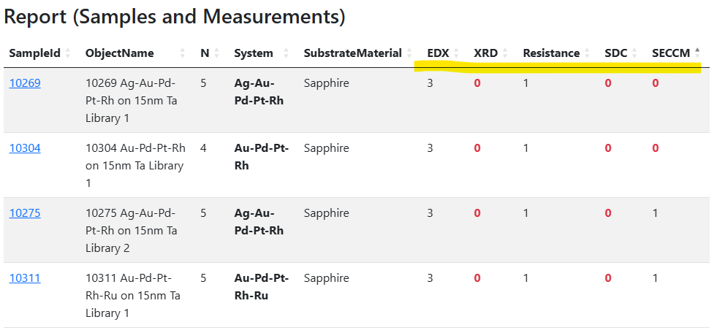
Report provided by “Idea or Experiment Plan”
Live monitoring: how well measurement workflows go to plan
Measurements according to the “Idea or Experiment Plan” object
Number of objects/documents according to measurement types
0 – no measurements done
https://mdi.matinf.pro/object/standard-screening-crc-aka-tobias-report-103066

Slide 13
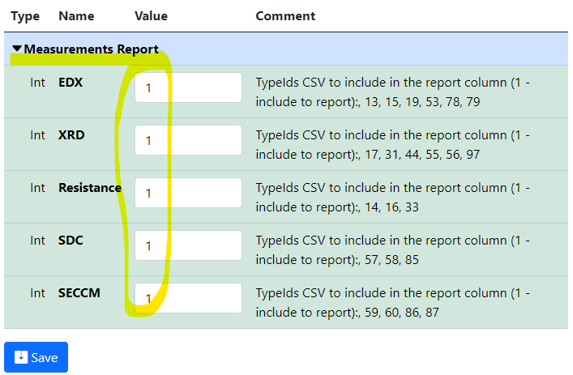
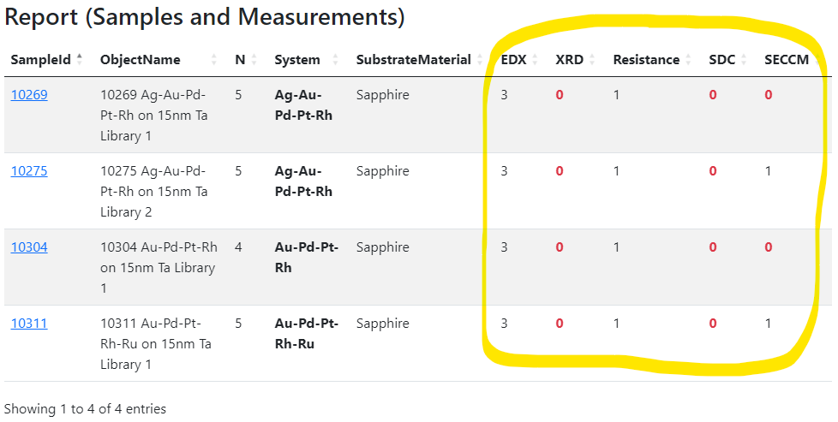
Experiment plan: summary
Motivation: set up the workflow by defining characterisation for the experiment (idea or plan)
and track the progress.
Idea or Plan
1) Create “plan” object
2) Define characterisations
3) Add samples and
measurements…
4) Monitor workflows via reports in the “plan” object
https://mdi.matinf.pro/properties/edititem/103066
https://mdi.matinf.pro/object/standard-screening-crc-aka-tobias-report-103066

Slide 14
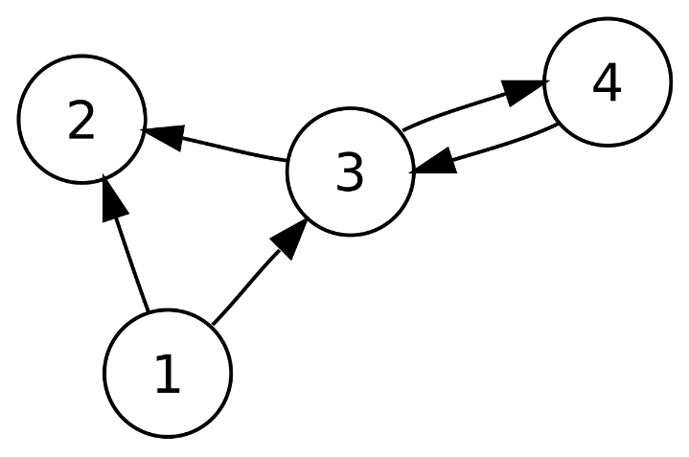
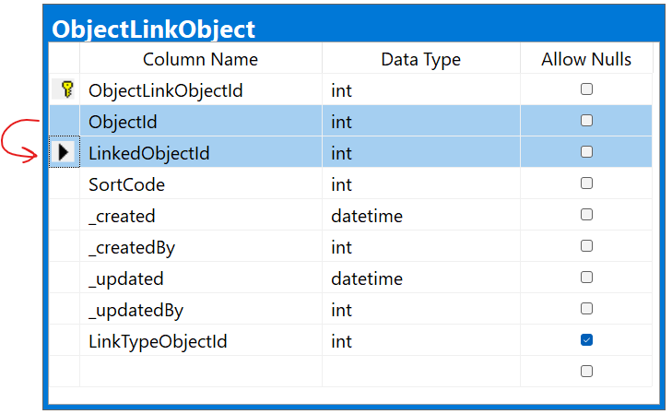
Graph: interlinking objects

Slide 15
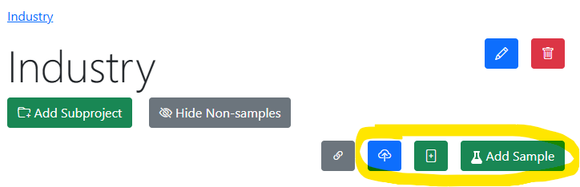
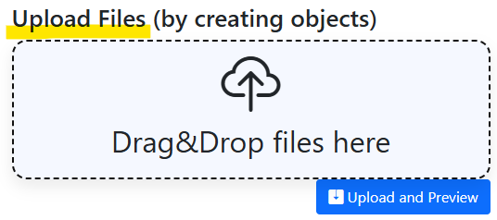
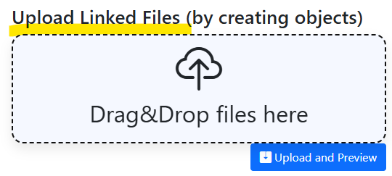
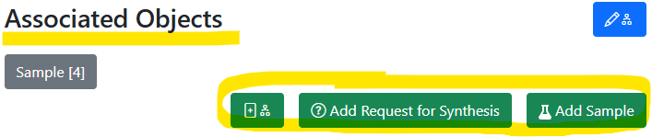
Graph: always think about object connections
Replace with “Idea or Experiment Plan”?
In Project: add unlinked objects.
https://mdi.matinf.pro/rubric/industry
Add “top level” objects
Add “children/dependent” objects
In Object (under associated objects): add linked objects.
https://mdi.matinf.pro/object/standard-screening-crc-aka-tobias-report-103066
https://mdi.matinf.pro/rubric/industry
https://mdi.matinf.pro/object/standard-screening-crc-aka-tobias-report-103066

Slide 16
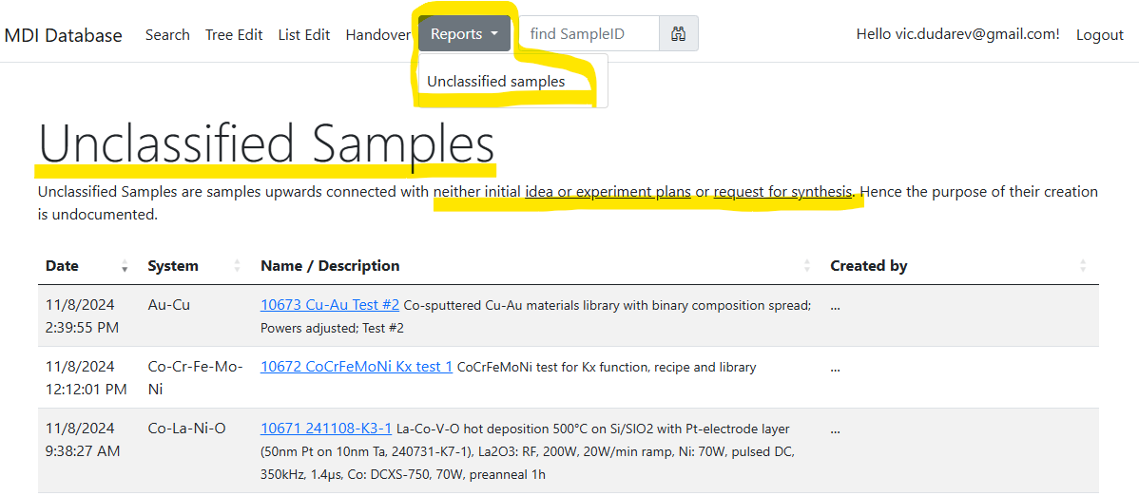
Unclassified samples: these should not exist anymore…
Goal: all samples should have a parent “Idea or Experiment Plan” / “Request for synthesis”
https://mdi.matinf.pro/report/unclassifiedsamples

Slide 17
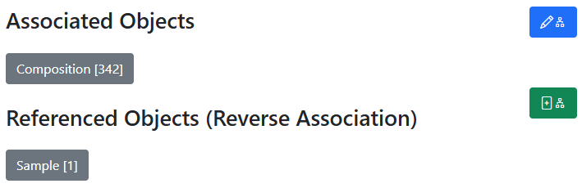
Oriented Graph: interlink & don’t mess up with directions
In all objects:
Control associated objects (children)
Child objects
Add a new (child) object + association
Parent objects
Idea or Plan
Sample
Synthesis
Request for Synthesis
Characterisations:
EDX, XRD, Resistance, Bandgap, …
342
x
Compositions

Slide 18
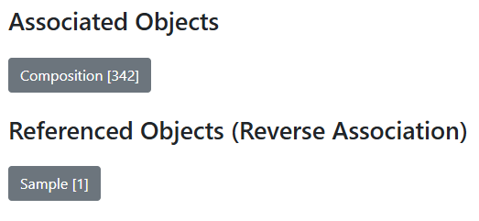
RDMS Quiz: do you know graph good enough?
Task: guess the object type by its associations
Type: ???
Sample
???
EDX CSV
Composition_1
…
Composition_342

Slide 19


Slide 20
What are nfdi / FAIRmat / NOMAD
nfdi: Nationale Forschungsdaten Infrastructure, link
(national research data infrastructure)
Numbers: 27 nfdi consortia…
nfdi
FAIRmat
FAIRmat: nfdi consortium for FAIR materials science data, link
(FAIR: findable, accessible, interoperable, re-usable)
Some numbers: ~60 PIs, ~30 Developers
NOMAD
NOMAD: a web-based service and software for managing FAIR materials science data, link
FAIRmat uses NOMAD to build a federated infrastructure of connected NOMAD installations
Some numbers: ~18M entries (110 TB uploaded files)
https://www.nfdi.de/
https://www.fairmat-nfdi.eu/fairmat/
https://nomad-lab.eu/

Slide 21

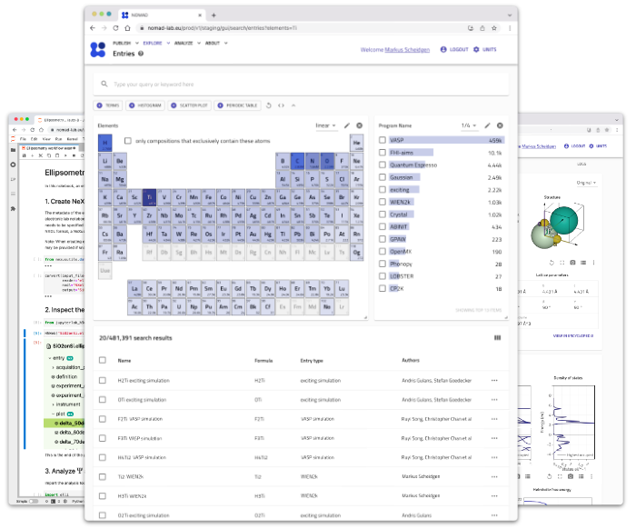
NOMAD
An open and free service that lets you manage, share, and publish data.
Privately manage a limited number of uploads (afaik 10)
Publish data to the whole community
Archive your data and obtain a DOI
Use without any installation or hosting
Access all published data
https://nomad-lab.eu/prod/v1/gui/search/entries

Slide 22
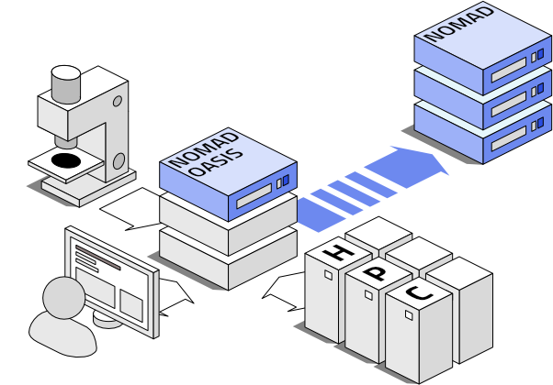
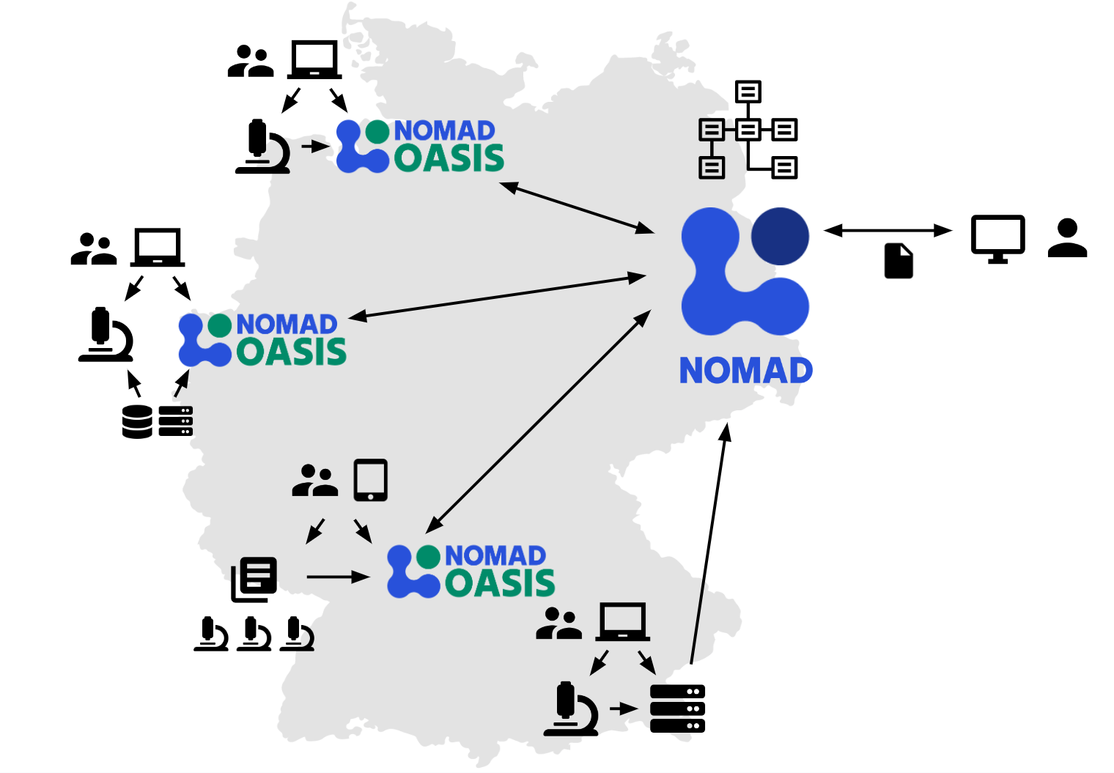
NOMAD Oasis
NOMAD Oasis lets you create your own NOMAD.
Reasons to use:
Privacy
Unrestricted (local) storage
Customisation
Publish to NOMAD (coming soon)
https://nomad-lab.eu/nomad-lab/nomad-oasis.html

Slide 23
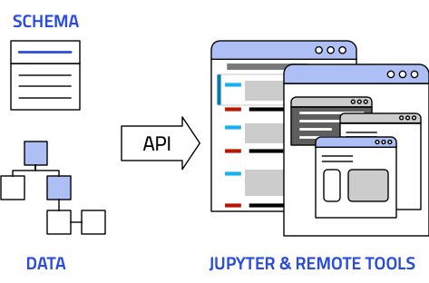

NORTH: NOMAD Remote Tools Hub
Analysis tools
The NOMAD Remote Tools Hub (NORTH) allows you to run containerized tools and Jupyter notebooks directly on your data.
Use JupyterLab to access and modify files in NOMAD
Run predefined notebooks for machine learning in the AI Toolkit
All data is available via API
https://nomad-lab.eu/nomad-lab/nomad.html

Slide 24

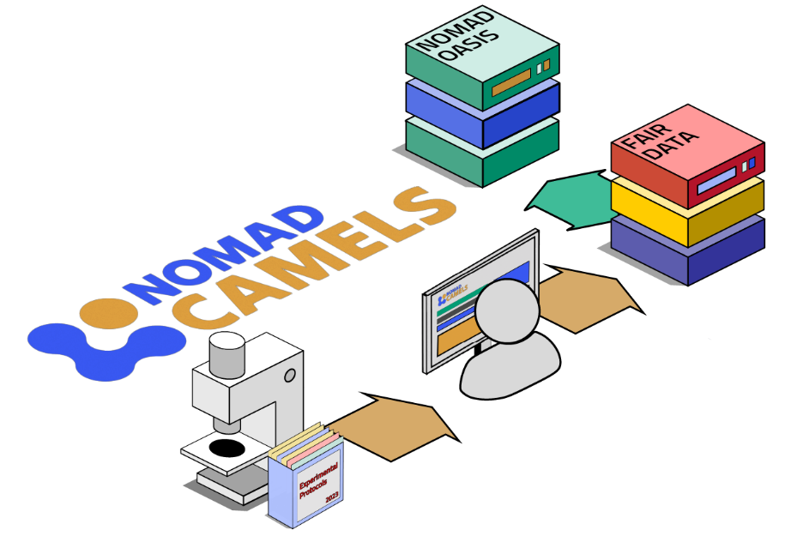
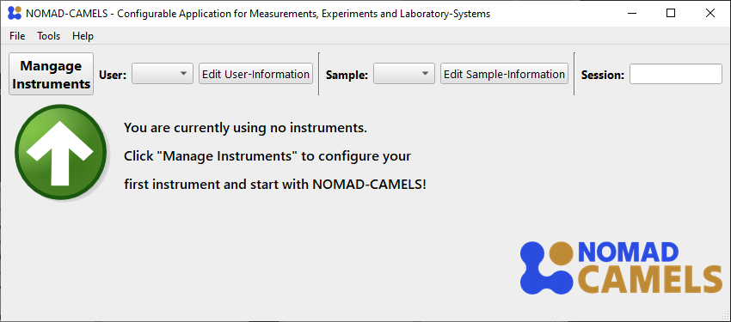
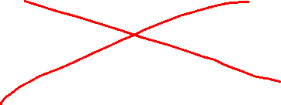
NOMAD CAMELS
Configurable Application for Measurements, Experiments and Laboratory-Systems.
Control instruments, run measurement protocols, and record FAIR data!
Graphical user interface
Instrument control (200+ drivers: https://fau-lap.github.io/NOMAD-CAMELS/doc/instruments/instruments.html)
FAIR data (Python code which runs the measurement protocol)
CAMELS is an open-source python package (distributed via PyPI).
https://nomad-lab.eu/nomad-lab/nomad-camels.html

Slide 25
Conclusion
    Data acquisition API (used by CRC1625 A05/A06)
    Typical workflow (please, no more samples without parent):
      Idea or experiment plan
      Request for synthesis
      Samples “air exposure time”
      Report in “Idea or Experiment Plan”
    Graph: on importance of edges (no orphaned objects, please)
    FAIRmat overview (we should connect with NOMAD)

Slide 26
Thanks for your kind attention
Questions & Answers
Victor Dudarev
Victor.Dudarev@rub.de
https://vdudarev.ru

