Slide 1

Data Management for MDI:
Current Status & Customisation via External API
Victor Dudarev

Slide 2
Agenda
    Some New Features you should be aware of:
      Main page personal helpers: recent user activity
      New Access Level: ProtectedNDA
      Project Description
    Sample Type and Lifecycle Workflow (states & splitting)
    Handover Event (Sample Tracking)
    Object Links
    Customisation:
      New Object Types & Templates: no-code approach
      External Web Services: Validataion & Data Extraction API
      External Visualisation (plotting outsource)
    Reports & Statistics

Slide 3
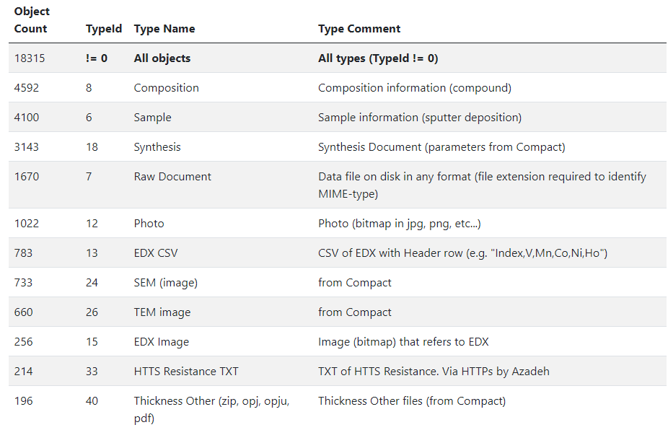
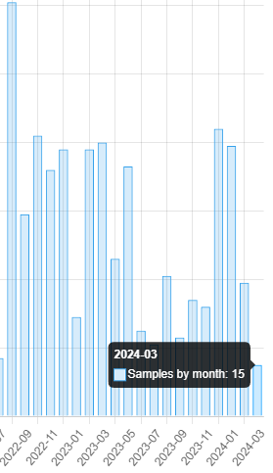
RDMS in Production: mdi.matinf.pro (since 13.11.2023)
Objects statistics (top 10+ types): Samples by month
4100 samples in total
Projects and object interlinks statistics:
RDMS – Research Data Management System
Current status: 4100+ samples: https://mdi.matinf.pro/report/samplesbymonth
Notes:
https://qr.io/

Slide 4
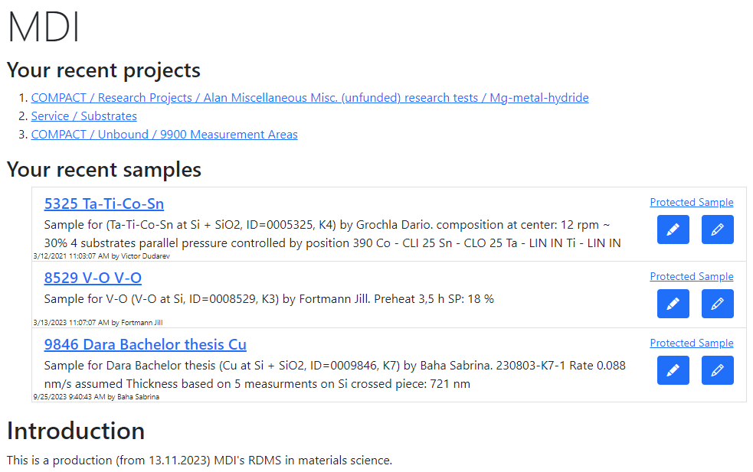
Personalised Home Page
Personalised helpers:
Recent projects
Recent samples
Any other ideas to make it better?
What would be useful for you?
Thanks to Rico for his suggestions!
Notes:
https://qr.io/

Slide 5

RDMS: Setting the Object Access Level
What is an Object?
Object (=document) is a data entry within RDMS that has user-defined access level and reflects an object of the real world (e.g. sample) or its model. Ultimately, object has it’s unique Web page (with unique URL address).
To establish data access policy Data Access Levels are introduced in RDMS.
Four Access Levels:
Public (default, we are doing open science, FAIR, aren’t we?):
    objects are available to everybody regardless of authorization (visible to internet search engines);
Protected (visible to the community only):
- objects are visible to the community (available to authorized users with at least User role assigned);
ProtectedNDA (restricted visiblility):
- objects are visible to the authorized users with NDA claim set OR to Administrators;
Private (person’s secret, but open for Administrators):
- objects are visible to the user-creator (at least PowerUser role assigned);
- objects are visible to all users of Administrator role.
Protected is default in mdi.matinf.pro tenant
NDA - Non-Disclosure Agreement

Slide 6
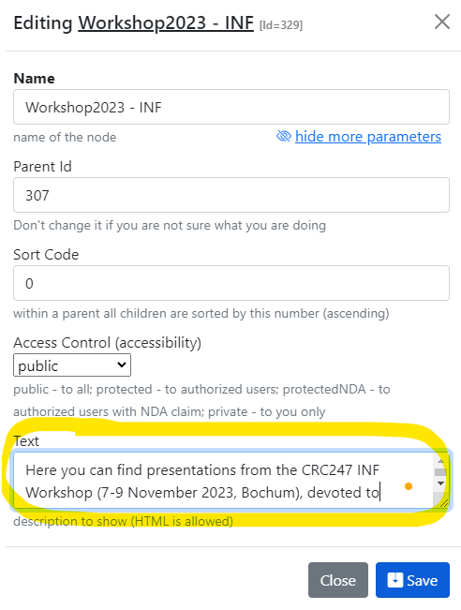
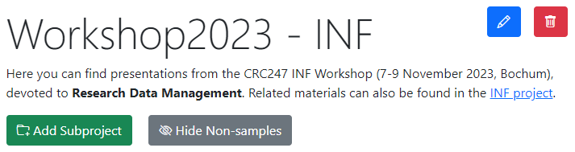
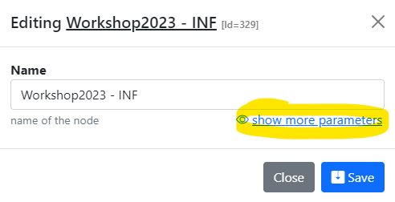
RDMS: Providing Project Description
Motivation: allow to add to a project arbitrary text (HTML).
please in edit project click “show more”:
https://crc247.mdi.ruhr-uni-bochum.de/rubric/how-to-do-wiki_workshop2023-inf

Slide 7
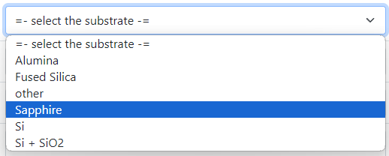

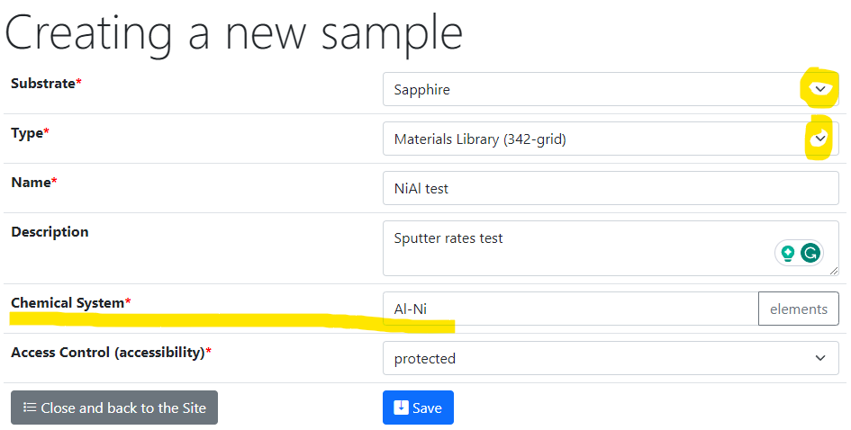
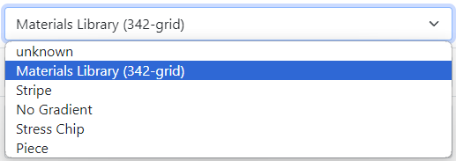
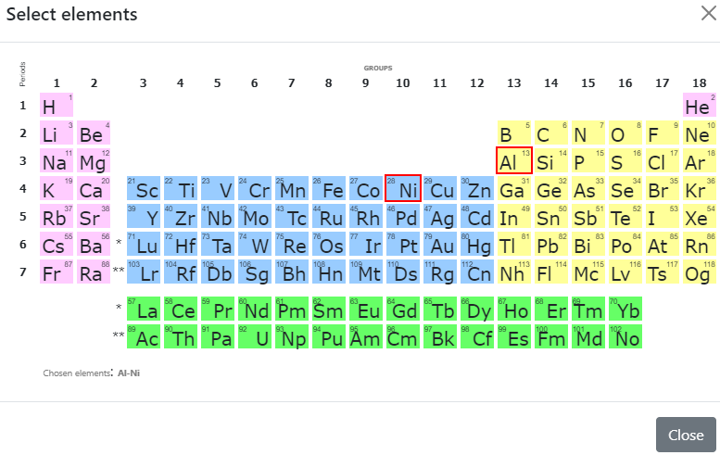
Sample Customised Form
List from Service / Substrates subproject
- Customised sample input
List from JS-template
Standard chemical system
Customisation with UI form / JS
Plans: leverage templates to enable such forms with no-code approach
Create a new sample form: https://mdi.matinf.pro/custom/editsample/0/?idr=1872&returl=%2Frubric%2Fservice
Substrates list: https://mdi.matinf.pro/rubric/service_substrates

Slide 8
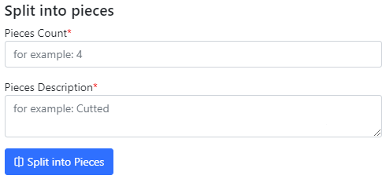
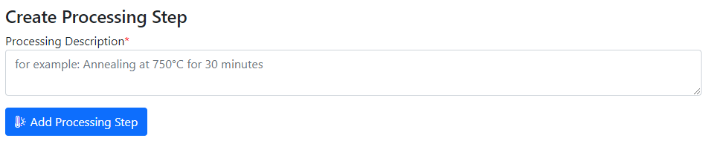

Use Case: Sample Transformation Workflow (Sample edit form)
Create Processing State & Split Sample
Sample_2a_2
(subsample 2a state 2)
polishing
Documents2a_2
Sample_2a
(subsample 2a)
annealing
splitting
Sample_2b_2
(subsample 2b state 2)
Sample
(initial state)
Sample_2
(changed state 2)
oxidation
Sample_2b
(subsample 2b)
documents
documents2
Documents2b_2
Use “Edit sample” form:

Slide 9
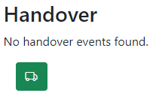
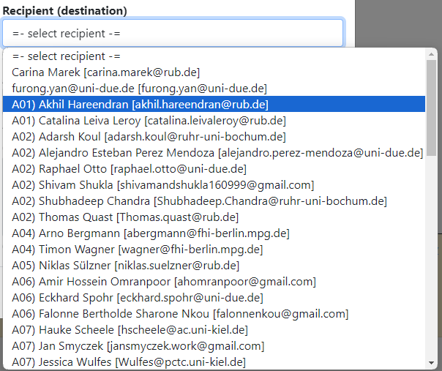
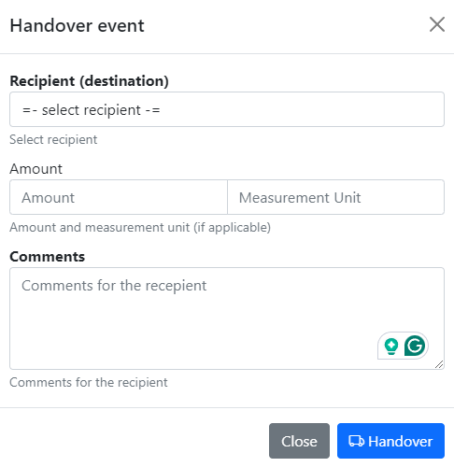
Tracking Samples or Handover event: initialisation
In “physically transferrable” objects (samples), find a green handover button
Select the recipient and press a blue button.
Select recipient
Specify Amount (optional)
Specify Comments
Click to initialise
Handover is available in any sample view form.

Slide 10
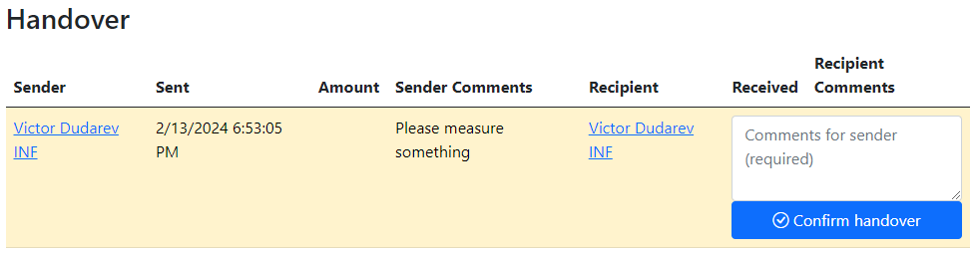
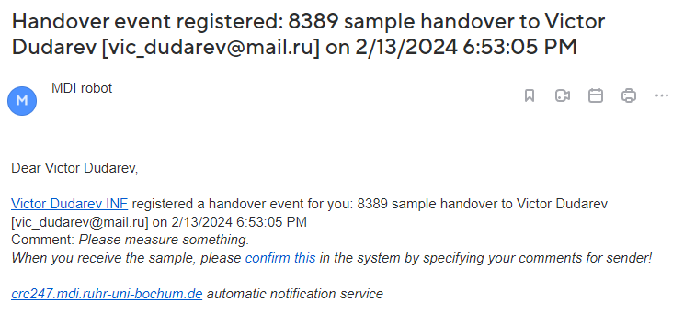
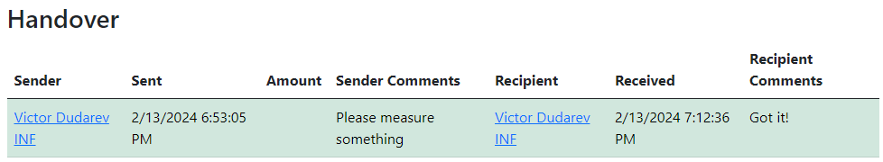
Tracking Samples or Handover event: delivering / delivered
1) Handover event is created
2) Recipient is notified by e-mail
3) Recipient should add comments and confirm the handover.
4) Confirmed
+ e-mail notification for sender
Creation by sender -> Recipient notification -> Recipient confirmation -> Sender notification.

Slide 11
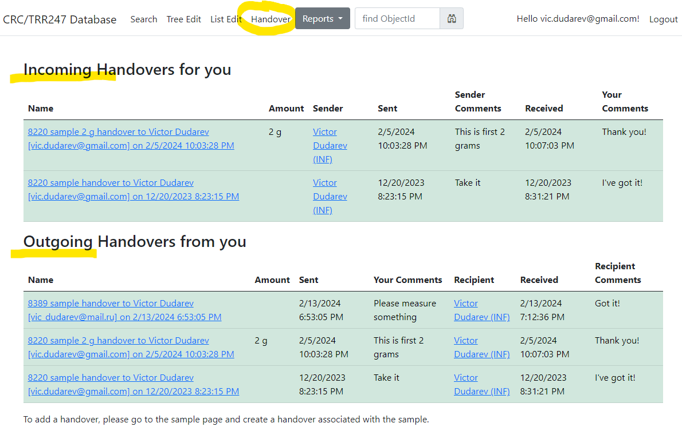
Tracking Samples or Handover event: user overview
Incoming
Outcoming
User-dependent handover overview (example in CRC247 tenant):
https://crc247.mdi.ruhr-uni-bochum.de/handover

Slide 12
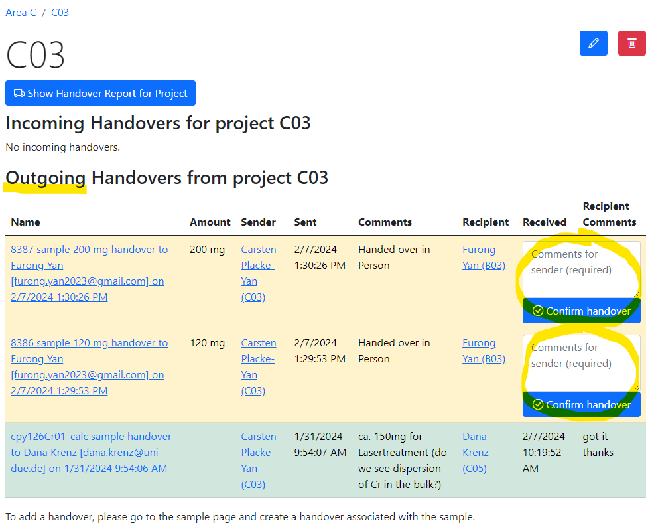
Tracking Samples or Handover event: project overview
Handover overview is displayed in project that matches by name with one of Project claims for users.
Contains overview for a group of users having the same Project claim.
Pending handovers (unconfirmed)
Successful handover
Project (a group of users working on the same project according to Project claim) overview for handovers (in CRC247):
https://crc247.mdi.ruhr-uni-bochum.de/rubric/area-c_c03

Slide 13
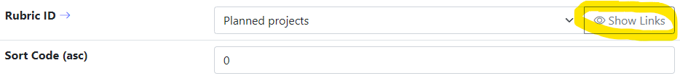
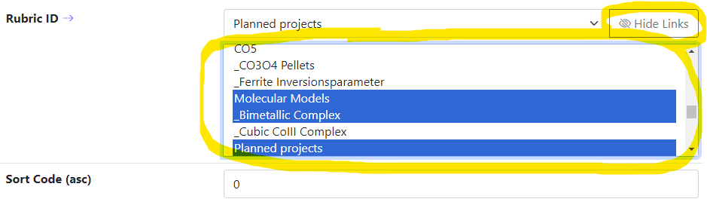

Object Links: object modification form
Motivation: Object is displayed in a project to which it belongs. Sometimes it’s required to associate object with multiple projects.
Object modification interface update
Select projects that should display the object:
Press “Save” button
Disadvantage: only user-creator or administrator can do this (object modification form).
Any edit object form

Slide 14
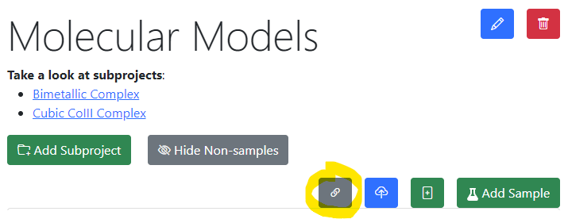
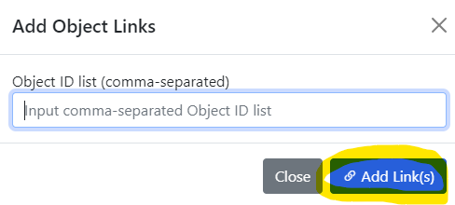
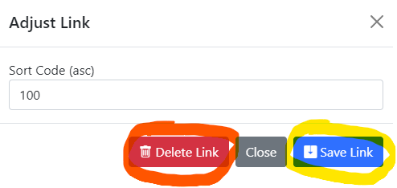

Use-Case: add object links to a project
Motivation: allow everybody (PowerUser+) to add object links to a rubric.
1) In a project click gray “Add Link” button 2) Popup window: add links for object(s)
4) Popup: adjust link order or delete it
3) Linked object layout in the project (with link button):
Links functionality in any project view (available to all PowerUser+)

Slide 15


User-Defined Type Support
Motivation: to support new user-defined object type (UDT) without modifying core RDMS source code
Given: New object type with/without a new arbitrary file format (could new measurement type result).
Solution (or 5 keys to success):
Templates – define object model (data structure) in terms of key-value pairs / table (properties)
Search – enable search for UDT objects based on defined data model
Validation – provide check for data correctness (valid/invalid)
Data Extraction – if valid, extract data in terms of properties / related object creation
Visualization – display data, including drawing charts / diagrams, etc…
UDT – user-defined type

Slide 16
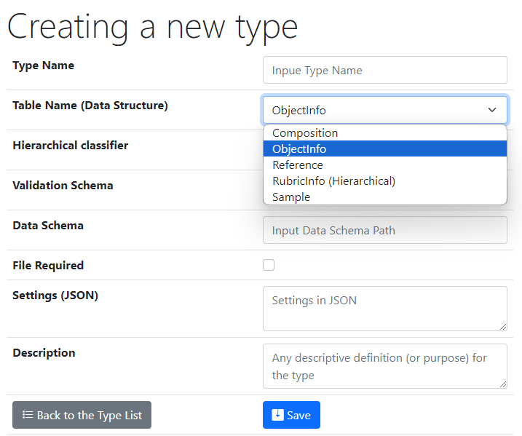
UI to create a new user-defined type
One of predefined base types
Type Name – user-defined type name
Core Object Types:
ObjectInfo – the simplest (bare) object
Sample – chemical system (set of chemical elements), for example Co-O
Composition – chemical composition (set of elements and quantities), for example Co₃O₄
Reference – literature reference (Authors, Title, Year, DOI, etc.)
Validation & Data Schema – only if you have external Web Services ready to validate & extract data from files
File Required – sets the file mandatory (boolean)
Settings (JSON) – type customization in RDMS
{ "CustomEditPath": "/custom/editsample",
"UrlPostVisualizer": "https://abc.de/VisualizeRT" }
Description – comments for type designation
Defining data & behavior
We can further enrich defined object specification by customized (templates!) properties of primitive types: Integer, Float, String.

Slide 17

Ways of customization
Basic (no-code)
  Introducing User-Defined Data Types:
    - List templates
    - Table templates
Simple (client-side code only)
  Page-code injection:
    - HTML
    - Javascript
    - CSS
Development abstraction layers
easy hard
data layout workflow application
Scope for today’s talk
External API (server-side code only)
  Validation & Data Extraction for User-Defined Data Types (any language)
Complex (client- & server-side code)
  INF-code adjust (ASP.Net Core App)
    - C#
    - SQL
    - HTML/Javascript/CSS
Complexity

Slide 18
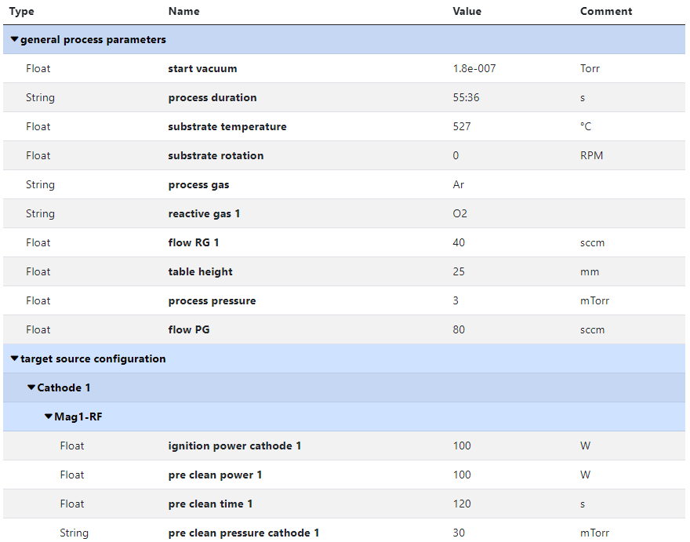
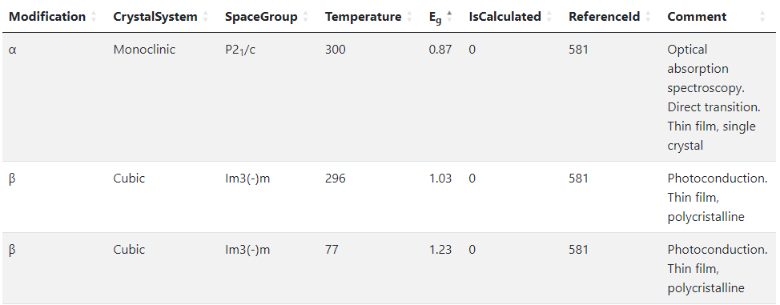
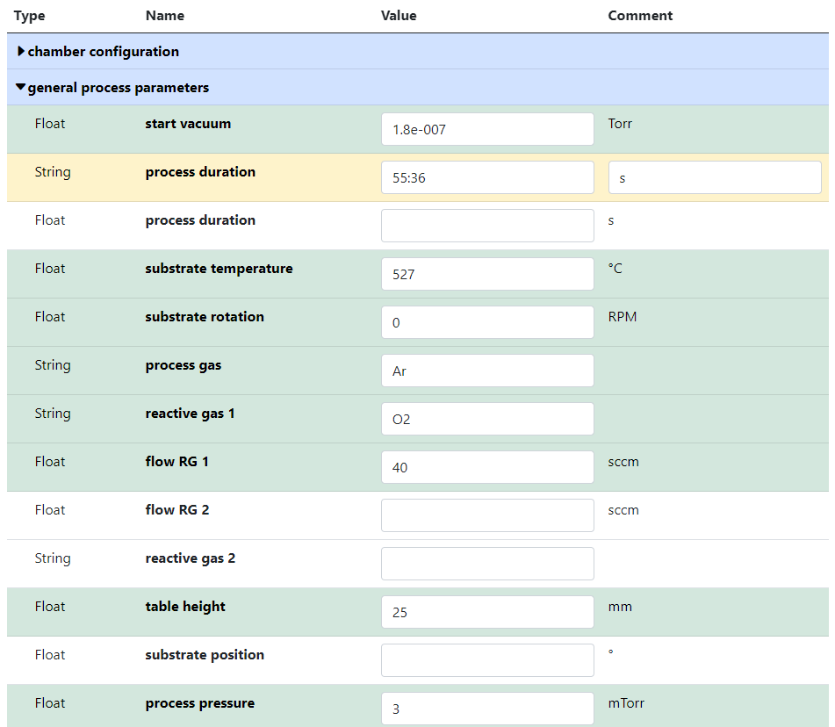


RDMS no-code customisation: Templates for object type
Template
List
(specify sorted properties list with separators)
Create an object with “_Template” name
Specify properties set for a type
Table
(specify table structure: columns & types)
Data in a table with predefined structure
Key-value pairs
https://crc247.mdi.ruhr-uni-bochum.de/object/synthesis-for-sample-8220-co-deposition-221111-k3-3-1922
https://demo.mdi.ruhr-uni-bochum.de/object/ag2s-4870

Slide 19
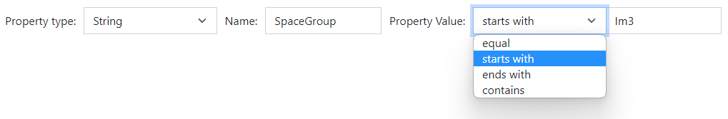
RDMS (no-code effort): Extended Properties Search
All values are to be stored using appropriate data types!
DEFINITION: Data type is a collection or grouping of data values, usually specified by a set of possible values, a set of allowed operations on these values, and/or a representation of these values as machine types.
Supported data types (and their visualization in the search form):
Int – integer values (64-bit signed integer) in range [-9 223 372 036 854 775 808; 9 223 372 036 854 775 807].
Float – double-precision floating-point (8 bytes, IEEE-754), ±5.0×10⁻³²⁴ to ±1.7 × 10³⁰⁸.
String – any characters sequence no longer than 4096 symbols.
BigString – any characters sequence no longer than 2 147 483 647 symbols (2 Gb).
https://en.wikipedia.org/wiki/Data_type

Slide 20
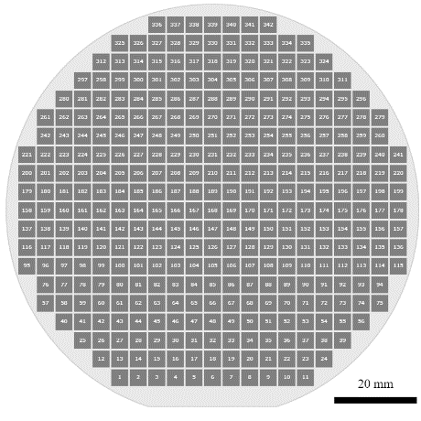
Materials Library: integrating heterogeneous measurement data
Typical Materials Library Data Lifecycle:
Sputtering:
Add Sample object (chemical system + substrate)
Add Synthesis object (sputtering parameters)
Characterisation:
Add processed EDX (342 Composition objects)
  Composition == Measurement Area
Add Other Characterisation Documents (Photo, XRD, Resistance, Thickness, Bandgap, etc…)
Storage, Curation, Search (on properties retrieved from devices / file formats), Reporting:
Find compositions with given properties in a certain range (across all known materials libraries)
Find by synthesis parameters
Find by chemical system / creation date / author / text / properties, etc…
Reports
Measurement Area
(composition)
Phases: [ Phase₁,
…, Phase_{N} ]
Resistance: __ Ohm
Thickness: __ nm
Bandgap: __ eV
…
ML – Materials Library
EDX – Energy-dispersive X-ray spectroscopy
XRD – X-ray diffraction analysis

Slide 21
Customisation via External Services
Motivation: support new data formats (models) without RDMS code change
Solution: RDMS can calls external services to get assistance dealing with new data formats with respect to:
Validation
Data Extraction
Visualisation
To provide full object type support (as if it was natively implemented in RDMS) one needs to implement three Web Services

Slide 22
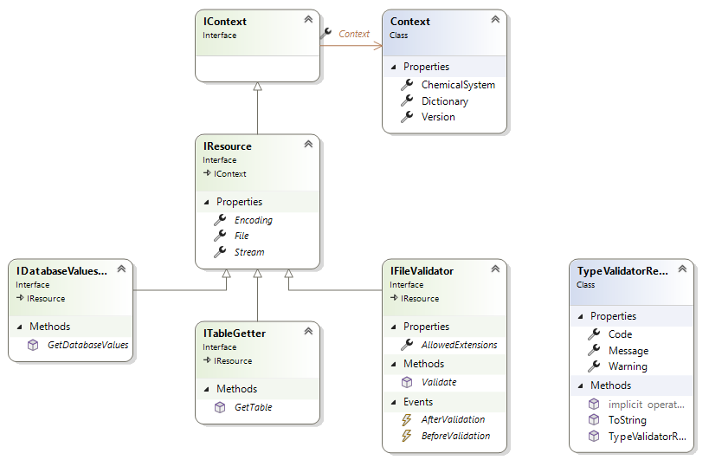
Type configuration: Data Validation types
Provide a validator for every object type. Implemented:
type:
any .Net-compatible type, that implements IFileValidator interface and is available in Application Domain (object is instantiated by type name using Reflection);
https:
URL to a REST Service (OpenAPI specification).
* - /body is added to URL which receives the file sent as a request body, as a response a JSON-document with TypeValidationResult is awaited
API – Application Programming Interface
URL – Uniform Resource Locator
REST – REpresentational State Transfer

Slide 23
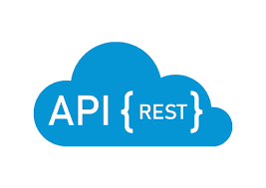

Type configuration: Data Validation via external Web Service
Validation task is delegated to an external service
Validation result
via external API call
Request URL: HTTPS_ValidationSchema + "/body"
Example:
Validation Schema (for EDX): https://validation.matinf.pro/edx/validation
Request URL: https://validation.matinf.pro/edx/validation/body
{
"Code": 0,
"Message": null,
"Warning": null
}
valid
Request body: application/octet-stream
External service decision
Response: text/json
invalid
Validation schema values (current status):
{
"Code": 500,
"Message": "error text",
"Warning": null
}
Validation Schema* | Comments | Author
type:TypeValidationLibrary.TypeValidator_Ok | default validator: checks extensions only | Victor
type:TypeValidationLibrary.TypeValidator_EDX_CSV | EDX (Victor) | Victor
https://validation.matinf.pro/edx/validation | EDX (Victor) | Victor
https://htts.matinf.pro/resistance/csv/validation | HTTS Resistance CSV | Azadeh
https://htts.matinf.pro/resistance/txt/validation | HTTS Resistance TXT | Azadeh
https://thickness.matinf.pro/thickness/xlsx/validation | Thickness XLSX | Azadeh
https://thickness.matinf.pro/thickness/txt/validation | Thickness TXT | Azadeh
Warning: context is not supported yet in Validation via Web Service implementation

Slide 24
Type configuration: Data Extraction (via external Web Service)
Data extraction & conversion to table tasks are delegated to an external service
Data Extraction
Request URL: HTTPS_DataSchema + ("/databasevaluesbody" | "/tablebody")
Example: Data Schema (for EDX): https://validation.matinf.pro/edx/data
/databasevaluesbody
/tablebody
Data
IDatabaseValuesGetter: properties, compositions, properties for measurement areas
Table
ITableGetter: arbitrary table
(used for table visualisation)
Request URL (data): https://validation.matinf.pro/edx/data/databasevaluesbody Request URL (table): https://validation.matinf.pro/edx/data/table
see next slides…
Data schema values (current status):
{
"DataTable": [
{
"Index": "1",
"V": 31.3,
"Mn": 2.7,
"Co": 22.6,
"Ni": 6,
"Ho": 37.4
},
...
],
"Coordinates": {
"CoordinateNames": [],
"HasCoordinates": false
},
"Dependencies": {
"DependencyNames": [
"Index"
],
"HasDependencies": true
}
}
Data Schema | Comments | Author
type:TypeValidationLibrary.TypeValidator_EDX_CSV | EDX (Victor) | Victor
https://validation.matinf.pro/edx/data | EDX (Victor) | Victor
https://htts.matinf.pro/resistance/csv/data | HTTS Resistance CSV | Azadeh
https://htts.matinf.pro/resistance/txt/data | HTTS Resistance TXT | Azadeh
https://thickness.matinf.pro/thickness/xlsx/data | Thickness XLSX | Azadeh
https://thickness.matinf.pro/thickness/txt/data | Thickness TXT | Azadeh
https://validation.matinf.pro/
Warning: context is not supported yet in Data Extraction via Web Service implementation

Slide 25
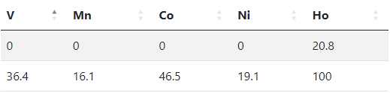
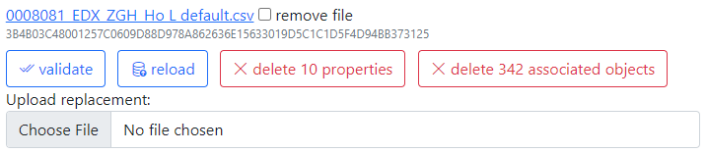
Data Extraction: creating properties
Task: create properties for object that contains file
{ "DeletePreviousProperties": true,
"Properties": [
{ "PropertyId": 0,
"Type": 1,
"Name": "V",
"Value": 0,
"ValueEpsilon": null,
"SortCode": 10,
"Row": 1,
"Comment": "Minimal V content"
},
{ "PropertyId": 0,
"Type": 1,
"Name": "V",
"Value": 36.400001525878906,
"ValueEpsilon": null,
"SortCode": 10,
"Row": 2,
"Comment": "Maximal V content"
}
]
}
Metadata for EDX (range values):
Administrative interface: Compositions
https://validation.matinf.pro/

Slide 26
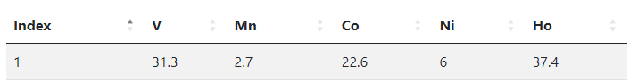
Data Extraction: creating compositions
Task: create compositions for every measurement area
Data from EDX (all values == 342 compositions):
{
"CompositionElements": [
{ "CompoundIndex": 0, "ElementName": "V", "ValueAbsolute": null, "ValuePercent": 31.299999237060547 },
{ "CompoundIndex": 10, "ElementName": "Mn", "ValueAbsolute": null, "ValuePercent": 2.700000047683716 },
{ "CompoundIndex": 20, "ElementName": "Co", "ValueAbsolute": null, "ValuePercent": 22.600000381469727 },
{ "CompoundIndex": 30, "ElementName": "Ni", "ValueAbsolute": null, "ValuePercent": 6 },
{ "CompoundIndex": 40, "ElementName": "Ho", "ValueAbsolute": null, "ValuePercent": 37.400001525878906 }
],
"DeletePreviousProperties": true,
"Properties": [
{
"PropertyId": 0, "Type": 2, "Name": "Measurement Area", "Value": 1, "ValueEpsilon": null,
"SortCode": 0, "Row": null, "Comment": null
}
]
}
https://validation.matinf.pro/

Slide 27
Data extraction: adding data to Measurement Area (Composition)
{
"CompositionsForSampleUpdate": [
{
"Predicate": {
"Properties": [
{
"Type": 2,
"Name": "Measurement Area",
"Value": 1
}
]
},
"DeletePreviousProperties": false,
"Properties": [
{
"PropertyId": 0,
"Type": 1,
"Name": "R",
"Value": 34143346,
"ValueEpsilon": null,
"SortCode": 10,
"Row": null,
"Comment": "Resistance (Room Temperature) for Measurement Area 1"
}
]
},
...
],
"DeletePreviousProperties": true,
"Properties": [
{
"PropertyId": 0,
"Type": 1,
"Name": "R",
"Value": 97692.43229,
"ValueEpsilon": null,
"SortCode": 10,
"Row": 1,
"Comment": "Minimal Resistance (Room Temperature) of Materials Library (of all 342 MAs)"
},
{
"PropertyId": 0,
"Type": 1,
"Name": "R",
"Value": 34143346,
"ValueEpsilon": null,
"SortCode": 10,
"Row": 2,
"Comment": "Maximal Resistance (Room Temperature) of Materials Library (of all 342 MAs)"
}
]
}
Use case: adding characterization data after EDX is done.
Resistance for MA 1
Sample
EDX
composition
R
Resistance
x 342
Resistance range for object (whole ML)
Data import:
Locate parent sample object.
Find measurement area collection.
Find a certain Measurement Area (corresponding to a predicate, e.g. MA index).
Add properties values to a composition corresponding to a measurement area index.
http://htts.matinf.pro/

Slide 28



Type configuration via JSON (extendable)
Task: configure type behavior (stored in TypeInfo.SettingsJson)
Type is applicable to enlisted types (For Handover Event)
For Sample Type (custom edit form implementation)
Array of allowed extensions for data files
External Visualization (with Web Application)
{
"ApplyForTypeIds": [ 6 ],
"CustomEditPath": "/custom/editsample",
"AllowedExtensions": [ ".txt", ".csv" ],
"UrlPostVisualizer": "https://..."
}
Request body: application/octet-stream
Response: text/html
We can further enrich defined object specification by customized (templates!) properties of primitive types: Integer, Float, String.

Slide 29

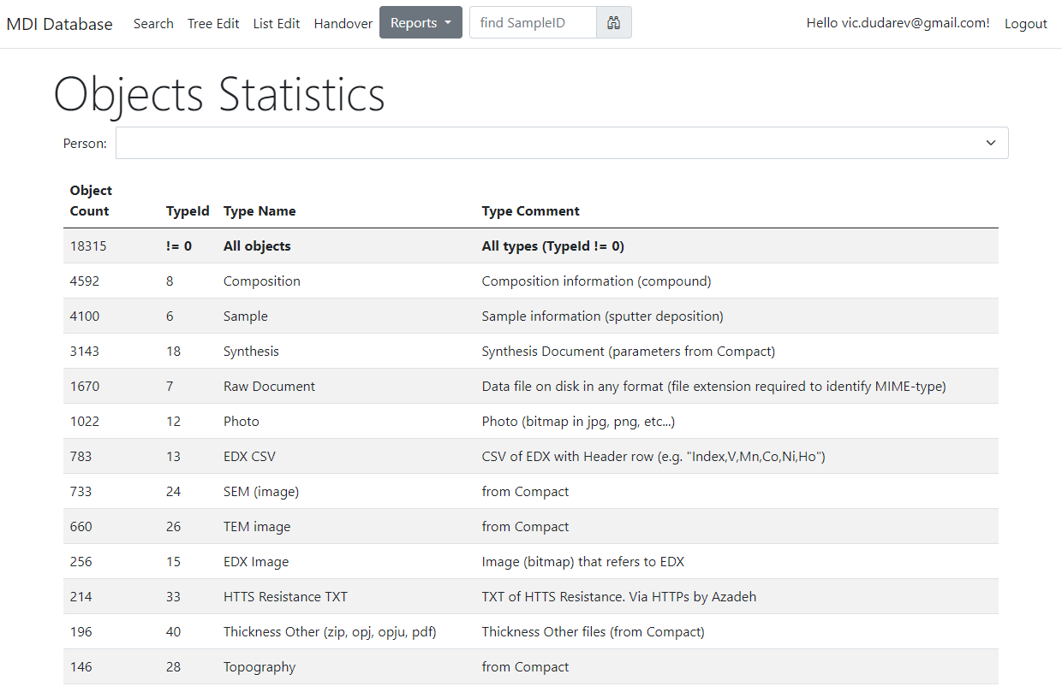
Reports & Statistics: Objects
Objects Statistics:
Objects (w.r.t. types)
Projects
Object Links
Feature:
Filter by person
https://mdi.matinf.pro/report/objectsstatistics

Slide 30
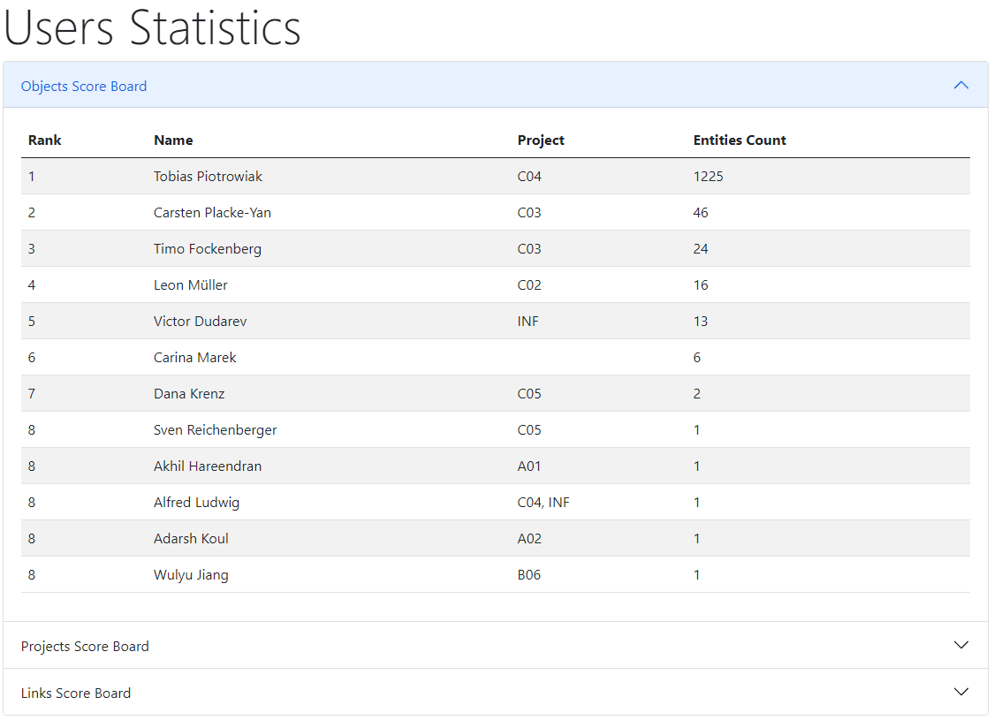

Reports & Statistics: Users
Users Statistics:
Objects
Projects
Links
https://mdi.matinf.pro/report/usersstatistics
https://crc247.mdi.ruhr-uni-bochum.de/report/usersstatistics

Slide 31



Project-wide Statistics / Person-wide Statistics
Even more is to be implemented…
Questions:
How productive is project/person in terms of adding data (objects creation)?
Is project subtree clearly structured (for manual subprojects traversing)?
What is the most referenced / liked object?
“Data Creator” awards (the winner is…):
The most productive data creator award project/person
The people’s choice award: project subtree clarity
The citation / popularity award
?

Slide 32
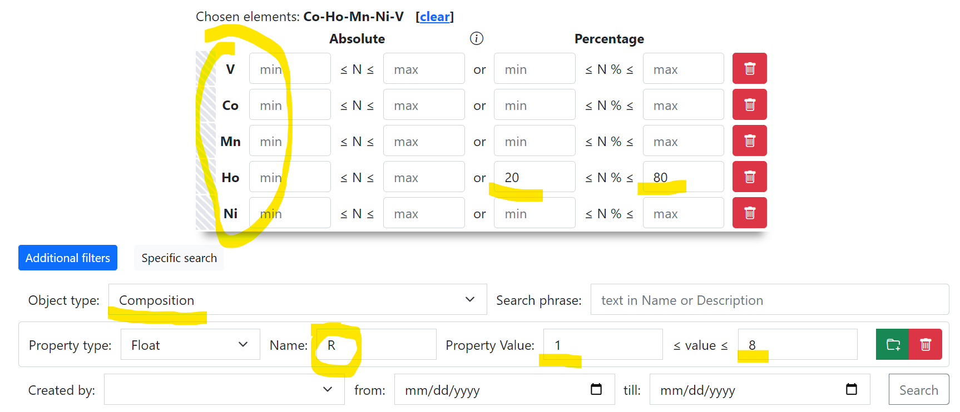
Use Case: data upload Sample -> EDX -> Resistance & Search
Create Project
Add Sample to Project
Add EDX document (342 Measurement Areas (MA), i.e. 342 Compositions)
Add Resistance document (associate property values to every MA)
Search for Composition with a given Resistance
Composition – object representing one of 342 measurement area
Container for other properties, associated with a certain measurement area
https://demi.matinf.pro/search/?system=Ni-V&typeid=8&Nipctmin=15&Nipctmax=20&pr0name=R&pr0type=Float&pr0min=10000000&pr0max=11111111&prcnt=1

Slide 33
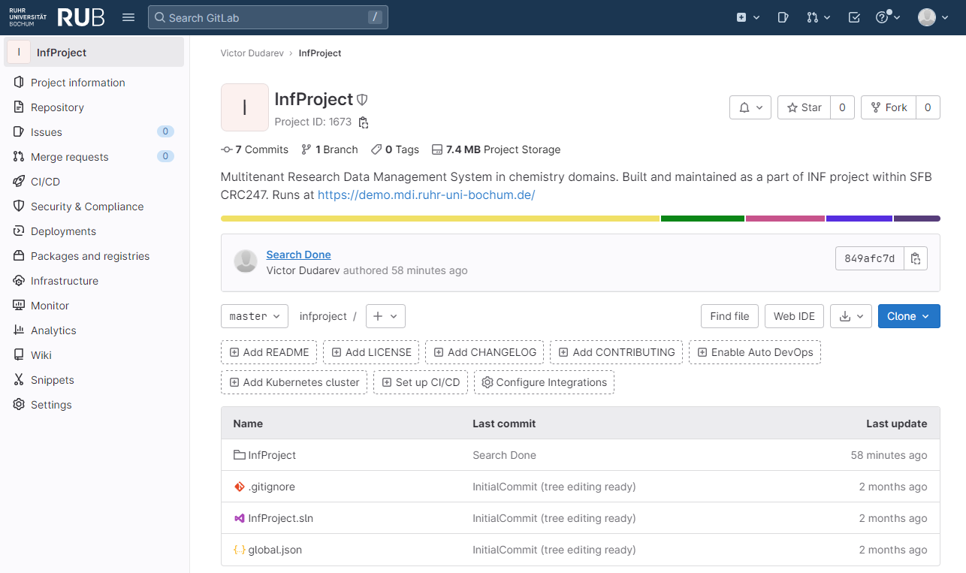

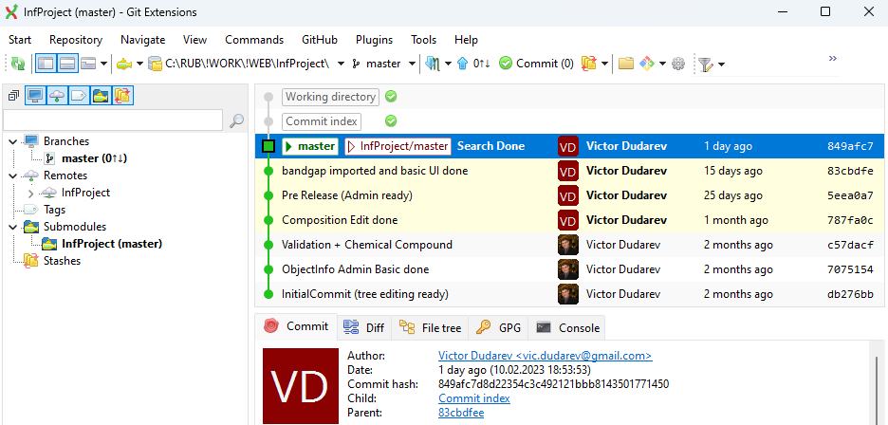



Source Control (GitLab)
Everybody’s welcome!
Feel free to contribute to open source!
Core INF project:
https://gitlab.ruhr-uni-bochum.de/vic/infproject
Shared projects (WebCompact):
1) Administration User Interface (Identity Manager UI):
https://gitlab.ruhr-uni-bochum.de/vic/identitymanagerui
2) Web Application General Library (WebUtilsLib):
https://gitlab.ruhr-uni-bochum.de/vic/webutilslib
https://gitlab.ruhr-uni-bochum.de

Slide 34
Thanks for your kind attention
Questions & Answers
Victor Dudarev
Victor.Dudarev@rub.de
https://vdudarev.ru

Slide 35


RDMS Playground
https://demo.mdi.ruhr-uni-bochum.de/ https://inf.mdi.ruhr-uni-bochum.de/
Playground to test RDMS (multiple tenants with shared users list):
https://demo.mdi.ruhr-uni-bochum.de/
https://inf.mdi.ruhr-uni-bochum.de/
Login and Password (User role): User1@user.org
Login and Password (PowerUser role): PowerUser1@user.org
Login and Password (Administrator role): Admin1@user.org
https://demo.mdi.ruhr-uni-bochum.de/
https://inf.mdi.ruhr-uni-bochum.de/
Notes:
https://qr.io/

