Slide 1

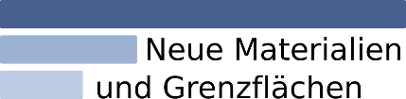

Research Data Management System:
Apps, XRD, XPS
Victor Dudarev

Slide 2
Research Workflow
    Please, no more samples without a parent:
      Root: “Idea or experiment plan” OR “Request for synthesis”!
      Samples with characterizations
      Report as an “Idea or Experiment Plan” finalizer
Defines characterizations
Provides report on samples & measurements
Idea or Plan
Calculation / Compu-tational Composition
Sample
Treatment:
annealing,
oxidation,
polishing, …
Sample_2
Report
Request for Synthesis
Characterisation:
EDX, XRD, Resistance, Bandgap, …
Characterisation:
EDX, XRD, Resistance, Bandgap, …

Slide 3
Agenda
    External Apps for Data Visualisation / Processing
      Tafel analysis
    XRD:
      XRD Phase Overview
      Phase or Crystal Structure (cif)
    XPS: Volume vs. Surface Composition

Slide 4
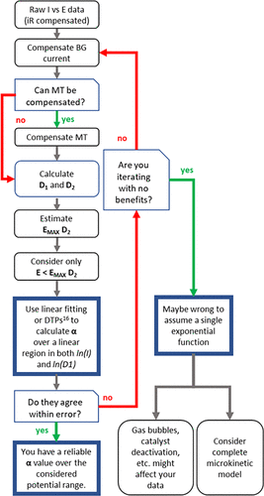
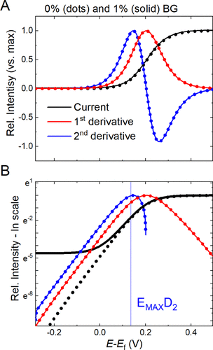
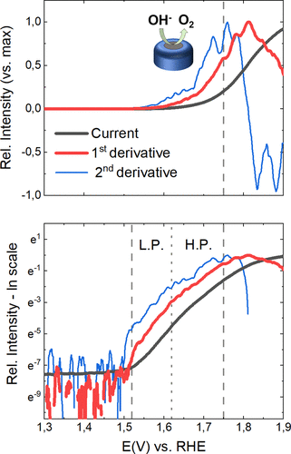
Catalyst Benchmark: Differential Tafel Analysis
Manuel Corva, Niclas Blanc, Christoph J. Bondue, and Kristina Tschulik
Differential Tafel Analysis: A Quick and Robust Tool to Inspect and Benchmark Charge Transfer in Electrocatalysis
ACS Catalysis 2022 12 (21), 13805-13812. DOI: 10.1021/acscatal.2c03581
https://pubs.acs.org/doi/10.1021/acscatal.2c03581

Slide 5
Source Data: diverse csv&txt formats (different potentiostats)
File............: lsv_lsv1_case_a_19_07_2023_12_19_42_0001 - JUL,19.2023
System..........:
Temperature.....: 49.2+-0.0C
Time............: 12:19:42-12:22:50
Scan mode.......: 5mV/s
Comment.........:
Electr.area/sqcm:
Reference.......: 0.4500929, 0.3194414 PO,PF,Imi-4.0e-01 ,Ima 4.0e-01 , -2, 11272
Lines: 187
Columns: 3
Number Time/s Potential/V Current/A
1 0 0.000 -3.800e-05
2 1.004 0.003 -1.086e-05
3 2.005 0.008 -7.868e-06
4 3.006 0.013 -6.100e-06
5 4.006 0.018 -4.871e-06
6 5.007 0.023 -3.926e-06
7 6.008 0.028 -3.146e-06
8 7.009 0.033 -2.464e-06
9 8.01 0.038 -1.842e-06
10 9.019 0.040 -1.873e-06
Experiment:, charge balanced
Start date:, 08 April 2025
Start time:, 18:08:35 +02:00
Time (s), Voltage (V), Current (A), Reverse I (A), Charge (C), V Range (), I Range ()
1029.63, -0.01006696, -9.316599e-06, , 0.001817496, 1, 5
1029.64, -0.009909317, -8.931254e-06, , 0.001817407, 1, 5
1029.65, -0.01006696, -9.187112e-06, , 0.001817315, 1, 5
1029.66, -0.01006696, -8.931254e-06, , 0.001817225, 1, 5
1029.67, -0.01006696, -1.038215e-05, , 0.001817121, 1, 5
1029.68, -0.01006696, -9.085705e-06, , 0.001817031, 1, 5
1029.69, -0.009751666, -8.836088e-06, , 0.001816942, 1, 5
1029.7, -0.009751666, -8.811126e-06, , 0.001816854, 1, 5
1029.71, -0.009594016, -8.432022e-06, , 0.00181677, 1, 5
1029.72, -0.009594016, -9.441408e-06, , 0.001816675, 1, 5
1029.73, -0.009594016, -8.533429e-06, , 0.00181659, 1, 5
1029.74, -0.009594016, -9.32284e-06, , 0.001816497, 1, 5
1029.75, -0.009594016, -8.851689e-06, , 0.001816408, 1, 5
WE(1).Potential (V) WE(1).Current (A) Time (s)
0.442474365234375 2.40173339843749E-06 1178.14680902547
0.44500732421875 2.08740234375E-06 1180.5882150193
0.447357177734375 1.89819335937499E-06 1183.02962101314
0.4498291015625 1.873779296875E-06 1185.47102700697
0.45233154296875 1.82189941406249E-06 1187.91243300081
0.4547119140625 2.20947265625E-06 1190.35383899465
0.457122802734375 1.910400390625E-06 1192.79524498848
0.45953369140625 2.6123046875E-06 1195.23665098232
0.462005615234375 1.8890380859375E-06 1197.67805697615
0.4644775390625 2.3651123046875E-06 1200.11946296999
0.466888427734375 1.7974853515625E-06 1202.56086896383
0.469329833984375 2.4444580078125E-06 1205.00227495766
0.47174072265625 2.81982421875E-06 1207.4436809515
0.474151611328125 2.57263183593751E-06 1209.88508694533
https://en.wikipedia.org/wiki/Potentiostat

Slide 6
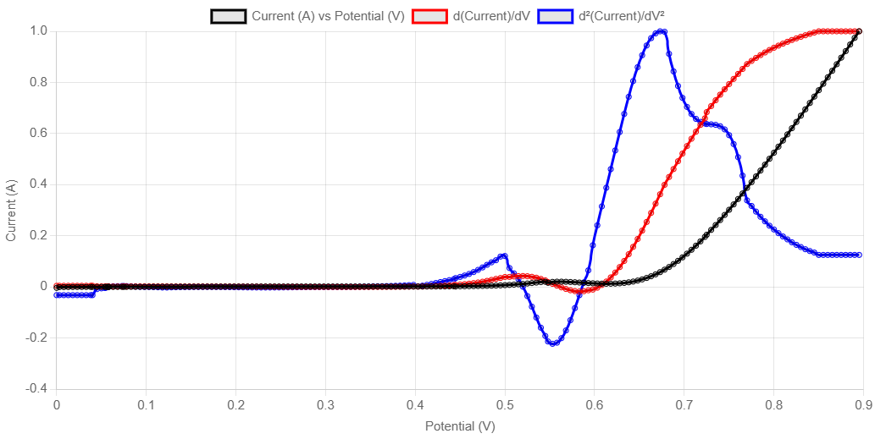
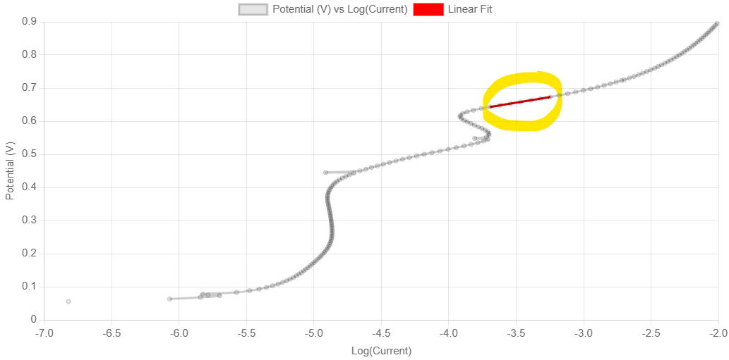
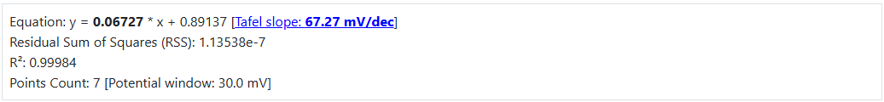
DTA App: Differential Tafel Analysis (DTA)
Motivation: provide a standard benchmark to evaluate catalysts (for CRC247)
An example from CRC247:
Normalization & Smoothing of derivatives with Savitzky–Golay filter:
Linear fit at potential of max d²(Current)/dV²:
https://en.wikipedia.org/wiki/Savitzky%E2%80%93Golay_filter
https://crc247.mdi.ruhr-uni-bochum.de/object/lsv_900mv_5mvpers_19_07_2023_cpy88_0_calc_ecbalanced_04_co3o4nps-on-gc_01-m-koh-2576
https://crc247.mdi.ruhr-uni-bochum.de/app/lsv/1.html?oid=2576&url=https%3A%2F%2Fcrc247.mdi.ruhr-uni-bochum.de%2Ffile%2Fdownload%2F2576

Slide 7

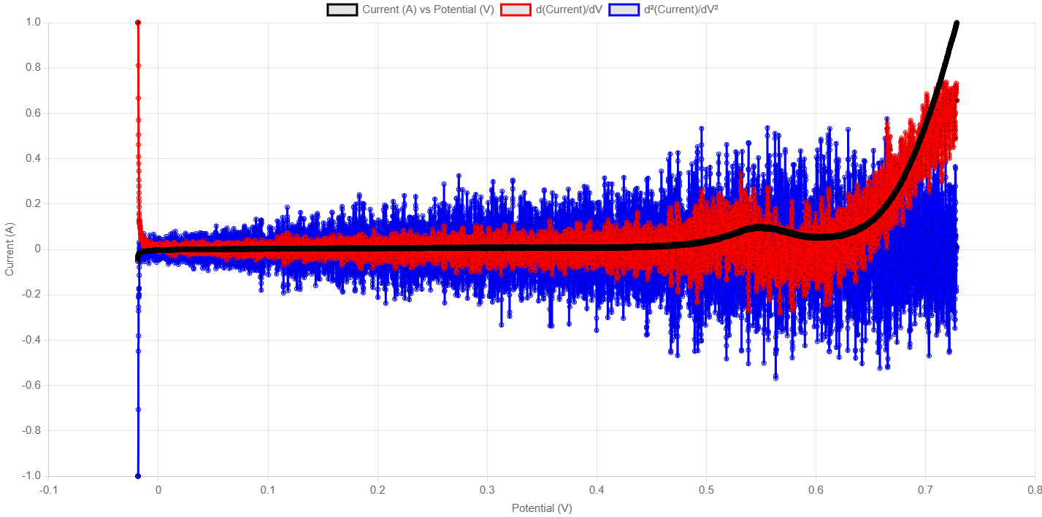
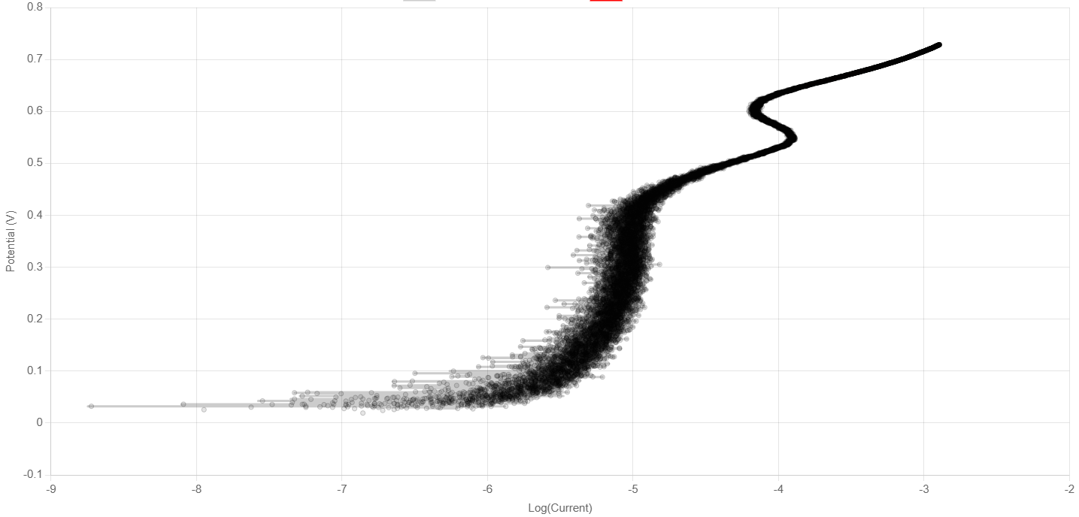
DTA: Noisy Data Makes Problems
CALCULATE THE TAFEL SLOPE
Any Suggestions?
https://crc247.mdi.ruhr-uni-bochum.de/object/ak250408_005_lsv_730mv_a_co3o4_cpy131_gc_rde-27605
https://crc247.mdi.ruhr-uni-bochum.de/app/lsv/1.html?oid=27605&url=https%3A%2F%2Fcrc247.mdi.ruhr-uni-bochum.de%2Ffile%2Fdownload%2F27605

Slide 8
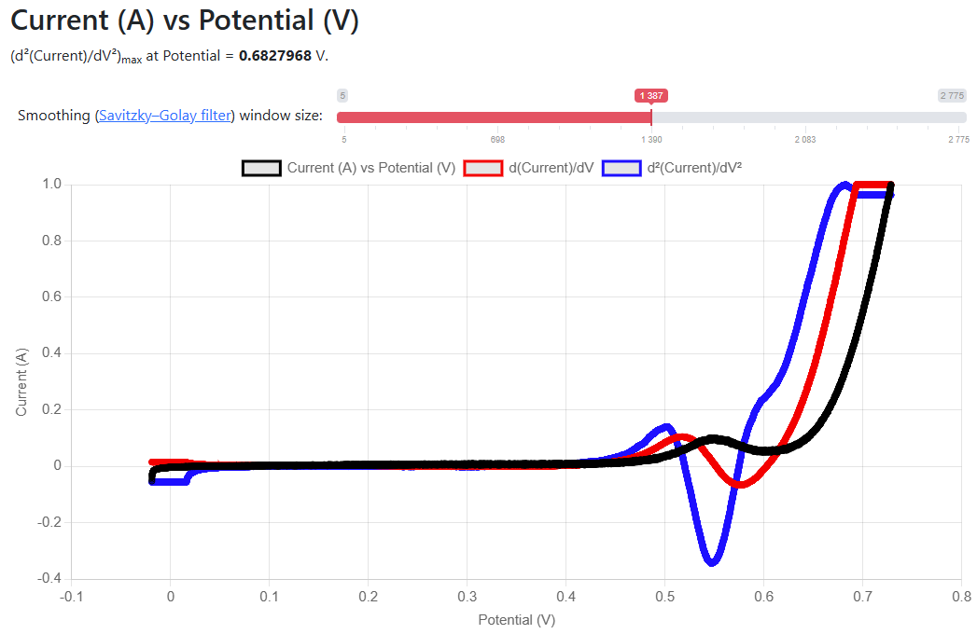
Solution: Derivatives smoothing with large window size
Trick:
window size for Savitzky-Golay filter is determined automatically (covering 70 mV potential window).
Algorithm:
Calculate smoothing window (70 mV)
Calc. first&second derivatives and smooth them
Norm all 3 charts
Find max of second derivative (V’’_{max})
Optimize linear fit (V’’_{max} - end of line) by playing with the line length on 20-50 mV window (R²>0.99; Tafel slope → min)
Equation: y = 0.07235 * x + 0.92528
[Tafel slope: 72.35 mV/dec]
Residual Sum of Squares (RSS): 6.126⁻⁵
R²: 0.99897
Points Count: 656
[Potential window: 32.9 mV]
https://crc247.mdi.ruhr-uni-bochum.de/object/ak250408_005_lsv_730mv_a_co3o4_cpy131_gc_rde-27605
https://crc247.mdi.ruhr-uni-bochum.de/app/lsv/1.html?oid=27605&url=https%3A%2F%2Fcrc247.mdi.ruhr-uni-bochum.de%2Ffile%2Fdownload%2F27605

Slide 9
Demo: Tafel slope
A couple of examples:
https://crc247.mdi.ruhr-uni-bochum.de/object/lsv_900mv_5mvpers_19_07_2023_cpy88_0_calc_ecbalanced_04_co3o4nps-on-gc_01-m-koh-2576
https://crc247.mdi.ruhr-uni-bochum.de/object/ak250408_005_lsv_730mv_a_co3o4_cpy131_gc_rde-27605

Slide 10
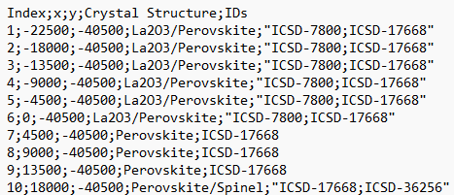
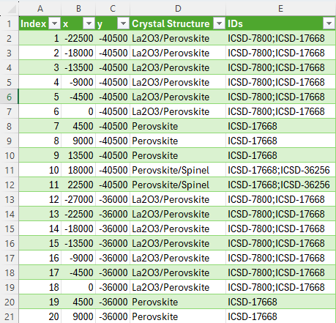
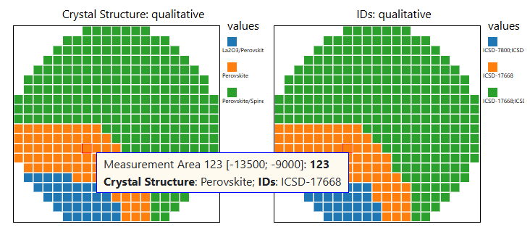
Type: XRD Phase Overview CSV
Motivation: Identify phases in every Measurement Area
https://mdi.matinf.pro/object/0010680_xrd-phase-overview-122315
https://mdi.matinf.pro/file/csv/122315

Slide 11
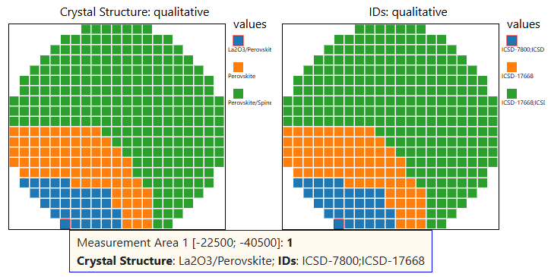
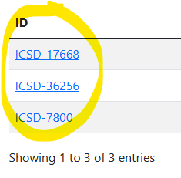
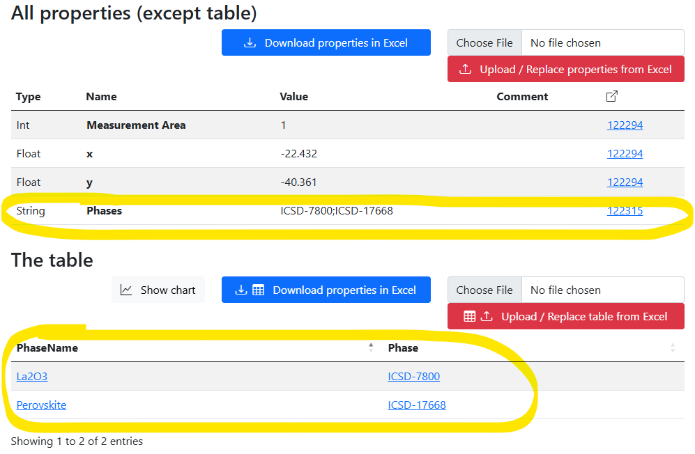
Data flow on XRD Phase Overview CSV upload
XRD Phase Overview
Sample
Table Properties:
342 x Volume composition
https://mdi.matinf.pro/object/0010680_xrd-phase-overview-122315

Slide 12
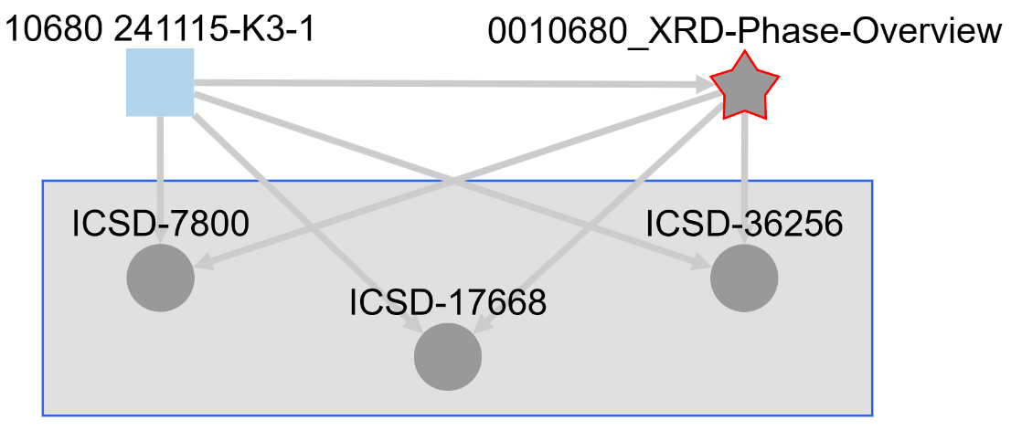
Type: Phase or Crystal Structure (cif)
Motivation: add Composition-based objects with CIF-files
Sample
XRD Phase Overview CSV
Phase or Crystal Structure (cif)
CIF-files
Inefficiency: ICSD-objects & corresponding CIF-files were added manually
CIF - Crystallographic Information File
https://mdi.matinf.pro/object/graph/0010680_xrd-phase-overview-122315

Slide 13
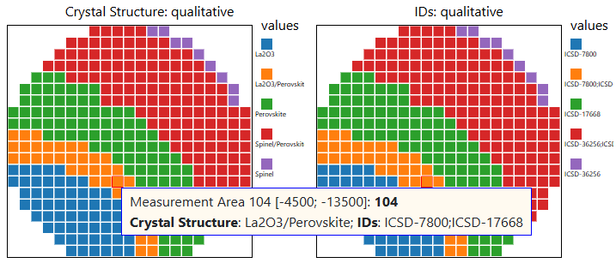
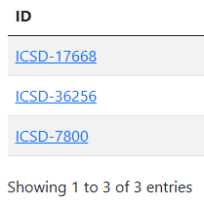
API access to ICSD?
Sample 10267 has even more phases:
Question: buy API access to ICSD (650 EUR/year)?
https://mdi.matinf.pro/object/0010267_xrd-phase-overview-117085
https://mdi.matinf.pro/file/csv/117085
API Costs & Terms: e-mail from Dr. Stephan Rühl on 28.04.2025
Notes:
RESISTANCE??? Ask Patrick

Slide 14
Demo: XRD Phase Overview
A couple of examples:
https://mdi.matinf.pro/object/0010680_xrd-phase-overview-122315
https://mdi.matinf.pro/object/0010267_xrd-phase-overview-117085

Slide 15
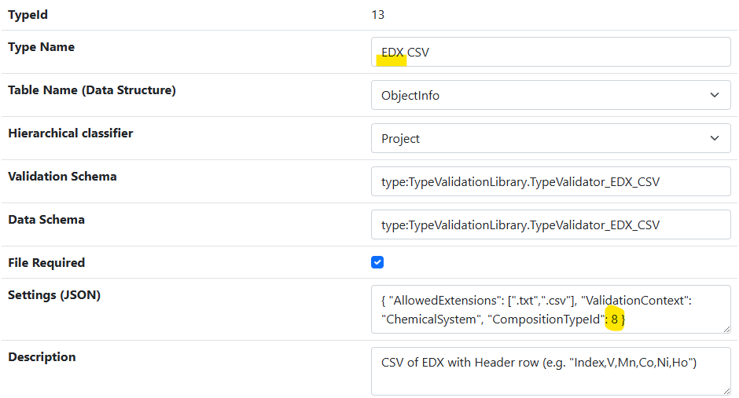
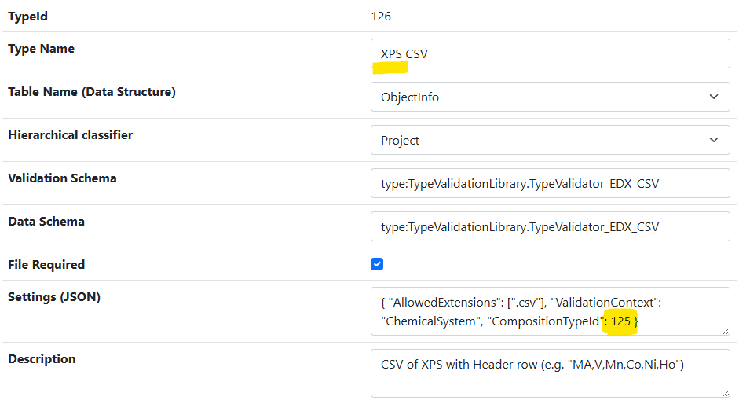
New Types: XPS CSV and Surface Composition
Motivation: distinguish between volume and surface composition
Workflows:
EDX CSV → 342 x Volume Composition
XPS CSV → 342 x Surface Composition
The type Volume Composition was named Composition previously.
efficient code reuse
https://mdi.matinf.pro/admintype/edititem/13
https://mdi.matinf.pro/admintype/edititem/126

Slide 16
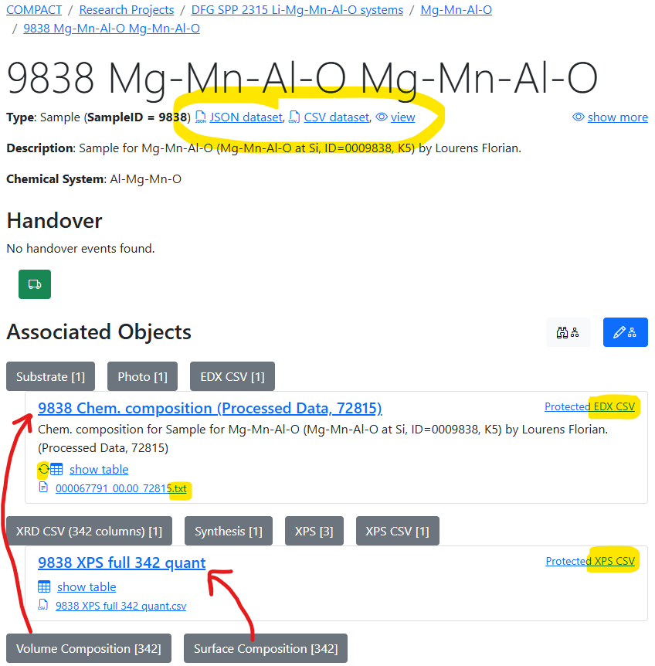
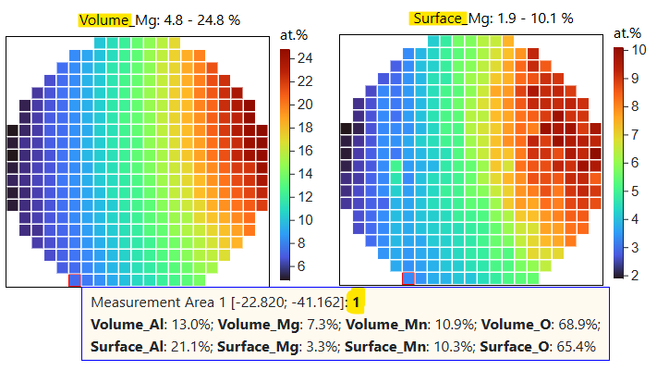
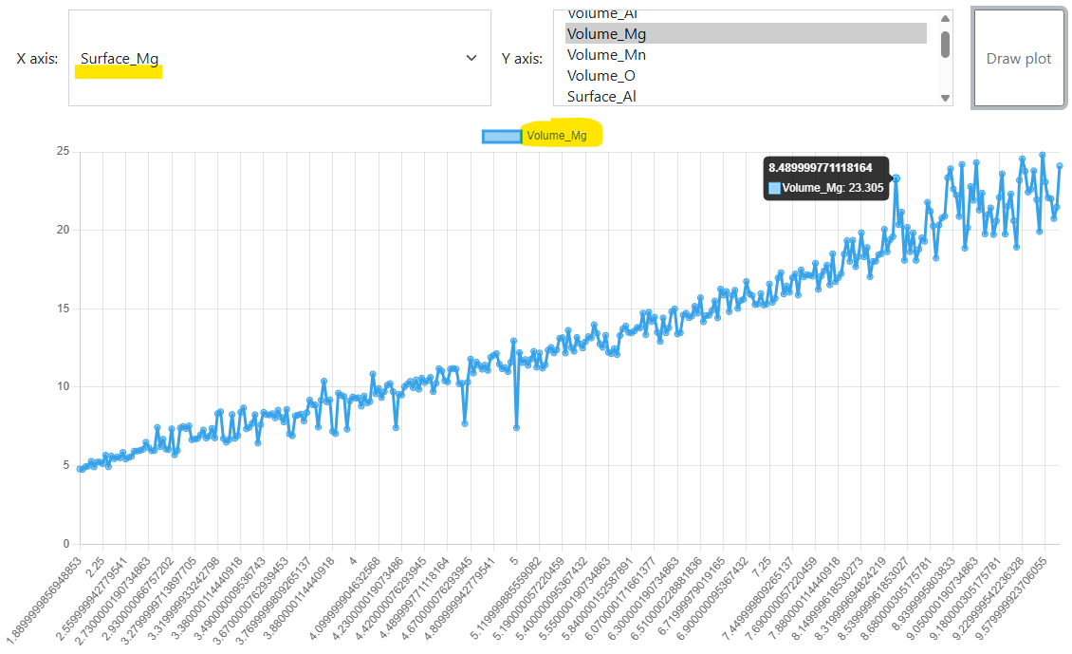
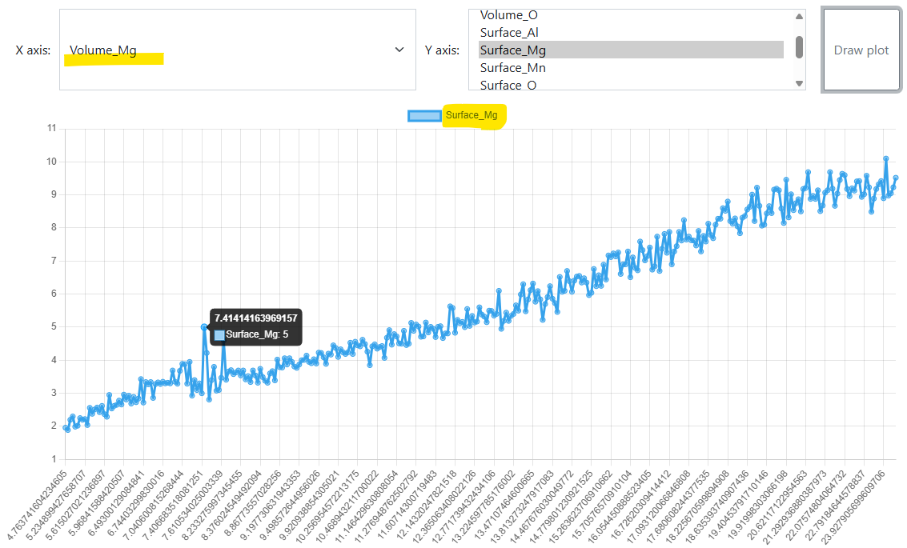
Sample 9838: EDX & XPS
Comparison: volume vs surface composition
Mg: Volume vs Surface Mg: Surface vs. volume
https://mdi.matinf.pro/object/9838-mg-mn-al-o-mg-mn-al-o-56489

Slide 17
Demo: XPS CSV & Surface Composition
An example:
https://mdi.matinf.pro/object/9838-mg-mn-al-o-mg-mn-al-o-56489

Slide 18
Thanks for your kind attention
Questions & Answers
Victor Dudarev
Victor.Dudarev@rub.de
https://vdudarev.ru

