Slide 1

Research Data Management System for MDI
Victor Dudarev
Victor Dudarev

Slide 2
Agenda
    Current MDI RDMS status overview
    Features to implement (overview of meetings)
    Release plans
    INF Workshop announcement
    Request for Data Type Support Example
    Q&A

Slide 3
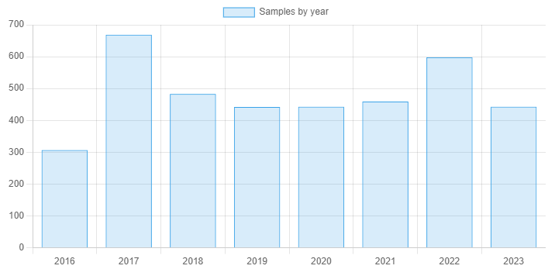
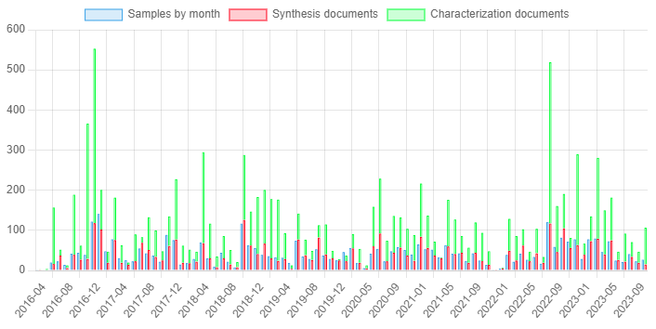
mdi.matinf.pro : Current Status
    Updated from Compact (as of 21.10.2023)
    Request to everyone:
      check your data presence & consistency
      test the system (add data, search, etc…)

Slide 4
mdi.matinf.pro : Feedback & Last Implemented Features
    Several bugs were fixed
    Hide non-sample objects in rubric (two gray buttons – ?)
    Associated objects: Add object button + drag&drop zone
    Sample type: “add sample” button & form (for insert & update)
    Processing step: new “sample state”, no “Id” change
    Tags object type (please, suggest tags, if needed…)
    TO DO: https://docs.google.com/document/d/1HTChWa_Lvih5EBjYt8D83zU7S86sccFg/edit
https://docs.google.com/document/d/1HTChWa_Lvih5EBjYt8D83zU7S86sccFg/edit

Slide 5
mdi.matinf.pro : Release plans
    Suggested on a weekend: 10th-11th November ?
    What will happen:
    Legacy Compact database will become read-only
    Clear all data in mdi.matinf.pro
    Data transfer: Compact -> mdi.matinf.pro
    mdi.matinf.pro general availability as a primary RDMS for MDI
https://docs.google.com/document/d/1HTChWa_Lvih5EBjYt8D83zU7S86sccFg/edit

Slide 6

RDMS FREE Playground
Try RDMS with various credentials
Playground to test RDMS:
https://inf.mdi.ruhr-uni-bochum.de/
Login and Password (User role): User1@user.org
Login and Password (PowerUser role): PowerUser1@user.org
Login and Password (Administrator role): Admin1@user.org
https://inf.mdi.ruhr-uni-bochum.de/
https://inf.mdi.ruhr-uni-bochum.de/
Notes:
https://qr.io/

Slide 7
CRC/TRR 247 INF Workshop, 7-9 November
    Tuesday, 7th November:
    13:30 - 14:10: Overview of RDMS infrastructure for CRC 247
    14:10 - 14:40: Overview of CRC 247 database and use cases
    15:00 - 15:20: Object Type Support Request on example of C04 (EDX Data)
    Wednesday, 8th November:
    09:00 - 09:20: Use Case: how to manage project tree and add your data
    13:00 - 13:20: Use Case: how to create a user-defined object type and configure a template
    15:00 - 16:00: Hands-On 1: each project tries to add their data in CRC 247 RDMS
    Thursday, 9th November:
    09:20 - 10:20: Hands-On 2: each project tries to search for data from partner projects

Slide 8
What is machine-readable data?
In general - all data are machine-readable to some extent (since they are effectively files, i.e. a sequence of bytes, that hopefully can be read by some software). Even PDF files, obtained from a scanner, by this definition can be considered "machine-readable“ (but not in our case).
Research data management is not about just storing files, but about storing also metadata and probably data, extracted from the files and effective search afterwards. We need a programmatic ability to EXTRACT meaningful data/metadata from the file.
A file format is in a "machine-readable" format for RDMS in either of two cases:
1) file format is standardized and well-described (from this description it should be obvious, how to get the required data, that the researcher needs)
Examples:
- see the EDX raw file example, described in C04 (the presentation was sent by Carina), an example of a proprietary text file, that is obvious how to parse.
- could be some CSV-data file with columns described and a how-to-do manual specifying what exactly should be put as metadata in RDMS, describing this object (for example, the average value from the "Current" column and the maximum value from the "Power" column).
- could be even Excel file (which is proprietary) with a fixed internal data format (for example, one sheet called "data_sheet" there should be a table with a predefined and fixed structure: columns names, data types, etc). Then, effectively this is like a CSV-data (or several SCV-data on a number of Excel sheets).
- XML/JSON file with a fixed structure and guidelines on what to extract for storing in RDMS (could be some aggregated information)
2) The file format could be a proprietary one, but some program libraries (from the device manufacturer or some open-source packages) or API exists that can extract required data
- for example, any binary proprietary file from a measurement device, but with an API (Python or any other programming language library), that enables us to have access to the data inside this file and work with programmatically (via some API).
There should be a clear understanding of what metadata (parameter names) should be extracted and stored in RDMS for effective search later.

Slide 9
What is machine-readable data?
“Machine-readable" means OUR ability (via existing API/libraries OR well-documented file format - then we can develop our own software to extract required values) to have meaningful access to internal data of the file to extract the required "fingerprint" of the file as a set of descriptive parameters to be stored in RDMS to facilitate search.
if 10,000 of these documents are in the RDMS you should be fine with searching for a required document (or a number of relevant documents) by these descriptive parameters. That is the main essence of having "readability", otherwise file is treated as a "raw document" that still can be manually annotated with meaningful parameters (since we can set up properties templates to fill for every object type) facilitating search in RDMS.
Even having a machine-readable file is not enough, since it’ required to negotiate and standardise what would be meaningful parameters for the search regarding a particular data type.
For example, if you measure catalytic activity that can be extracted from data somehow (it can be either placed in some column or should be calculated from several columns in CSV via the provided formula), then obviously you would like to ask to extract and store "maximal" activity from the data in the file together with composition. Consequently, in RDMS you'll get an opportunity to search for documents having specified activity (within some range)...
Conclusion: a description for every file type (object type): what parameters, describing data/metadata are required to store and make searchable!

Slide 10
Extensible Data Support in RDMS
    To support a new file type, one could create a new type in RDMS.
    We need answers to questions:
    How to validate data?
    How to extract metadata?
    How to extract data?
    Two approaches
    Automated Manual
    Write a Web-service for:
    Data validation on upload
    Data & metadata extraction
    Data visualization
    Everything is automated.
    Zero-code effort:
    No data validation on upload
    Templates to edit data/metadata
    Manual template guided data input, if required (file is considered raw, i.e. unprocessable)

Slide 11
Material Characterisation: Chemical Entities Hierarchy
Chemical system
System
(qualitative composition)
Co-O
Solution
Compound
Heterogeneous mixture
Material
(quantitative composition)
Co₃O₄
Crystal
modification
Crystal
modification
Crystal
modification
Modification
(crystal structure type)
β-Co₃O₄
…
…
…
…

Slide 12
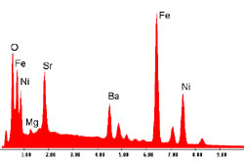
Motivation: EDX as a “must have” characterisation
known from synthesis
System
(qualitative composition)
Co-O
Material
(quantitative composition)
EDX
Co₃O₄
Modification
(crystal structure type)
Energy-dispersive X-ray spectroscopy (EDX)
Analytical technique used
for the elemental analysis
or chemical characterization
of a sample
XRD
β-Co₃O₄
…
X-ray diffraction analysis (XRD)
technique used in to determine the crystallographic structure of a material (other story…)

Slide 13
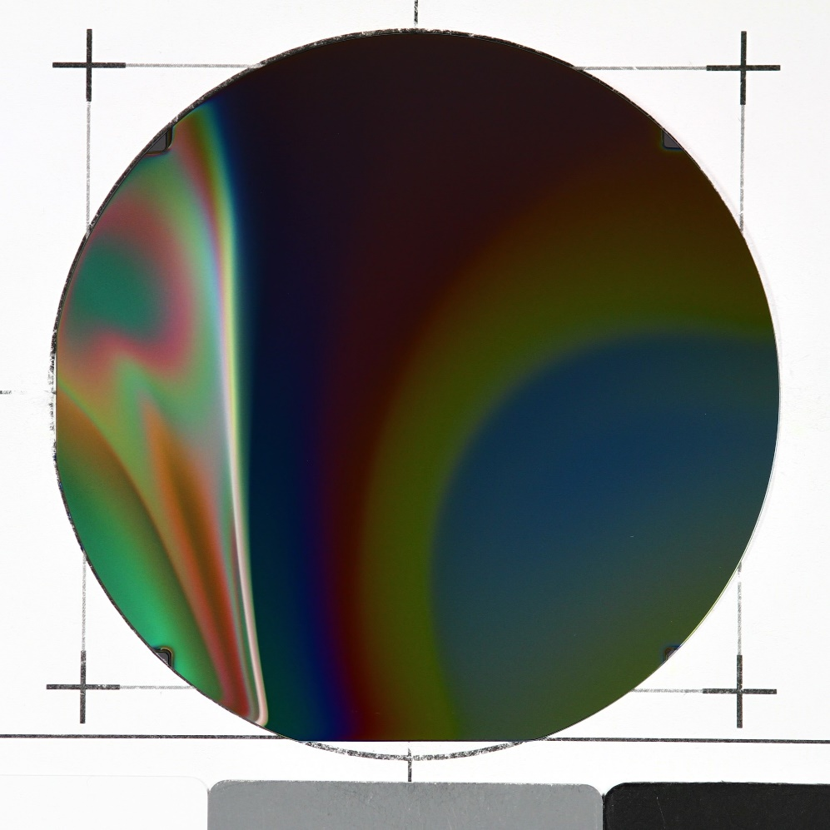
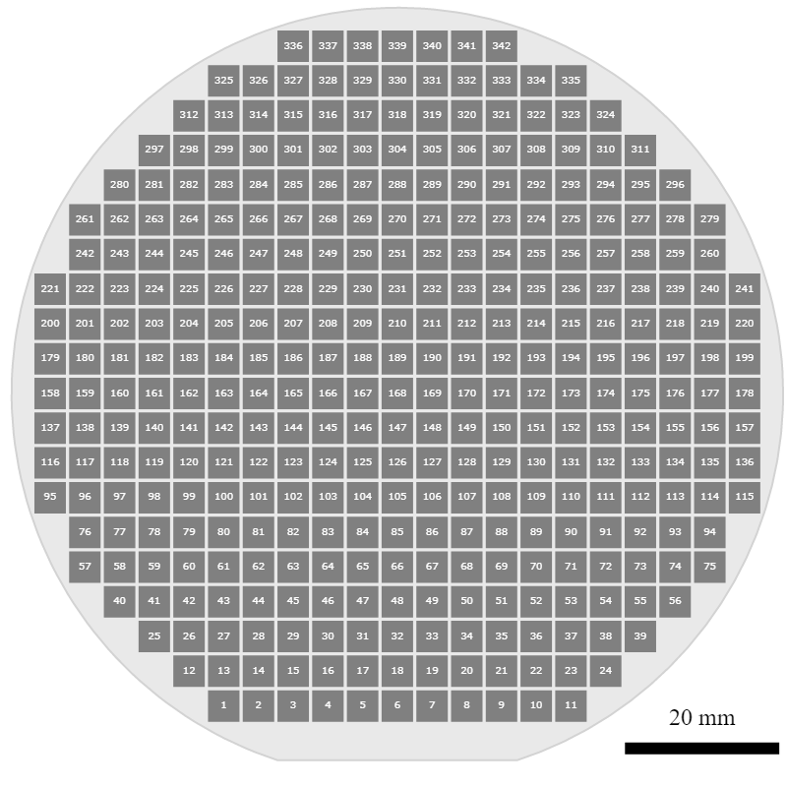
Combinatorial Materials Library: basic agreements
I X Y
1 27000 4500
2 31500 4500
3 36000 4500
…
11 72000 4500
12 22500 9000
13 27000 9000
...
341 58500 90000
342 63000 90000
Materials Library Measurement Areas
342 Measurement Areas (4.5 mm x 4.5 mm)
(x; y) coordinates on the surface

Slide 14
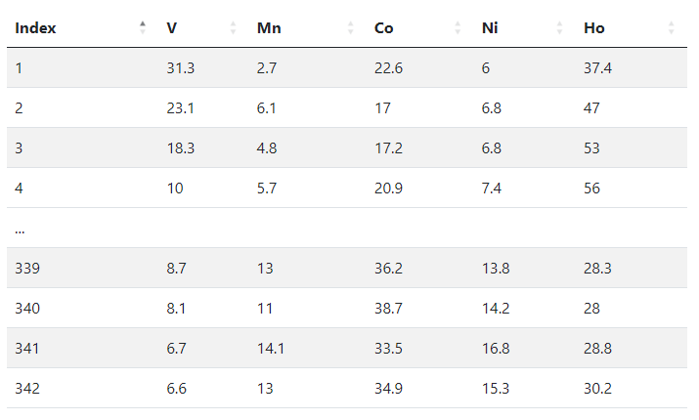
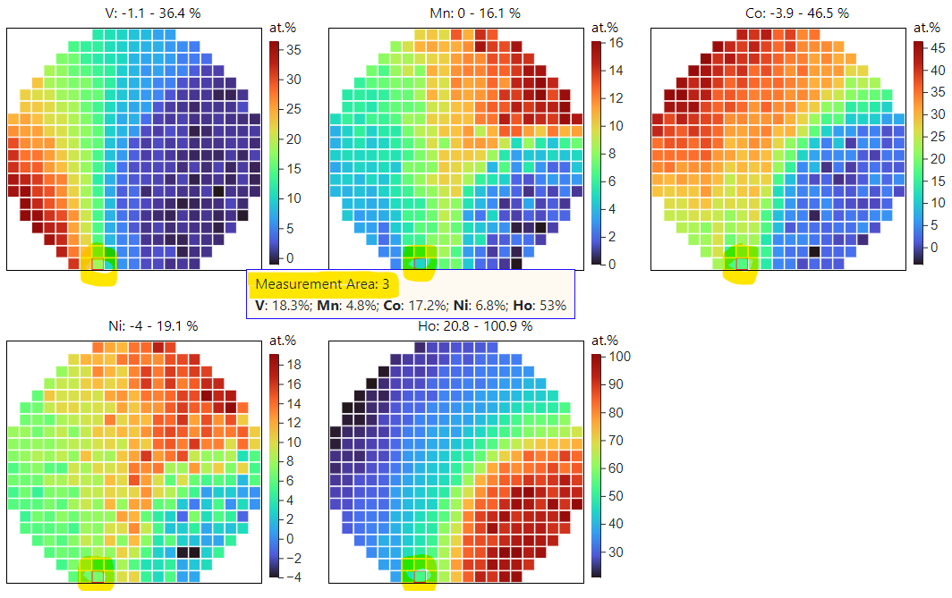
EDX Measurement Outcome (Processed Data): the Table
After processing one can conclude with the final outcome
V: 18.3 %
Mn: 4.8 %
Co: 17.2 %
Ni: 6.8 %
Ho: 53 %
Measurement Area Index Chemical Elements
[1, 342]
Composition for the Measurement Area 3 (atomic %)
Measurement
Area 3
Composition
Data
https://dim.mdi.ruhr-uni-bochum.de/file/csv/6691

Slide 15

Raw EDX data format (parseable text file)
Project: 0008081_EDXmapping ZGH (1)
Owner:
Site: Site of Interest 1
Sample: Sample 1
Type: Default
ID:
Processing option : All elements analysed
All results in atomic%
X and Y are stage positions
Spectrum In stats. X (mm) Y (mm) C O Si V Mn Co Ni Ho
Spektrum 1 {1} Yes -44.600 -40.300 80.36562 17.7799 0.331076 -0.3328189 9.434319E-02 1.12593 1.070188 -0.4342265
Spektrum 1 {2} Yes -40.100 -40.300 80.1367 23.03086 0.2024186 -4.792345E-02 -0.2482219 -3.621299 0.6450471 -9.758038E-02
Spektrum 1 {3} Yes -35.600 -40.300 83.67403 14.34433 0.2835474 -6.302138E-02 -7.115601E-02 1.043958 1.091217 -0.3029233
- … - … - … - … - … - … - … - … - … - … - … - …
Spektrum 1 {418} Yes 36.400 45.200 81.8801 12.53673 0.5853955 -1.528375E-02 4.889345E-02 -1.36448 6.783489 -0.4548477
Spektrum 1 {419} Yes 40.900 45.200 80.46669 12.32581 0.2078687 0.27237 -0.2769422 -7.077376 12.81309 1.268483
Spektrum 1 {420} Yes 45.400 45.200 83.68153 15.48148 0.0646082 0.2312067 -0.1969592 -2.165317 2.769571 0.1338789
Mean 43.79094 18.89702 29.09091 0.7714614 0.4576146 1.19483 3.057466 2.739753
Std. deviation 21.38218 7.121112 11.38863 0.9768385 0.3503809 20.70591 9.166298 3.695945
Max. 321.3774 82.92272 36.86385 3.61815 1.213754 225.3098 62.29993 5.617296
Min. -93.34522 -33.35334 -1.881486 -0.7680827 -0.4307786 -309.4584 -2.63329 -66.55944
Header (could be skipped)
Data we need (TAB separated). Almost, but:
420 measurement areas (instead of 342), need to filter;
Other elements (from substrate, need to filter: C, O, Si).
Footer
(to skip)

Slide 16
Processed EDX data (good to go)
Good CSV document (processed)
Measurement Area Index Chemical Elements
[1, 342]
Index,V,Mn,Co,Ni,Ho
1,31.3,2.7,22.6,6,37.4
2,23.1,6.1,17,6.8,47
3,18.3,4.8,17.2,6.8,53
4,10,5.7,20.9,7.4,56
...
339,8.7,13,36.2,13.8,28.3
340,8.1,11,38.7,14.2,28
341,6.7,14.1,33.5,16.8,28.8
342,6.6,13,34.9,15.3,30.2
Even more open questions:
How to validate EDX data (raw&processed)?
What metadata for EDX should we store in RDMS?
How we would like to find our EDX data in RDMS?

Slide 17





Validation Principle and Importance
Index,V,Mn,Co,Ni,Ho
1,31.3,2.7,22.6,6,37.4
2,23.1,6.1,17,6.8,47
3,18.3,4.8,17.2,6.8,53
4,10,5.7,20.9,7.4,56
...
339,8.7,13,36.2,13.8,28.3
340,8.1,11,38.7,14.2,28
341,6.7,14.1,33.5,16.8,28.8
342,6.6,13,34.9,15.3,30.2
Processed EDX CSV data
1
to Database
Project: 0008081_EDXmapping ZGH (1)
Owner:
Site: Site of Interest 1
Sample: Sample 1
Type: Default
ID:
Processing option : All elements analysed
All results in atomic%
X and Y are stage positions
Spectrum In stats. X (mm) Y (mm) C O Si V Mn Co Ni Ho
Spektrum 1 {1} Yes -44.600 -40.300 80.36562 17.7799 0.331076 -0.3328189 9.434319E-02 1.12593 1.070188 -0.4342265
Spektrum 1 {2} Yes -40.100 -40.300 80.1367 23.03086 0.2024186 -4.792345E-02 -0.2482219 -3.621299 0.6450471 -9.758038E-02
Spektrum 1 {3} Yes -35.600 -40.300 83.67403 14.34433 0.2835474 -6.302138E-02 -7.115601E-02 1.043958 1.091217 -0.3029233
- … - … - … - … - … - …
Spektrum 1 {418} Yes 36.400 45.200 81.8801 12.53673 0.5853955 -1.528375E-02 4.889345E-02 -1.36448 6.783489 -0.4548477
Spektrum 1 {419} Yes 40.900 45.200 80.46669 12.32581 0.2078687 0.27237 -0.2769422 -7.077376 12.81309 1.268483
Spektrum 1 {420} Yes 45.400 45.200 83.68153 15.48148 0.0646082 0.2312067 -0.1969592 -2.165317 2.769571 0.1338789
Mean 43.79094 18.89702 29.09091 0.7714614 0.4576146 1.19483 3.057466 2.739753
Std. deviation 21.38218 7.121112 11.38863 0.9768385 0.3503809 20.70591 9.166298 3.695945
Max. 321.3774 82.92272 36.86385 3.61815 1.213754 225.3098 62.29993 5.617296
Min. -93.34522 -33.35334 -1.881486 -0.7680827 -0.4307786 -309.4584 -2.63329 -66.55944
Raw EDX data
to Database
2
Trust me,
I’m cute!
Some other data
3
Validator

Slide 18
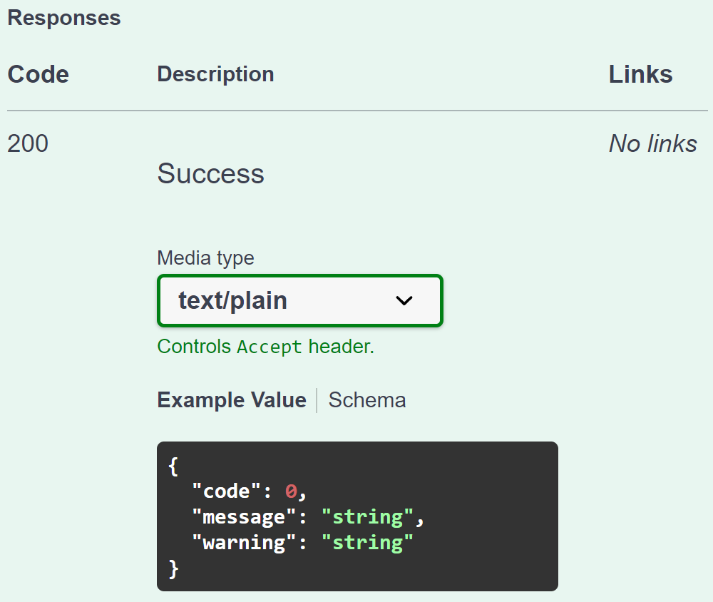
Validation from RDMS perspective: API makes it flexible for all
Provide a validator for every object type in configuration:
type: built-in type (object instantiated by class name);
https: URL to a REST Service (OpenAPI specification).
{
"Code": 0,
"Message": null,
"Warning": null
}
type:TypeValidationLibrary.TypeValidator_EDX_CSV (interface IFileValidator)
https://validation.matinf.pro/edx/validation
valid
Validation result
via external API call
External service decision
invalid
type
{
"Code": 500,
"Message": "error text",
"Warning": null
}
API – Application Programming Interface
URL – Uniform Resource Locator
REST – REpresentational State Transfer

Slide 19
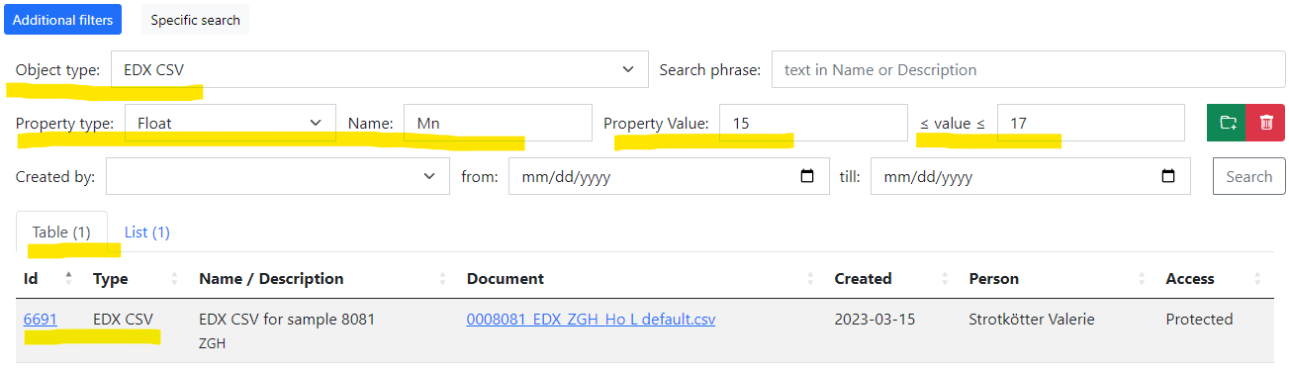
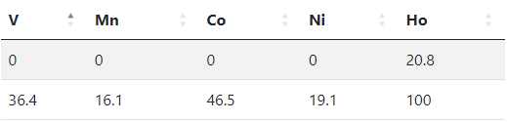
User perspective: how EDX should be findable?
Processed EDX CSV document should be findable by any chemical element concentration!
We need to store (Concentration_{MIN}; Concentration_{MAX}) for every element present in the sample:
Sample 8081 (V-Mn-Co-Ni-Ho): fill properties
 | V | Mn | Co | Ni | Ho
Min | 0 | 0 | 0 | 0 | 20.7
Max | 36.4 | 16.1 | 46.5 | 19.1 | 100
After authorization (User group member):
https://dim.mdi.ruhr-uni-bochum.de/search/?typeid=13&pr0name=Mn&pr0type=Float&pr0min=15&pr0max=17&prcnt=1
https://dim.mdi.ruhr-uni-bochum.de/object/edx-csv-for-sample-8081-6691

Slide 20
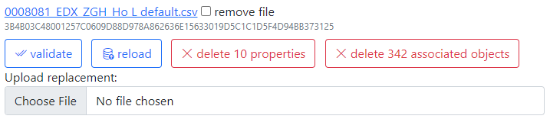
Metadata extraction: external API
Provide a data extractor for every object type in configuration:
type: built-in type (object instantiated by class name);
https: URL to a REST Service (OpenAPI specification).
type:TypeValidationLibrary.TypeValidator_EDX_CSV (interface IDatabaseValuesGetter)
https://validation.matinf.pro/edx/data
{ "DeletePreviousProperties": true,
"Properties": [
{ "PropertyId": 0,
"Type": 1,
"Name": "V",
"Value": 0,
"ValueEpsilon": null,
"SortCode": 10,
"Row": 1,
"Comment": "Minimal V content"
},
{ "PropertyId": 0,
"Type": 1,
"Name": "V",
"Value": 36.400001525878906,
"ValueEpsilon": null,
"SortCode": 10,
"Row": 2,
"Comment": "Maximal V content"
}
]
}
Metadata for EDX (range values):
Administrative interface: Compositions

Slide 21
All data extraction: external API
Provide a data extractor for every object type in configuration:
type: built-in type (object instantiated by class name);
https: URL to a REST Service (OpenAPI specification).
type:TypeValidationLibrary.TypeValidator_EDX_CSV (interface IDatabaseValuesGetter)
https://validation.matinf.pro/edx/data
Data from EDX (all values == 342 compositions):
{
"CompositionElements": [
{ "CompoundIndex": 0, "ElementName": "V", "ValueAbsolute": null, "ValuePercent": 31.299999237060547 },
{ "CompoundIndex": 10, "ElementName": "Mn", "ValueAbsolute": null, "ValuePercent": 2.700000047683716 },
{ "CompoundIndex": 20, "ElementName": "Co", "ValueAbsolute": null, "ValuePercent": 22.600000381469727 },
{ "CompoundIndex": 30, "ElementName": "Ni", "ValueAbsolute": null, "ValuePercent": 6 },
{ "CompoundIndex": 40, "ElementName": "Ho", "ValueAbsolute": null, "ValuePercent": 37.400001525878906 }
],
"DeletePreviousProperties": true,
"Properties": [
{
"PropertyId": 0, "Type": 2, "Name": "Measurement Area", "Value": 1, "ValueEpsilon": null,
"SortCode": 0, "Row": null, "Comment": null
}
]
}

Slide 22
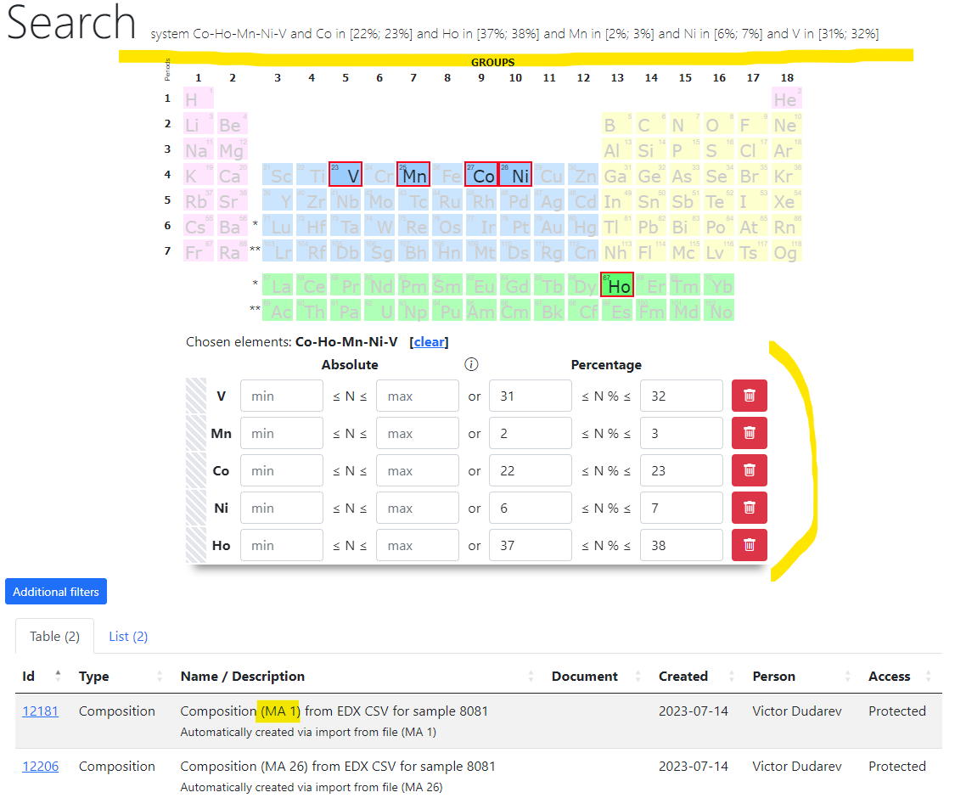
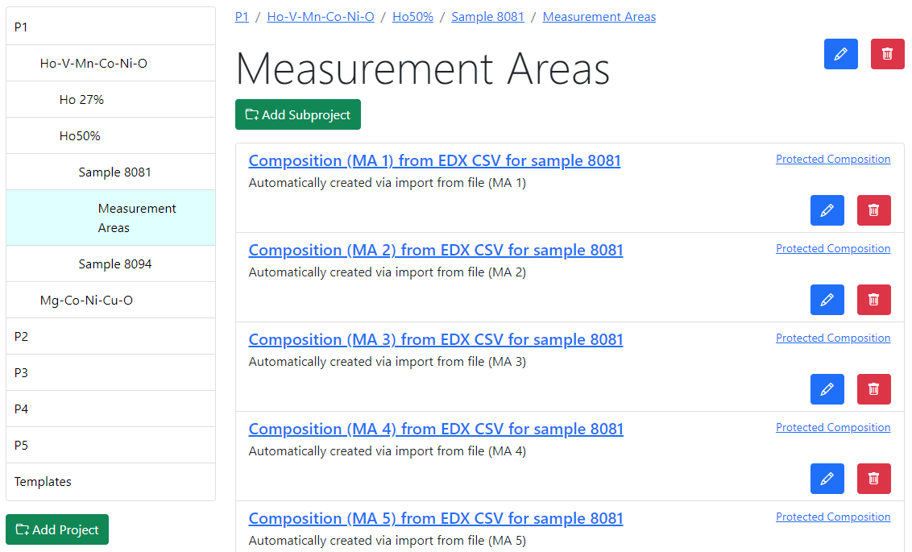
Search for Composition (obtained from EDX)
1) Search: https://dim.mdi.ruhr-uni-bochum.de/rubric/p1project_ho-v-mn-co-ni-o_ho50_sample-id-0008081_measurement-areas
2) https://dim.mdi.ruhr-uni-bochum.de/search/?system=Co-Ho-Mn-Ni-V&Copctmin=22&Copctmax=23&Hopctmin=37&Hopctmax=38&Mnpctmin=2&Mnpctmax=3&Nipctmin=6&Nipctmax=7&Vpctmin=31&Vpctmax=32

Slide 23
Recommended plan for data presentation (for every project)
    Brief introduction to data / measurements
    Data format description
    Search requirements:
      How do you (partners) find your object among thousands of similar objects?
      What are essential parameters/properties?
    Proposal for object type in RDMS:
      File validation requirements (no validation -> formal schema)
      Metadata extraction or template proposal (enlist mandatory properties)
      Data extraction (if required, specify requirements)
    Q&A.

Slide 24
Thanks for your kind attention
Q&A
Victor Dudarev
Victor.Dudarev@rub.de
https://vdudarev.ru

